Slide 1
The single-cell transcriptome landscape across human tissues
4/17/2019
Notes:
大家好，今天我总结一下目前的一些进展。

Slide 2
Content
Tissues (esophagus, stomach, small intestine, large intestine and ovary)
Cell type annotation
Cell type composition
Common regulators for each cell type / Gene regulatory network
Trajectory
System level
The cell composition along the digestive system
The difference between the same cell type across tissues
Notes:
Figure tissues:
Figure 96-well plate:
Figure NGS: https://coursesandconferences.wellcomegenomecampus.org/our-events/next-generation-sequencing-2019/

Slide 3
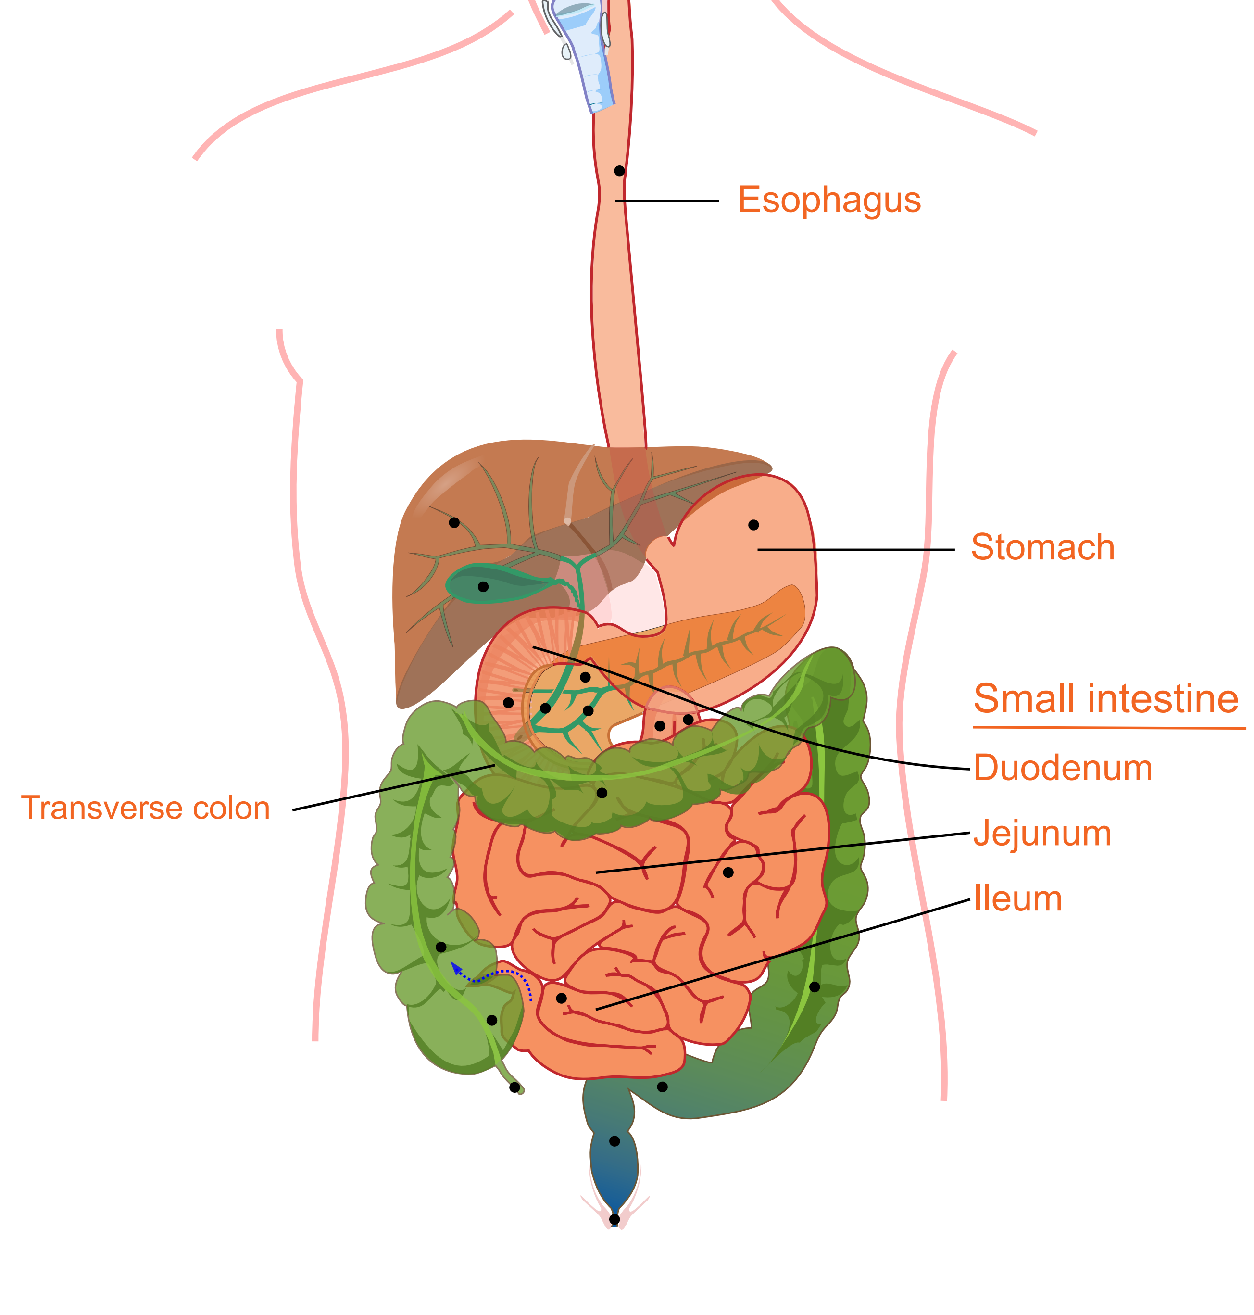
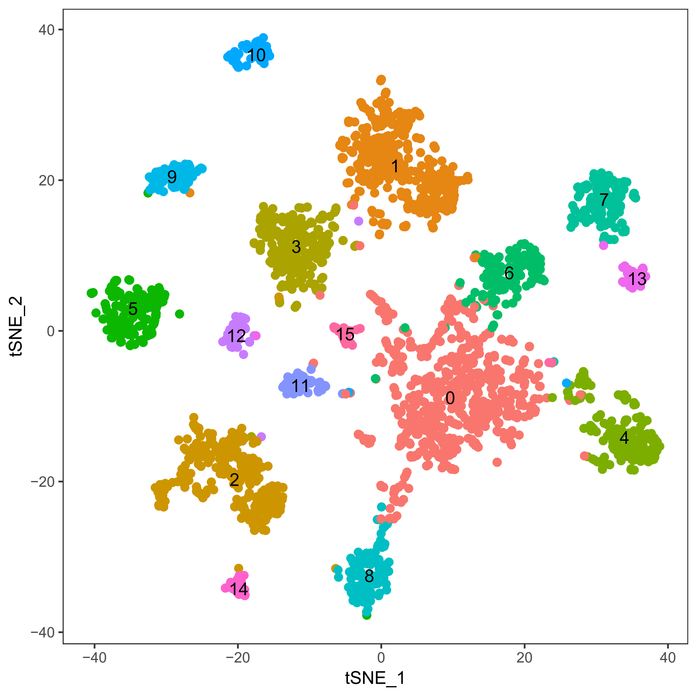
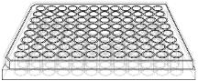
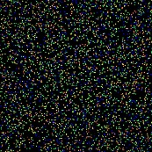

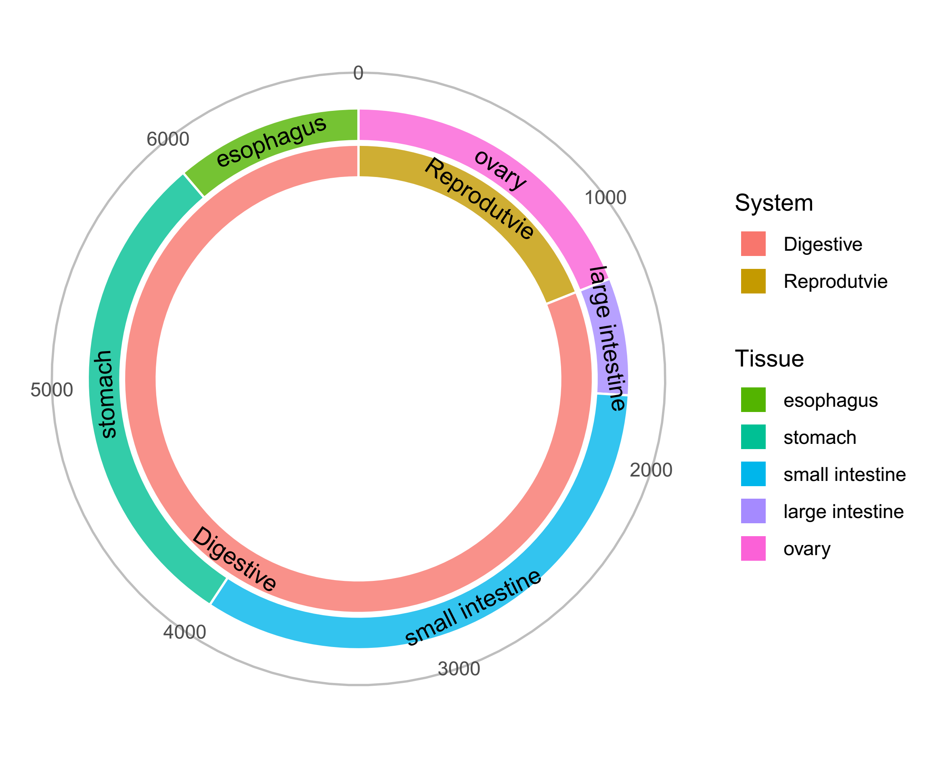
Single-cell sequencing for the human tissues
Ovary
The diagram was modified from Wikipedia.
Notes:
Figure tissues:
Ovary: https://www.flaticon.com/free-icon/uterus_818872#term=ovary&page=1&position=5
Figure 96-well plate:
Figure NGS: https://coursesandconferences.wellcomegenomecampus.org/our-events/next-generation-sequencing-2019/

Slide 4
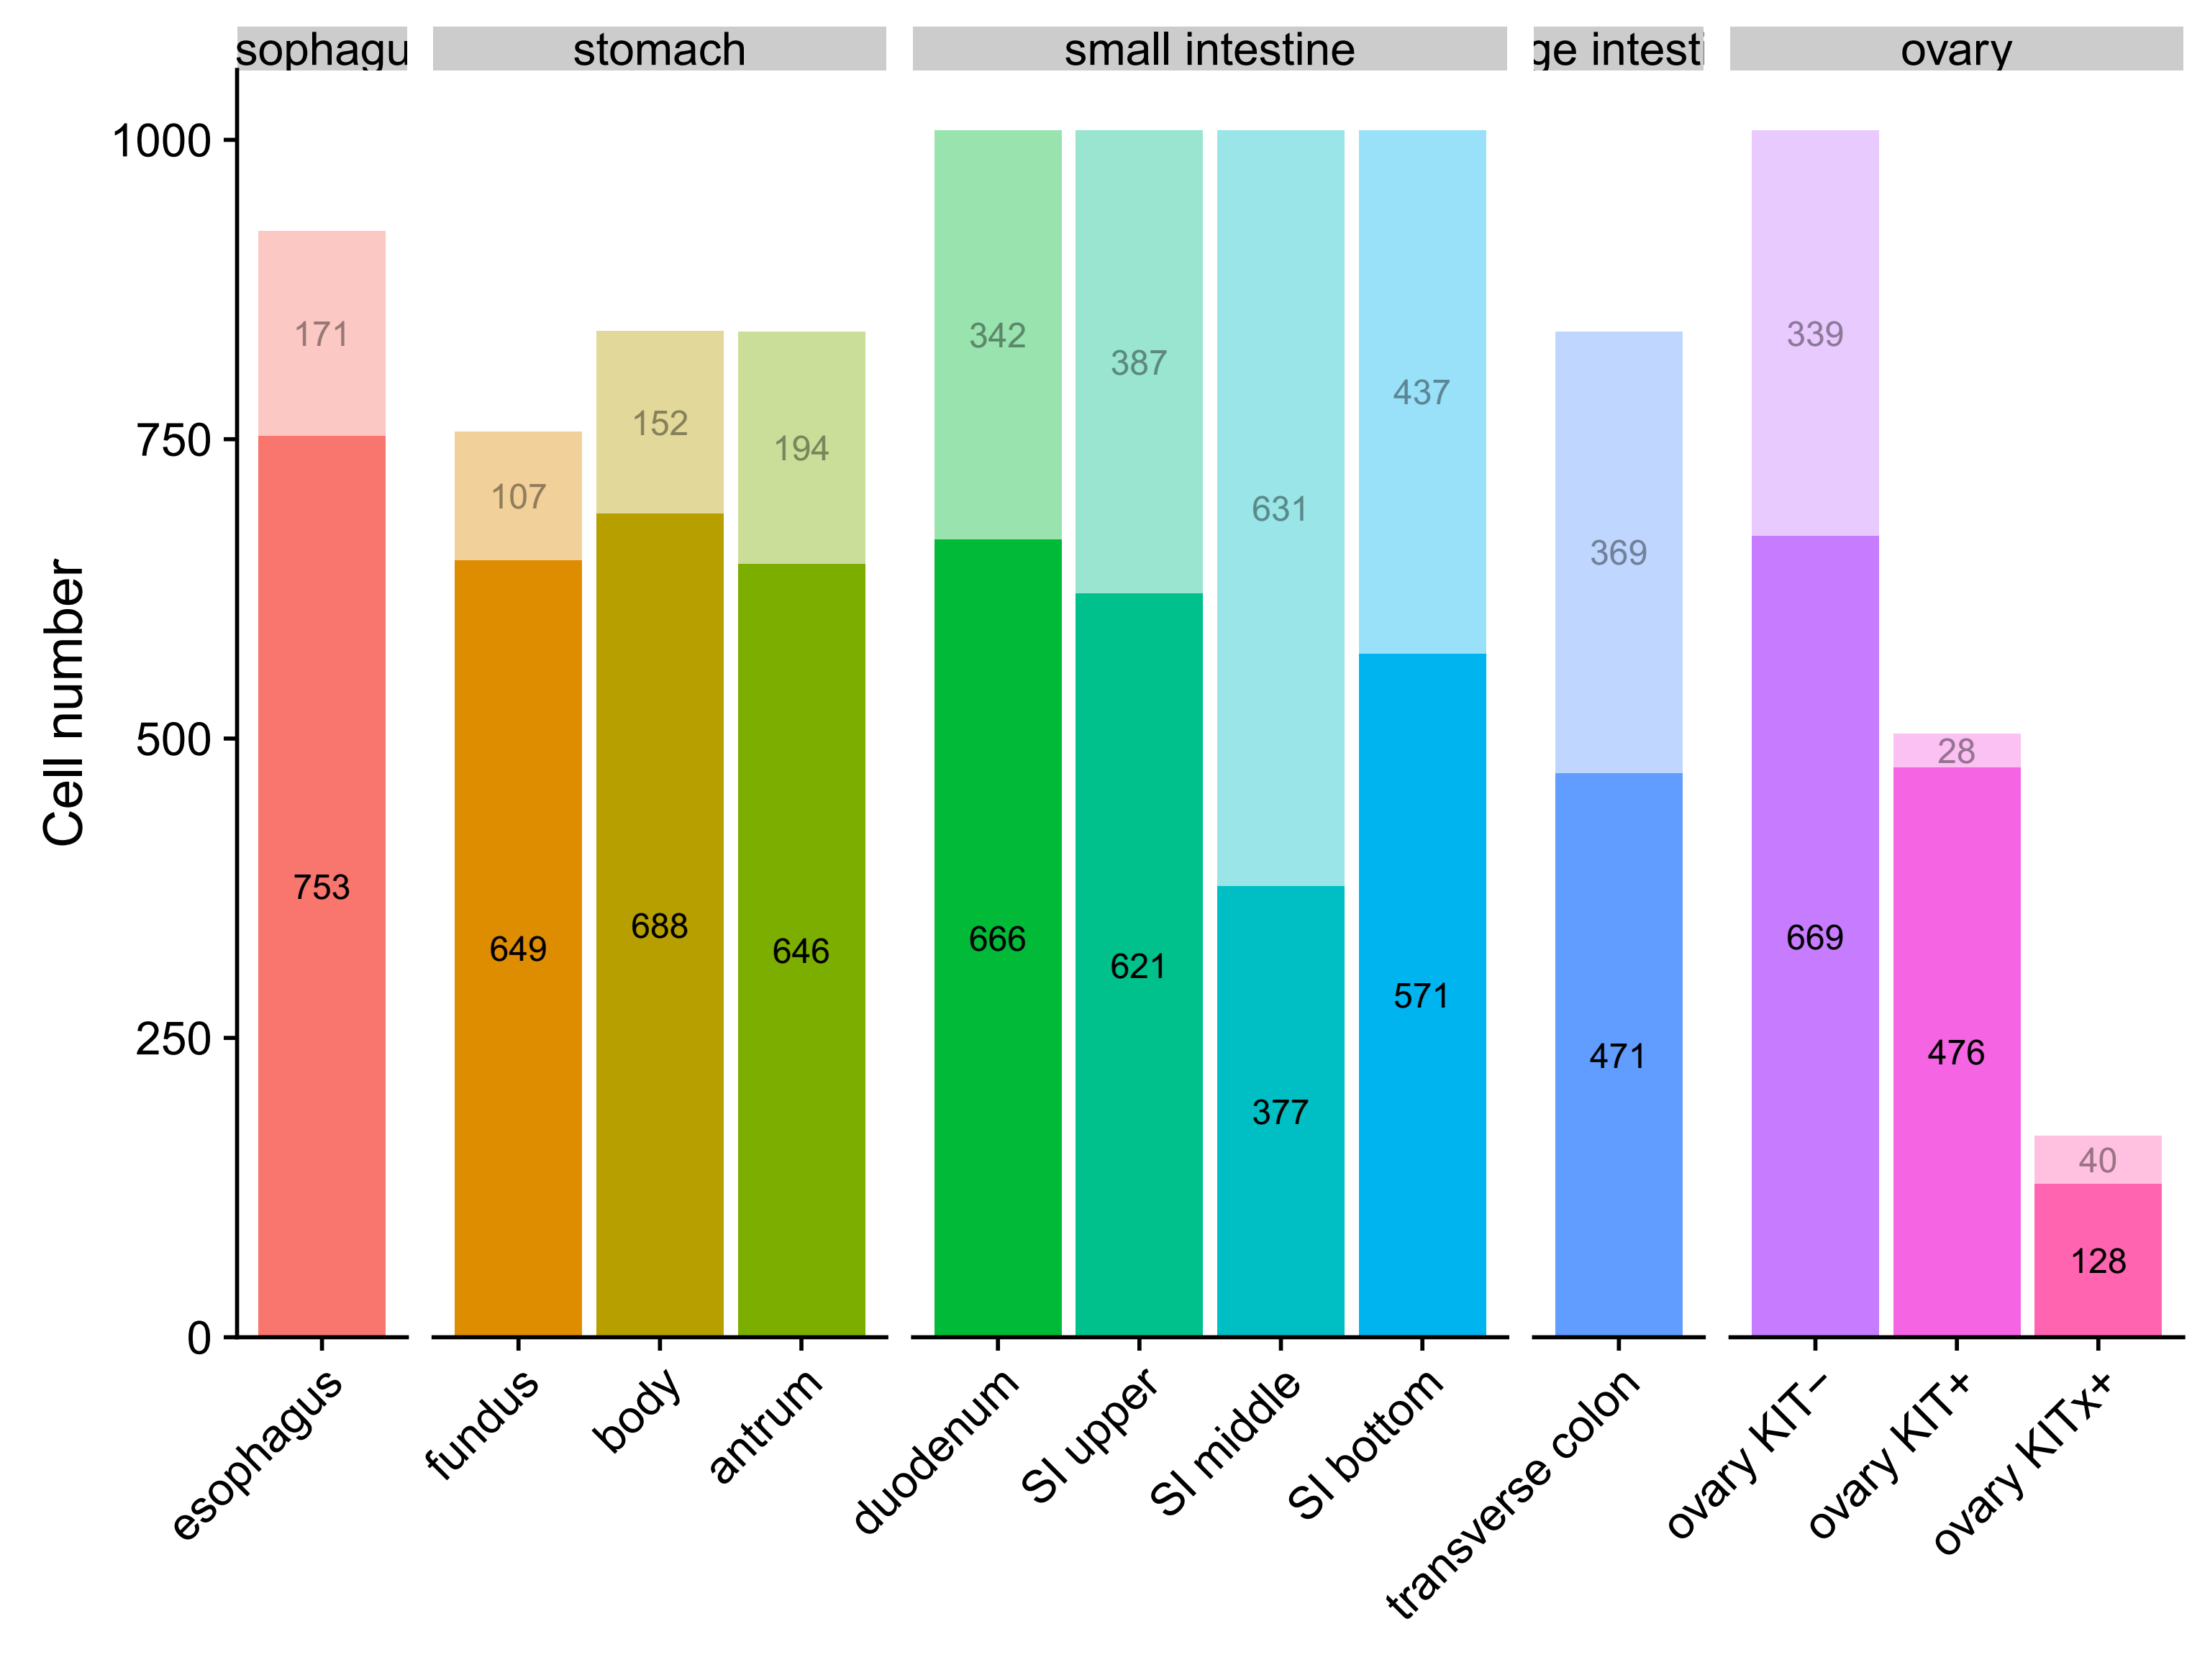
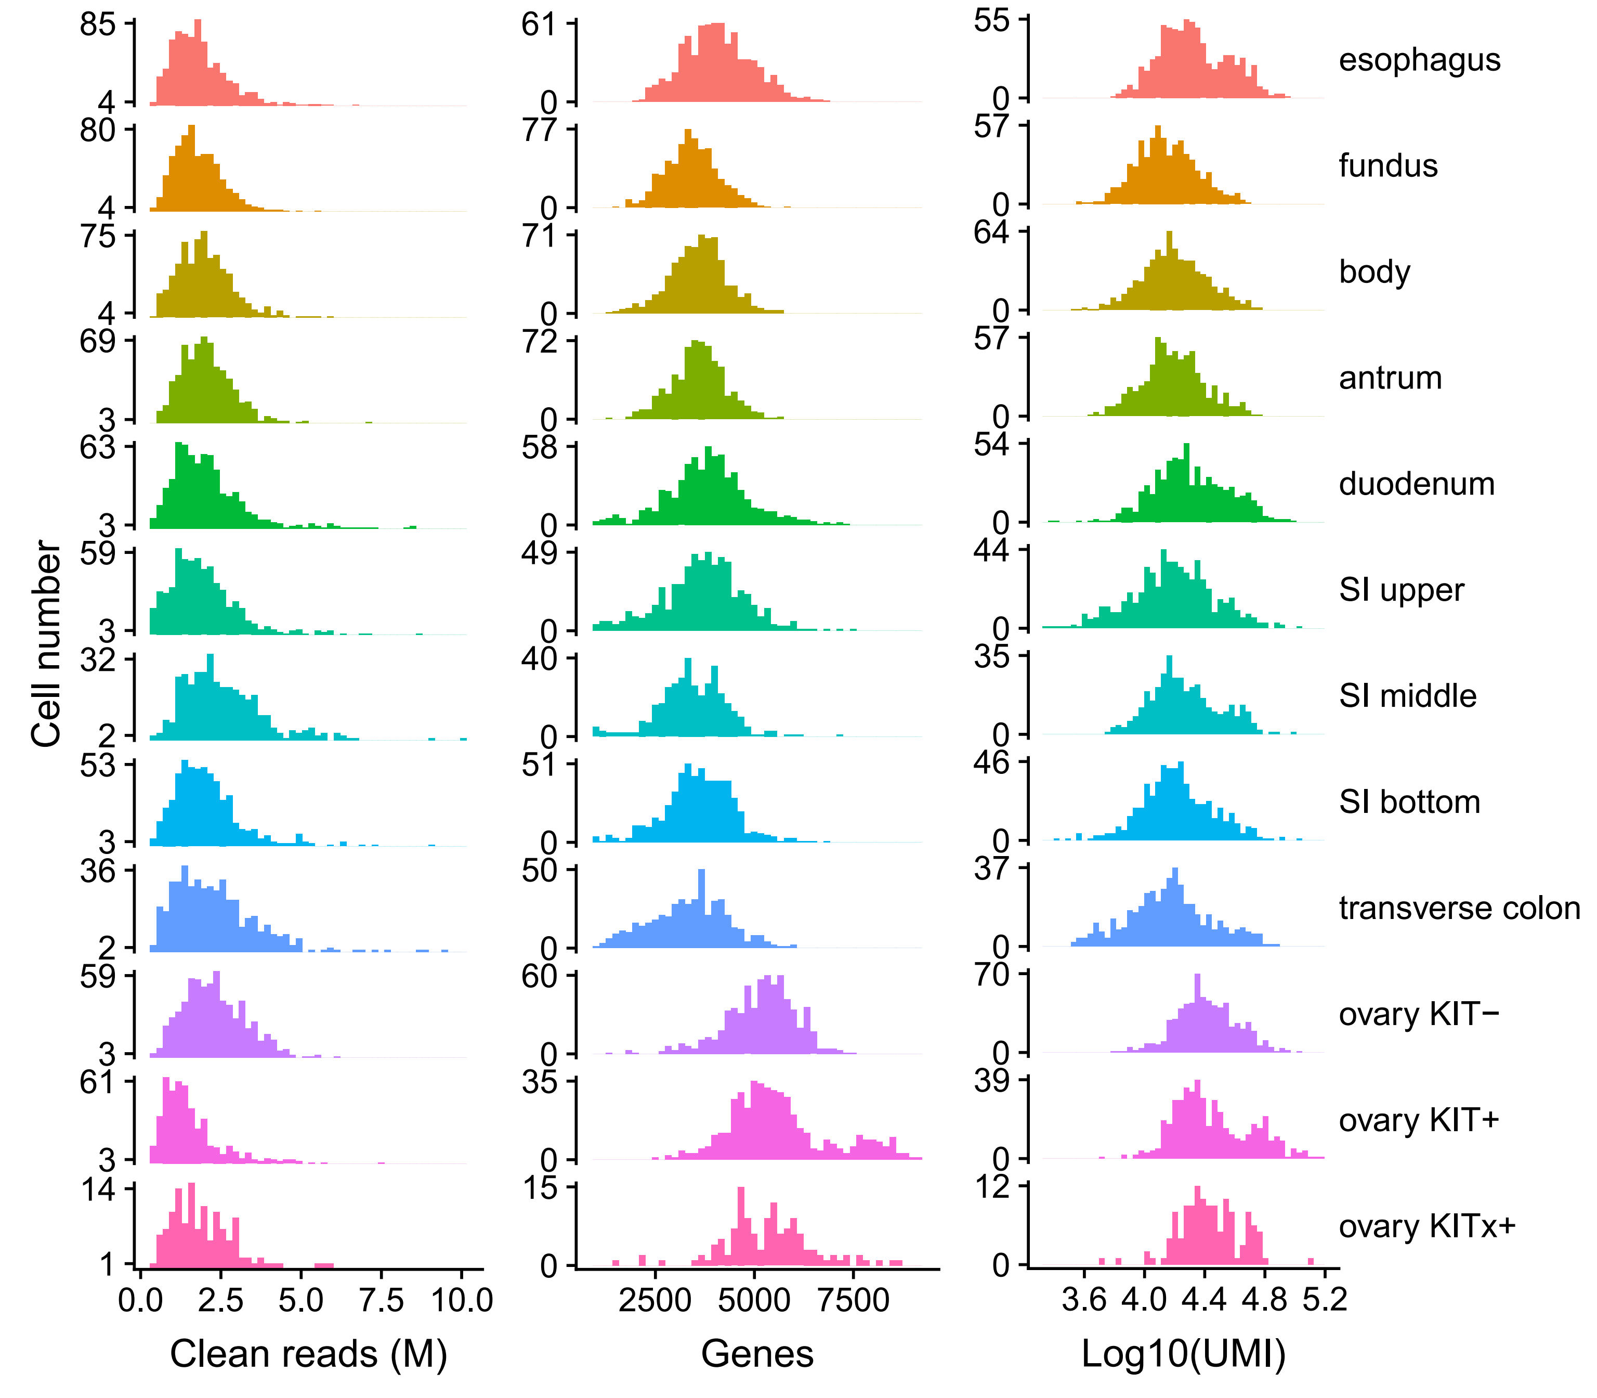
Quality control (QC) of cells
66.10% (5,442 / 8,232) of cells passed the filtering process.
For the 5,442 cells after QC:
2.03 million clean reads, 3,970 detected genes and 21,792 UMIs.

Slide 5
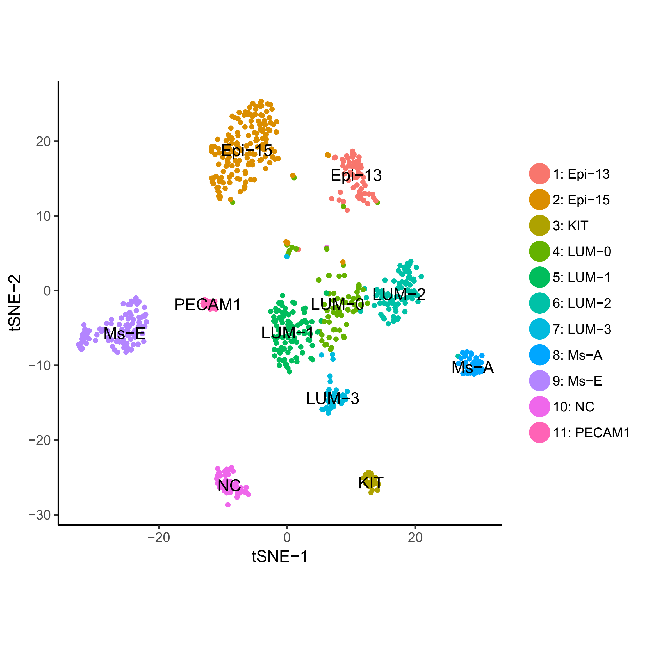
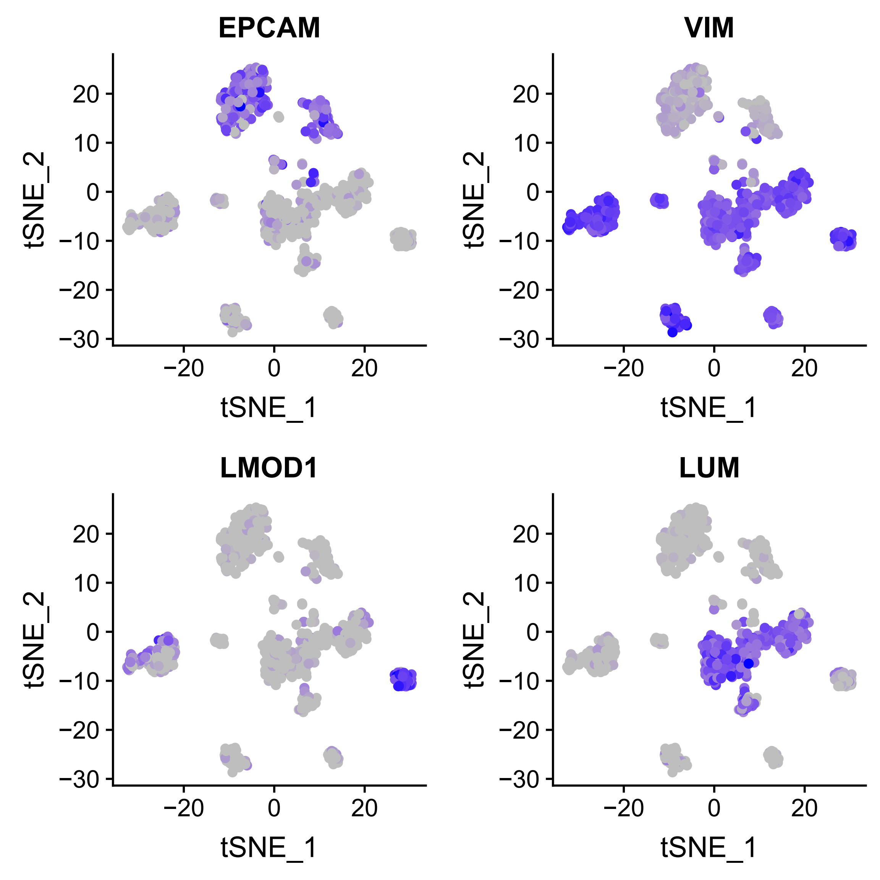
1. Esophagus (食道)
There are 11 cell types for 753 cells.
Cells were grouped by known epithelial and mesenchymal markers.

Slide 6
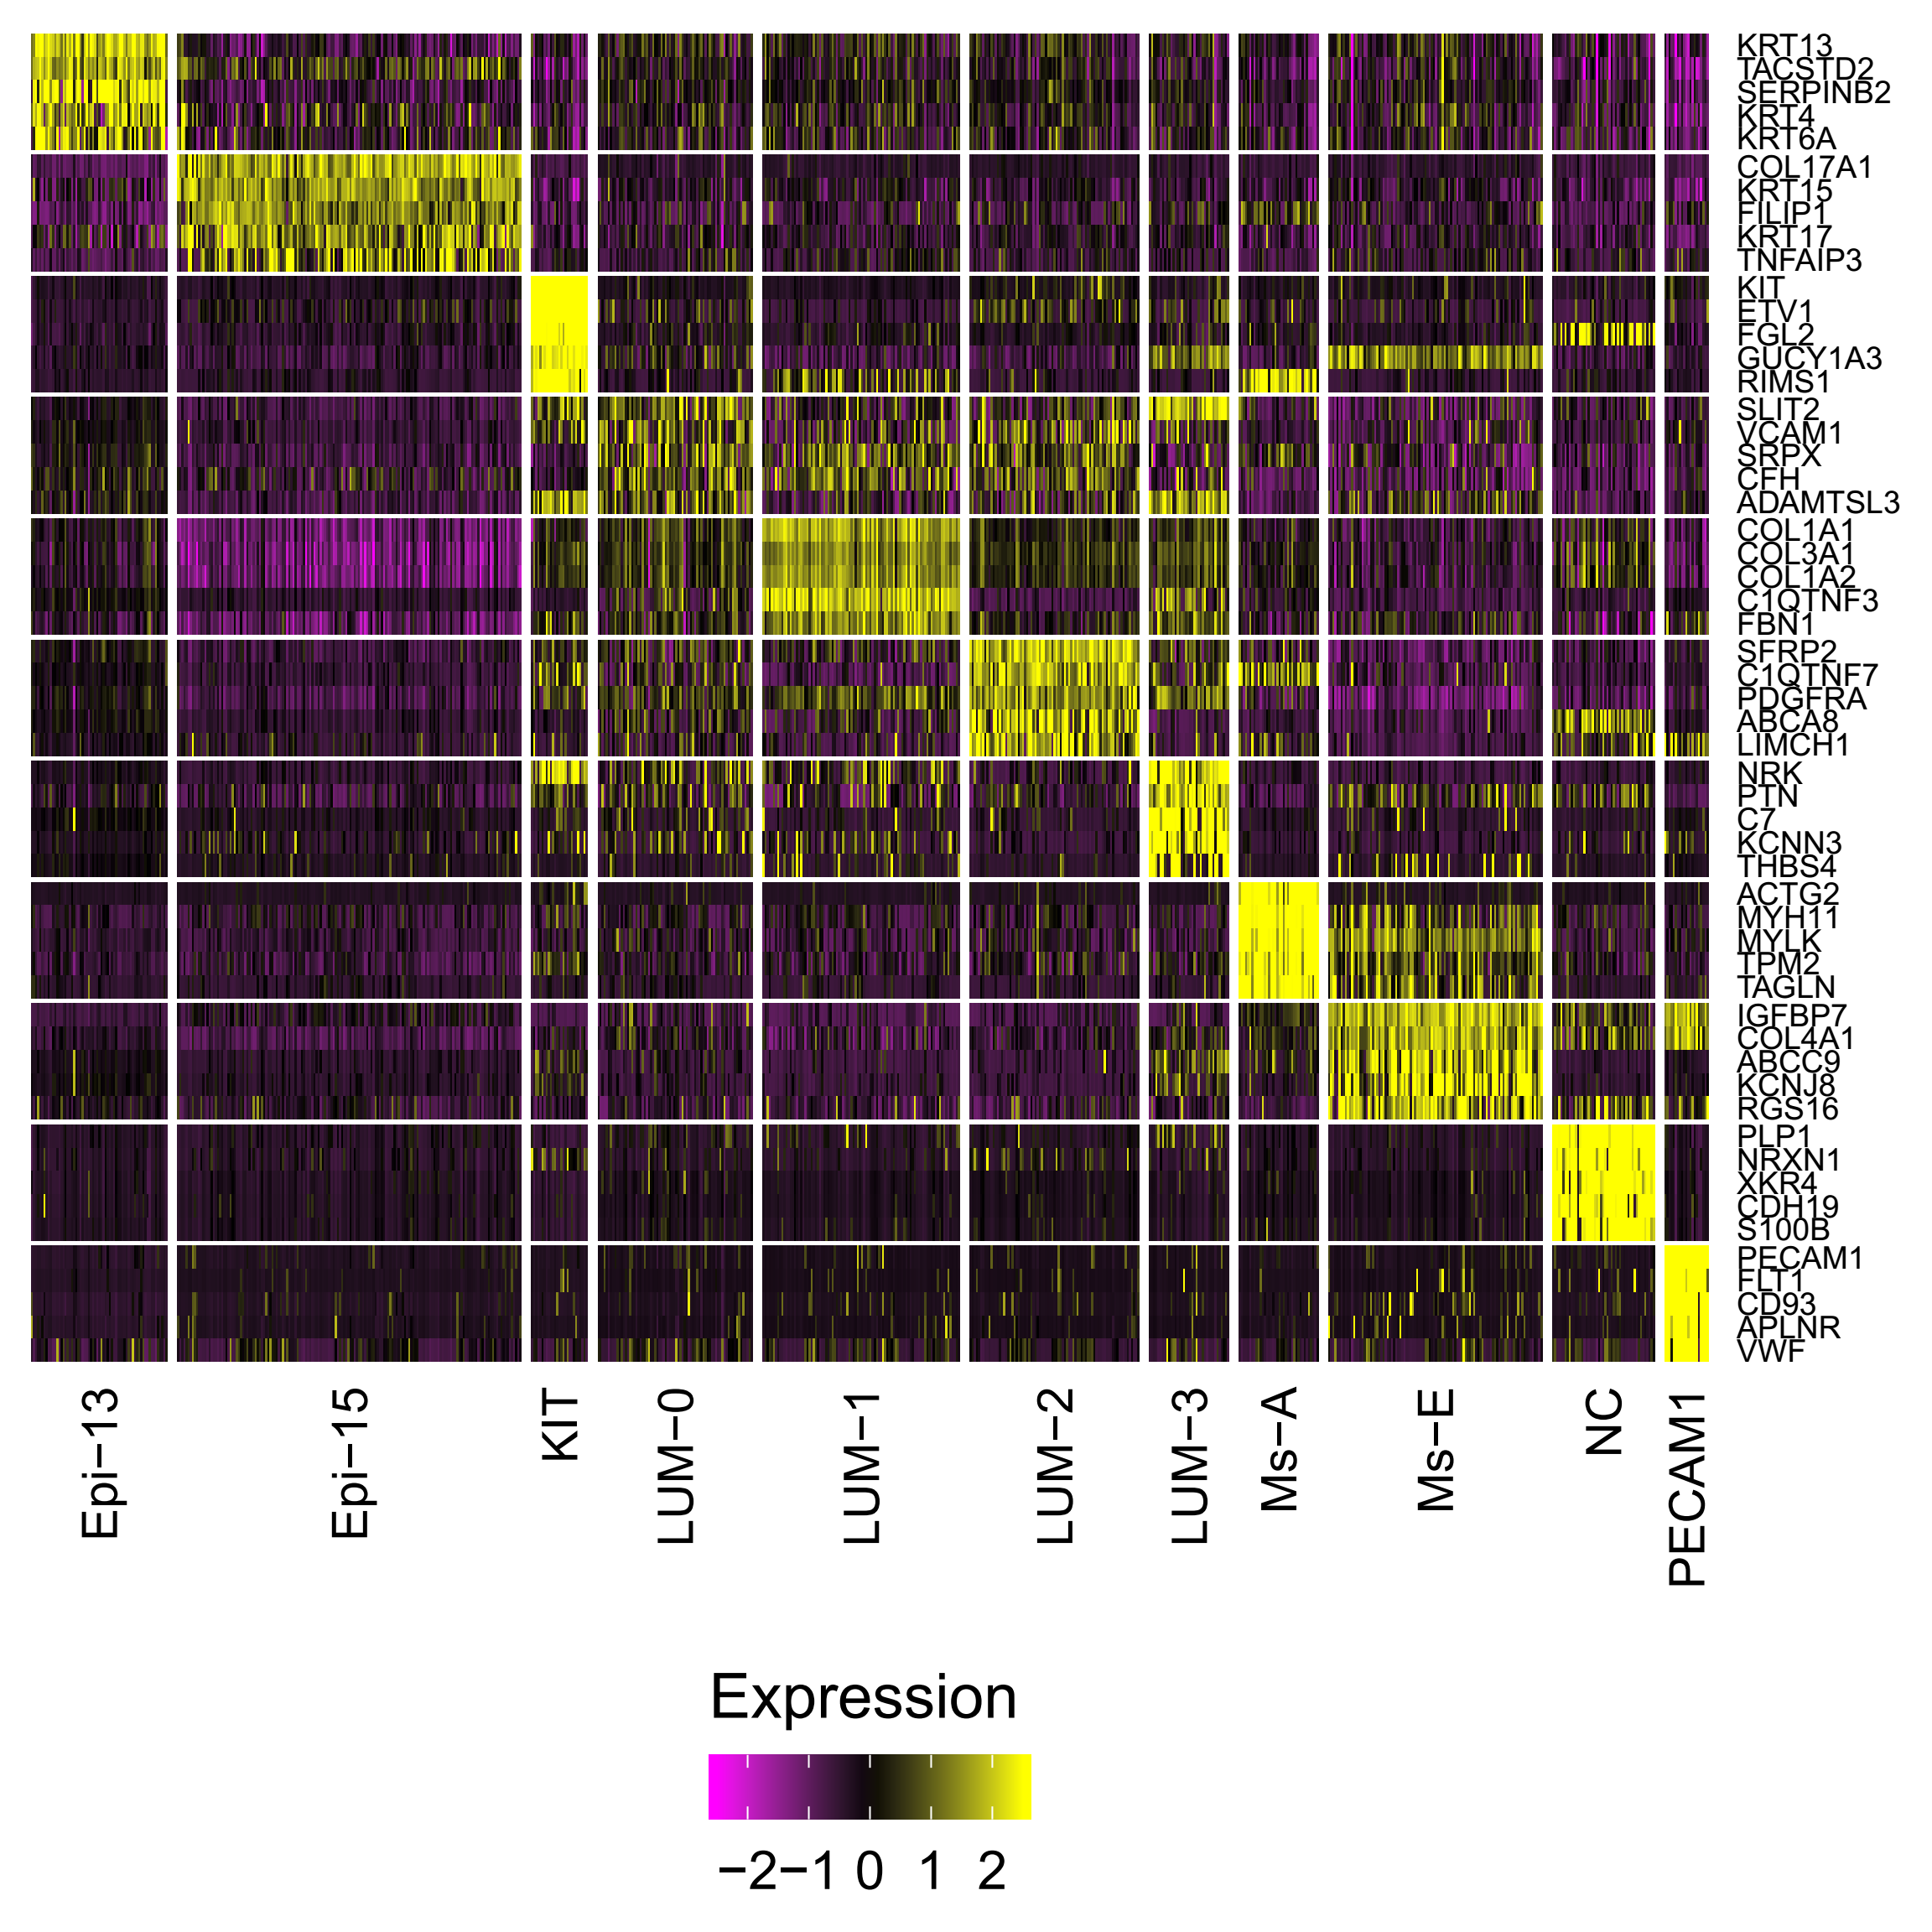
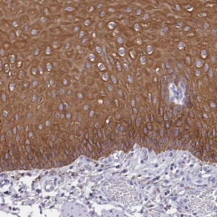
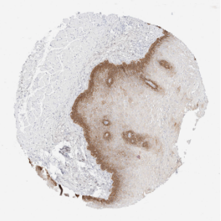
Expression of signature genes
KRT13
KRT15
KIT
PLP1
Top 5 genes for each cluster were shown
The staining figures were downloaded from HPA.
Notes:
the esophagus express a variety of keratin 角蛋白 intermediate filaments proteins whose function is to provide structural integrity between the cells. Among structural proteins, Keratin 4 (KRT4), -6 (KRT6A, KRT6B and KRT6C) -13 (KRT13) showed high enrichment together with the calcium-binding proteins S100A14. KRT13 is primarily expressed in the mucosal epithelia
https://www.proteinatlas.org/images/30877/142302_B_4_1_val_selected.jpg
The type I cytokeratin 15 (KRT15) is important for the structural integrity of epithelial cells. KRT15 is group enriched in esophagus, skin and breast.

Slide 7
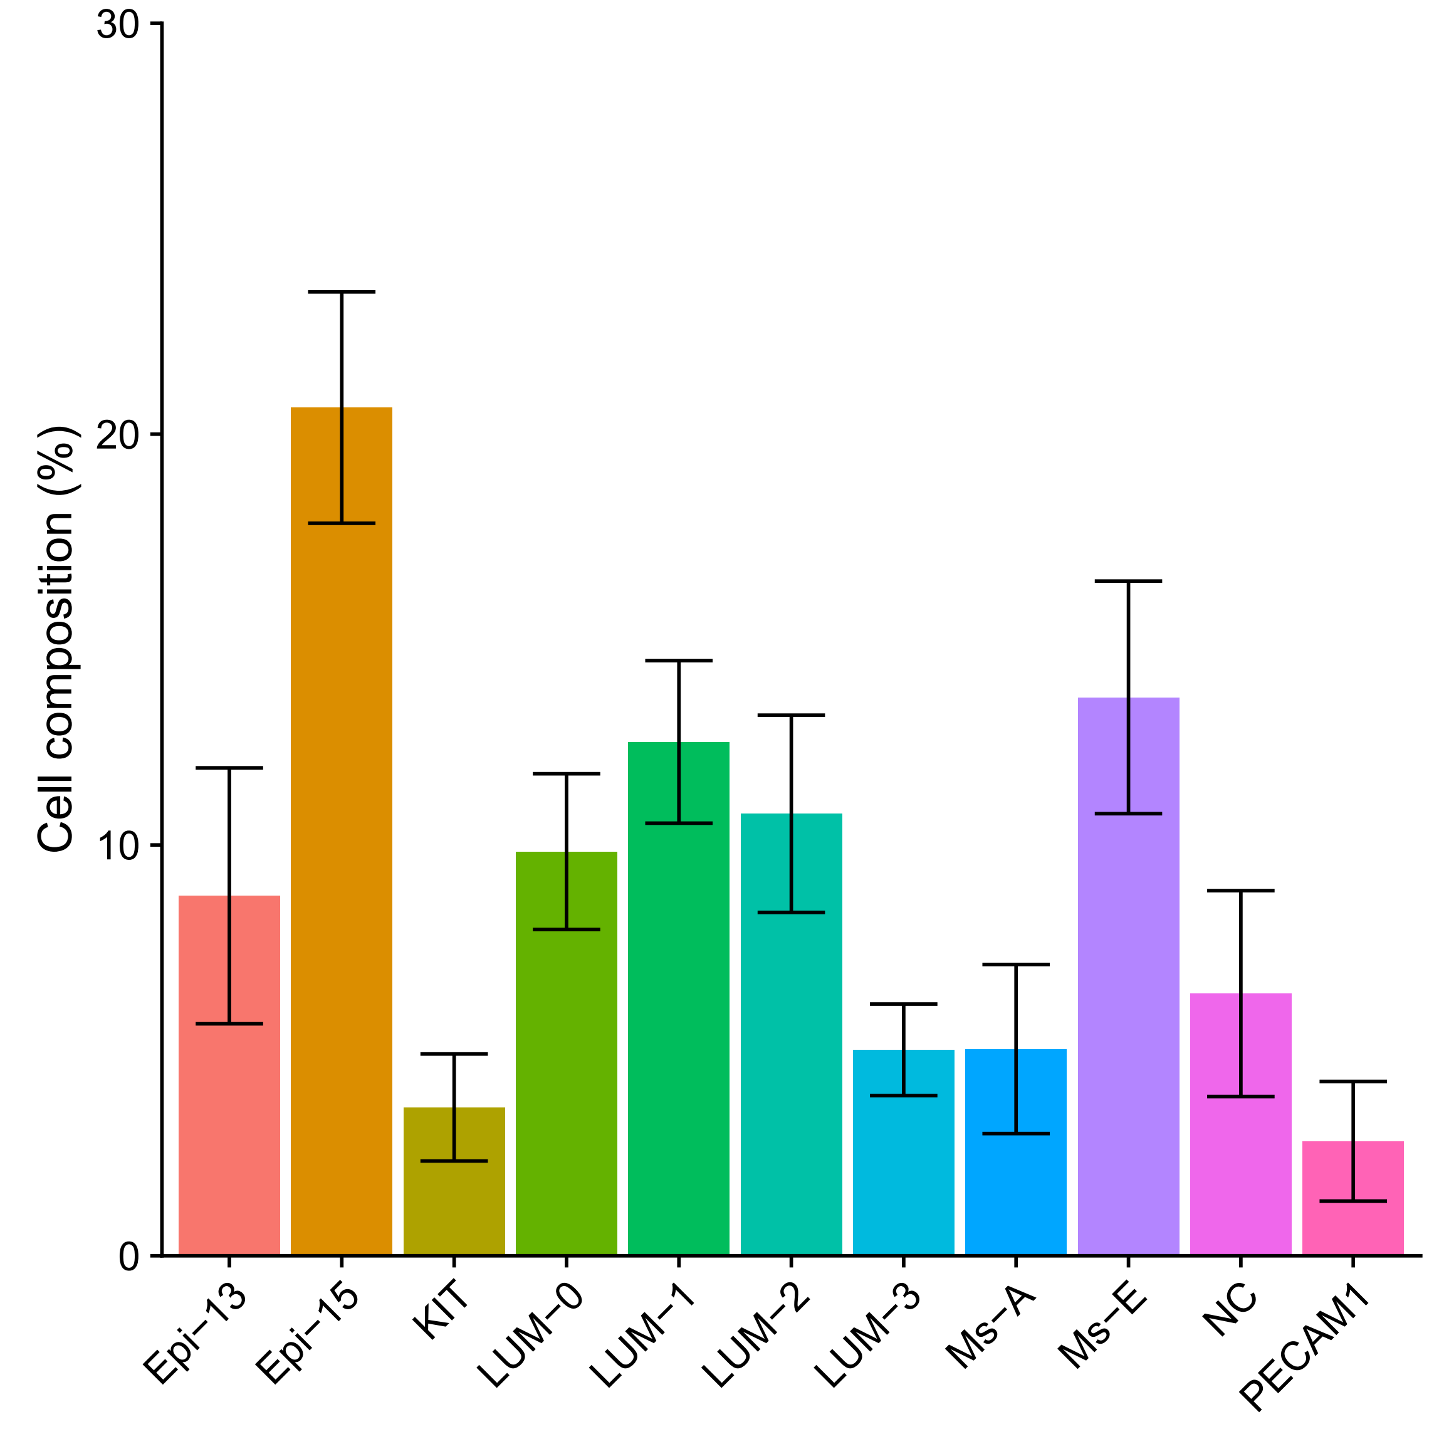
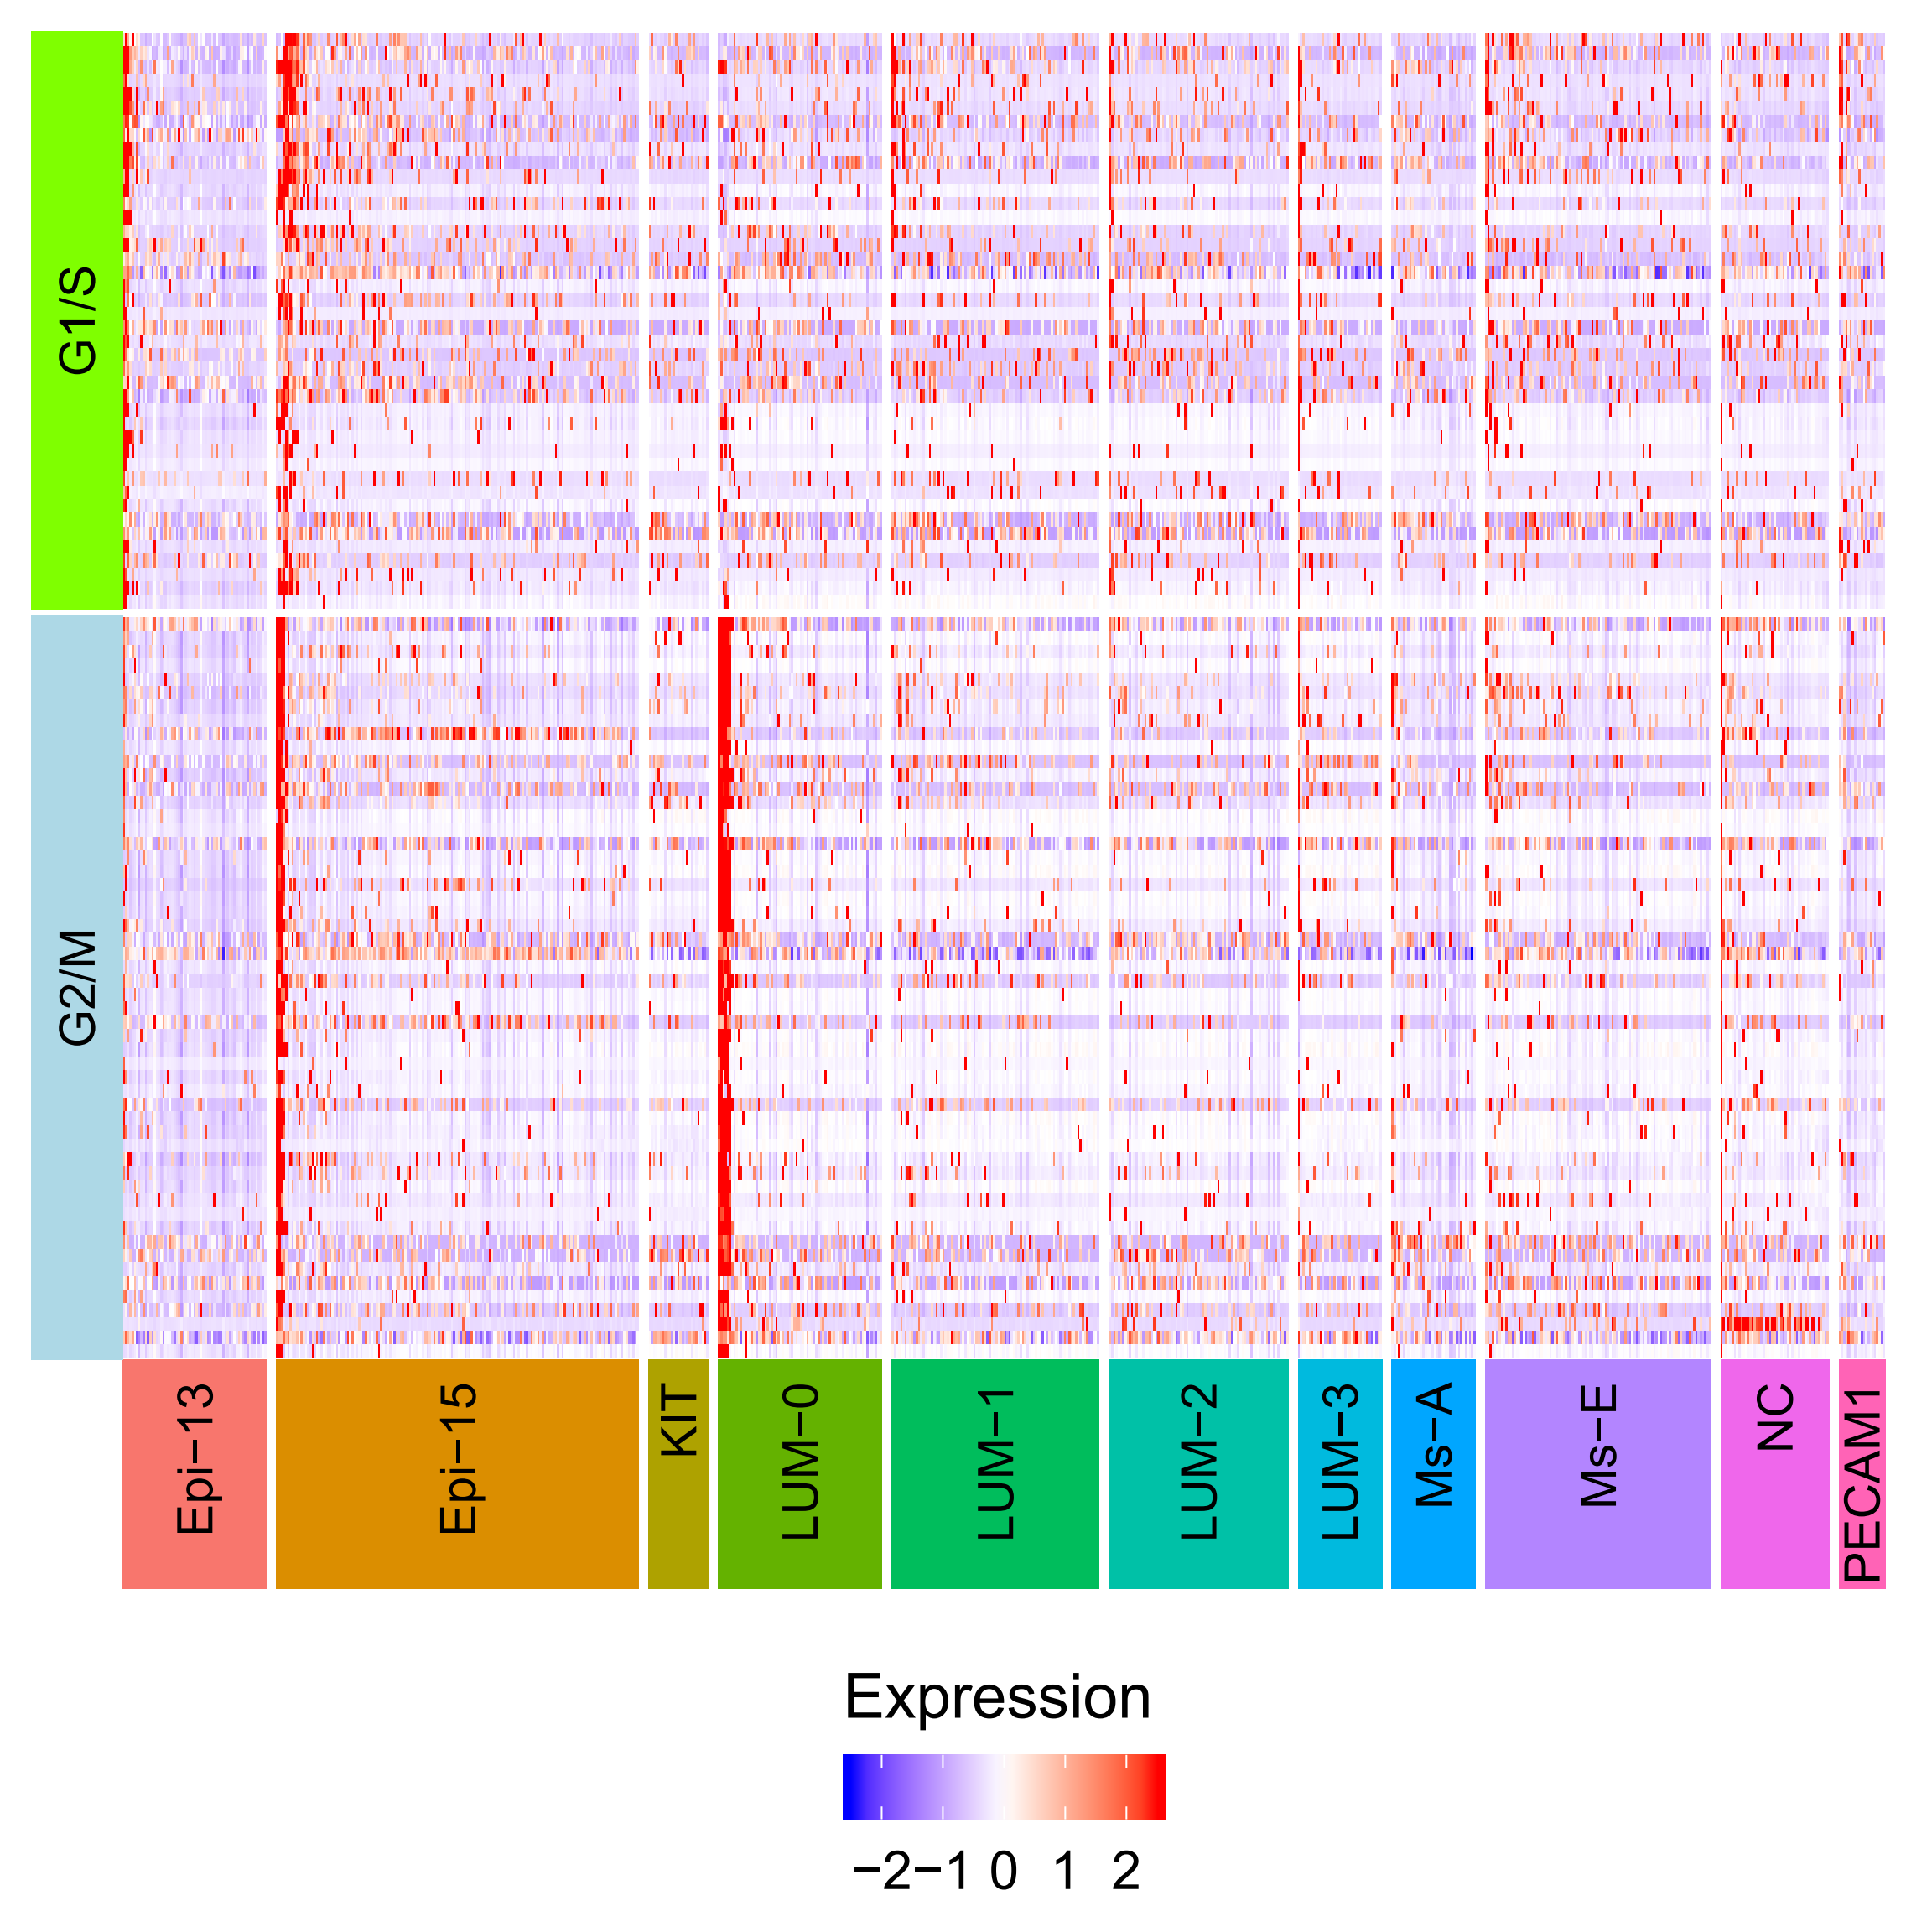
Cell type composition and heterogeneity in cell cycle
Error bars mean SD (across plates)

Slide 8
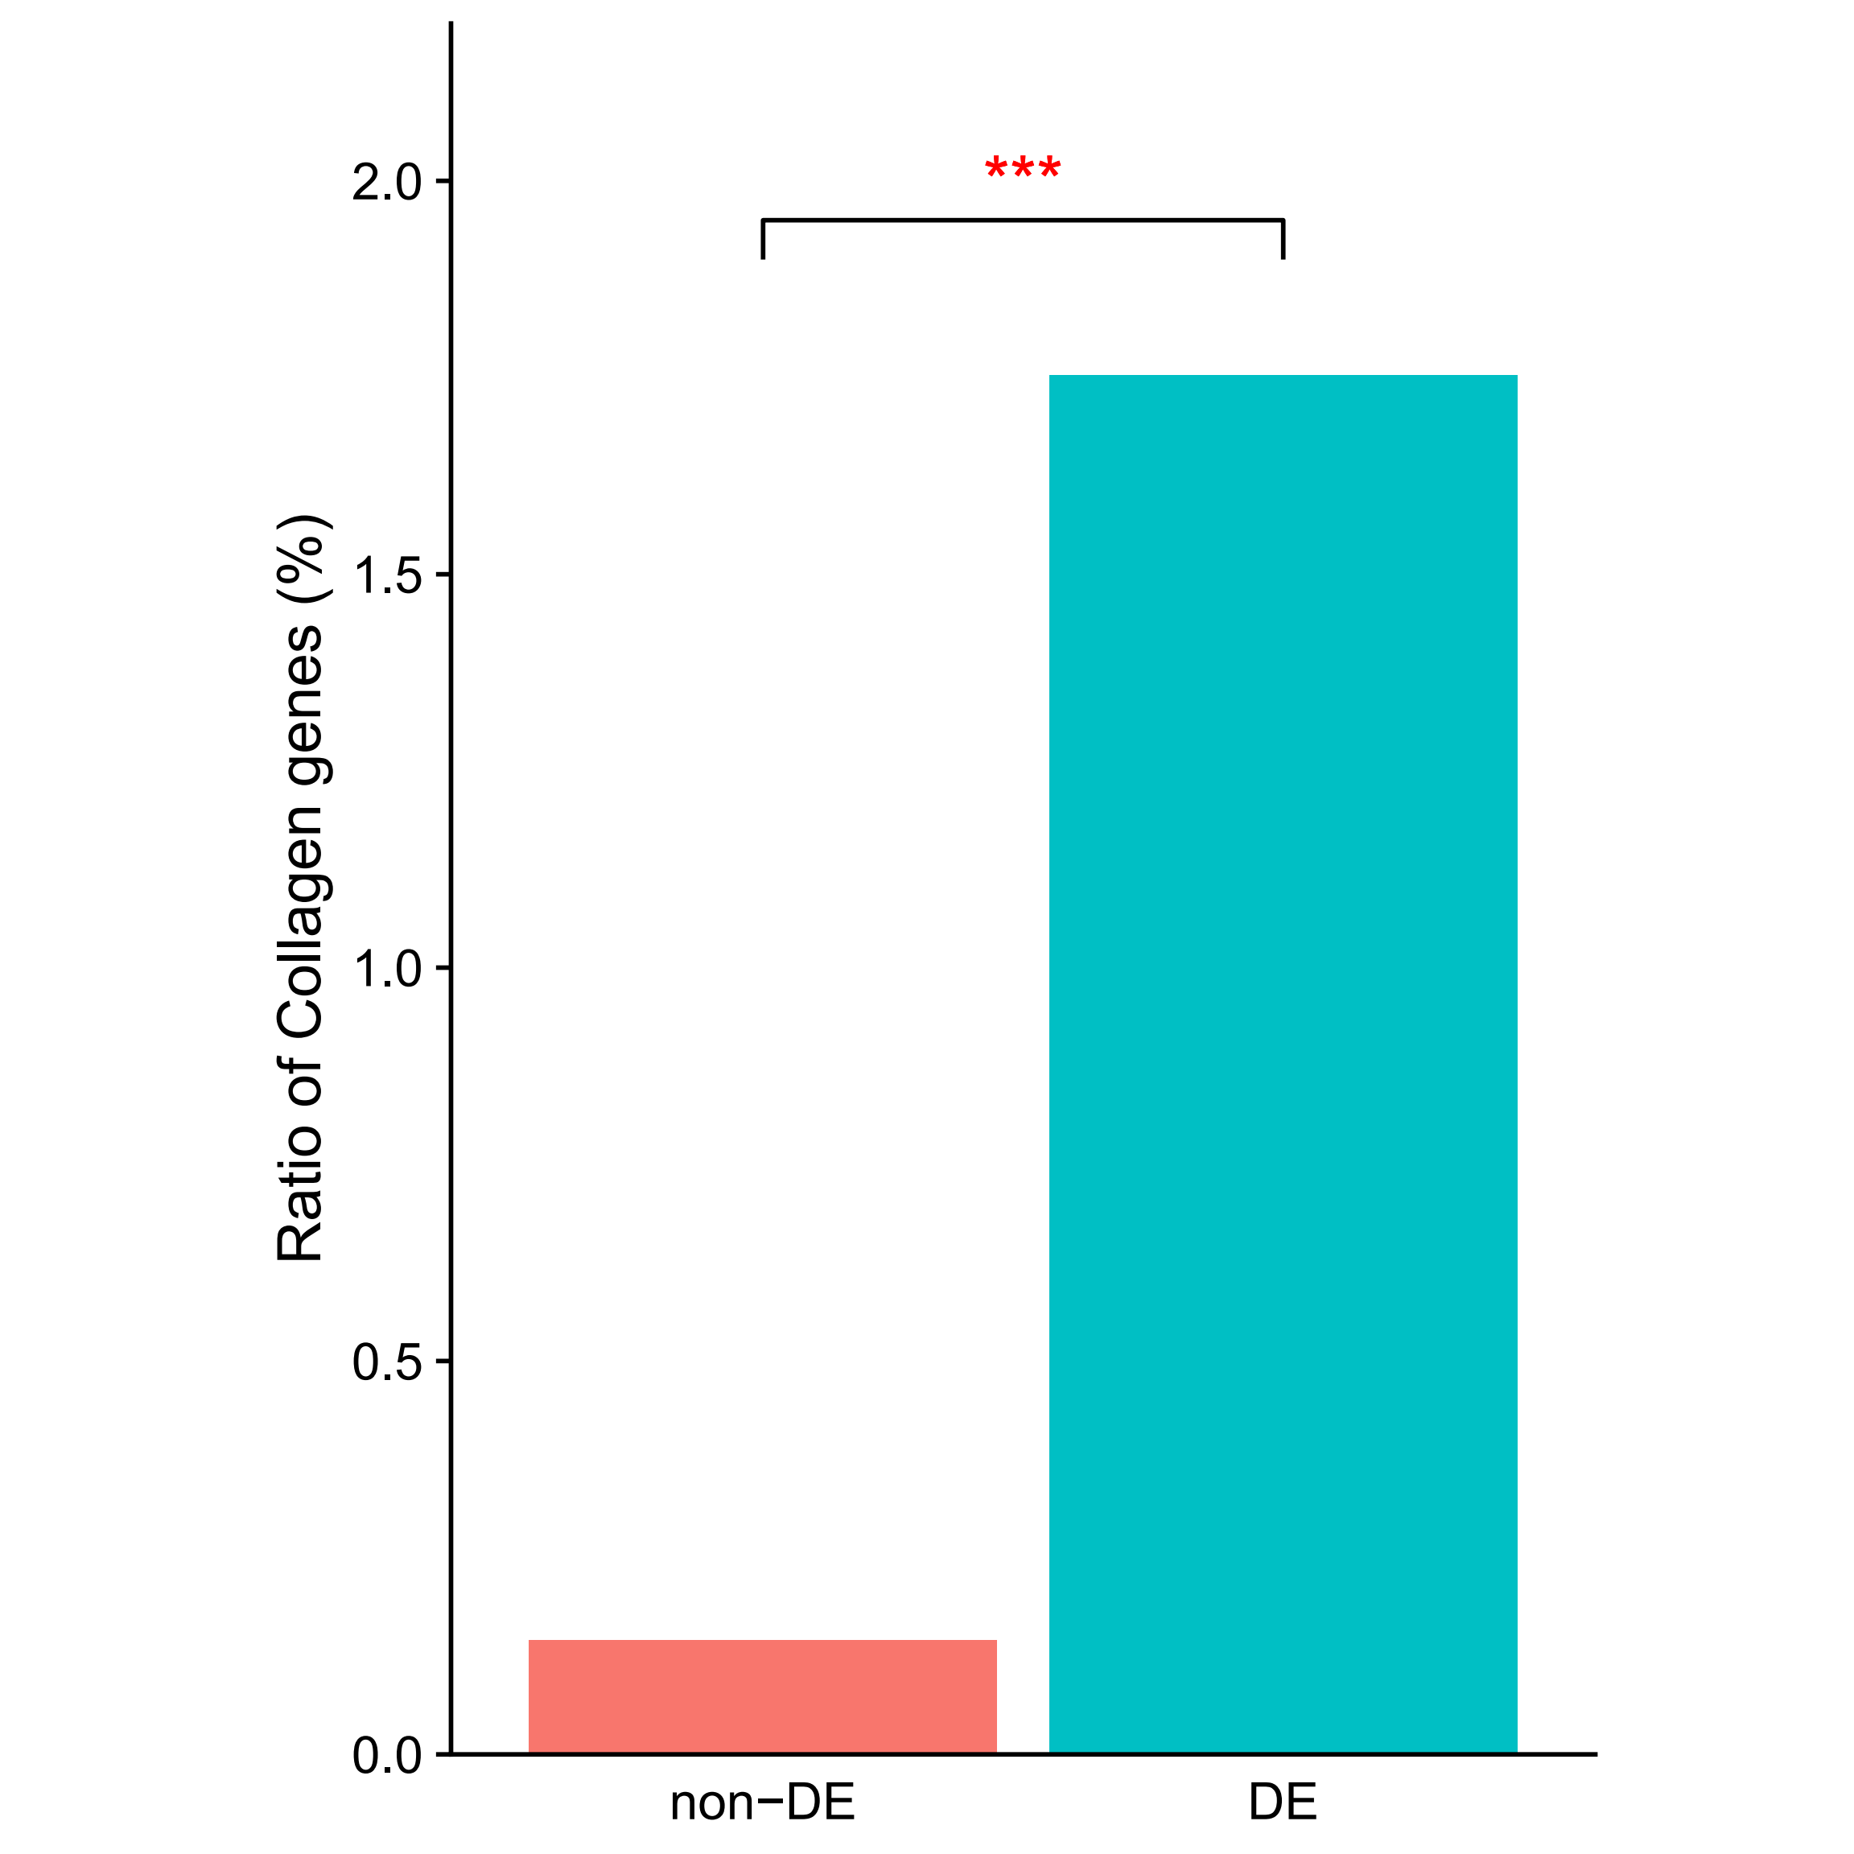
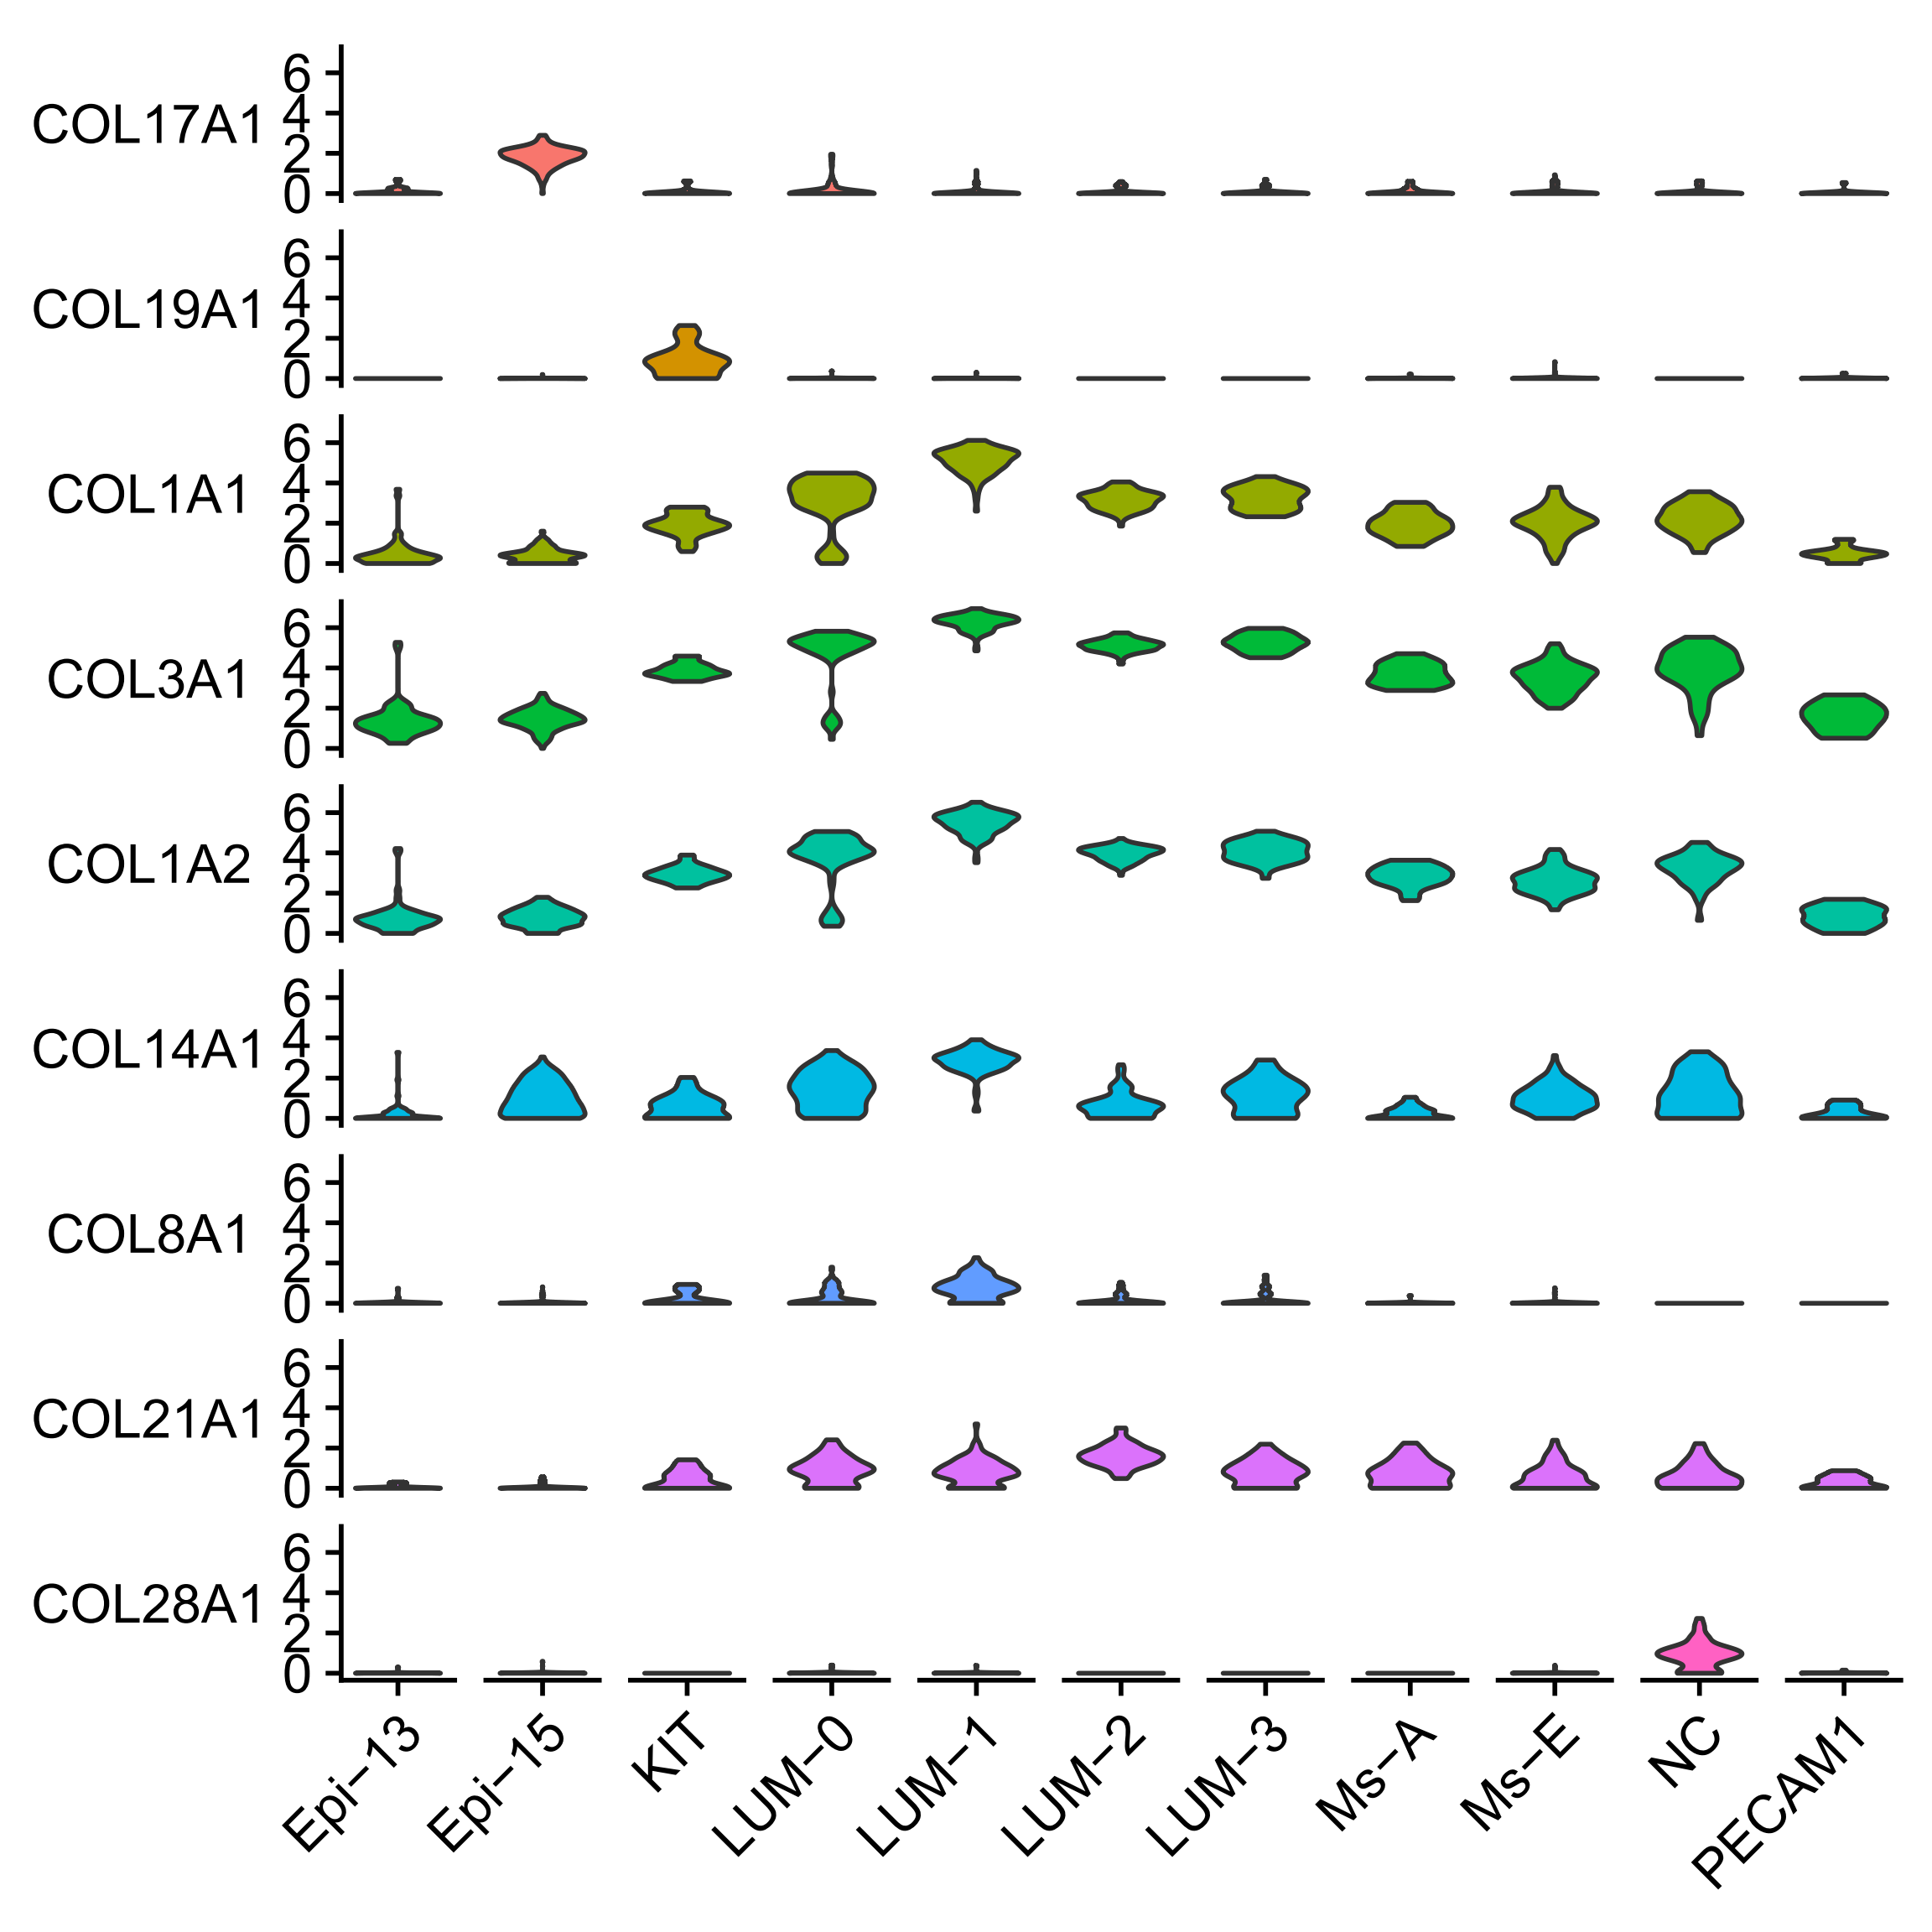
Collagens are representative signature genes
Differentially expressed genes are enriched for collagens.
Fisher's exact test (*** means p < 0.001)
Notes:
Lumican (基膜聚糖) may regulate collagen fibril organization and circumferential growth, corneal transparency, and epithelial cell migration and tissue repair.

Slide 9
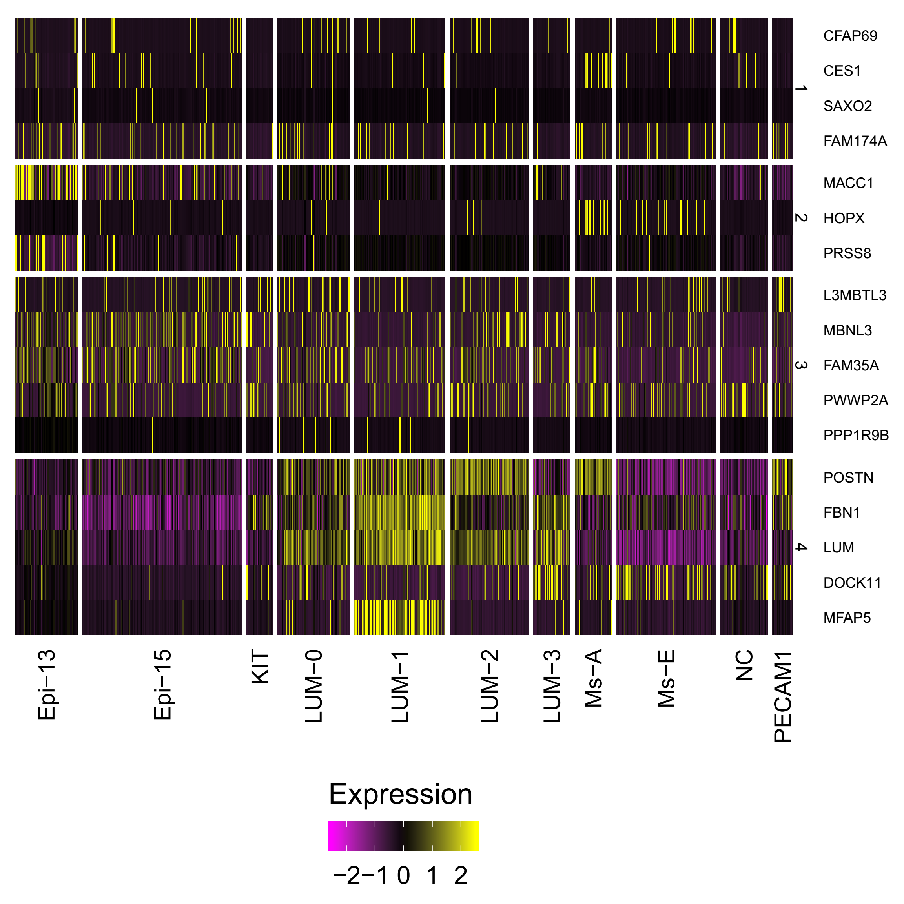
Comparison of cell types in the previous work
Gao S et al., Nat Cell Biol, 2018

Slide 10
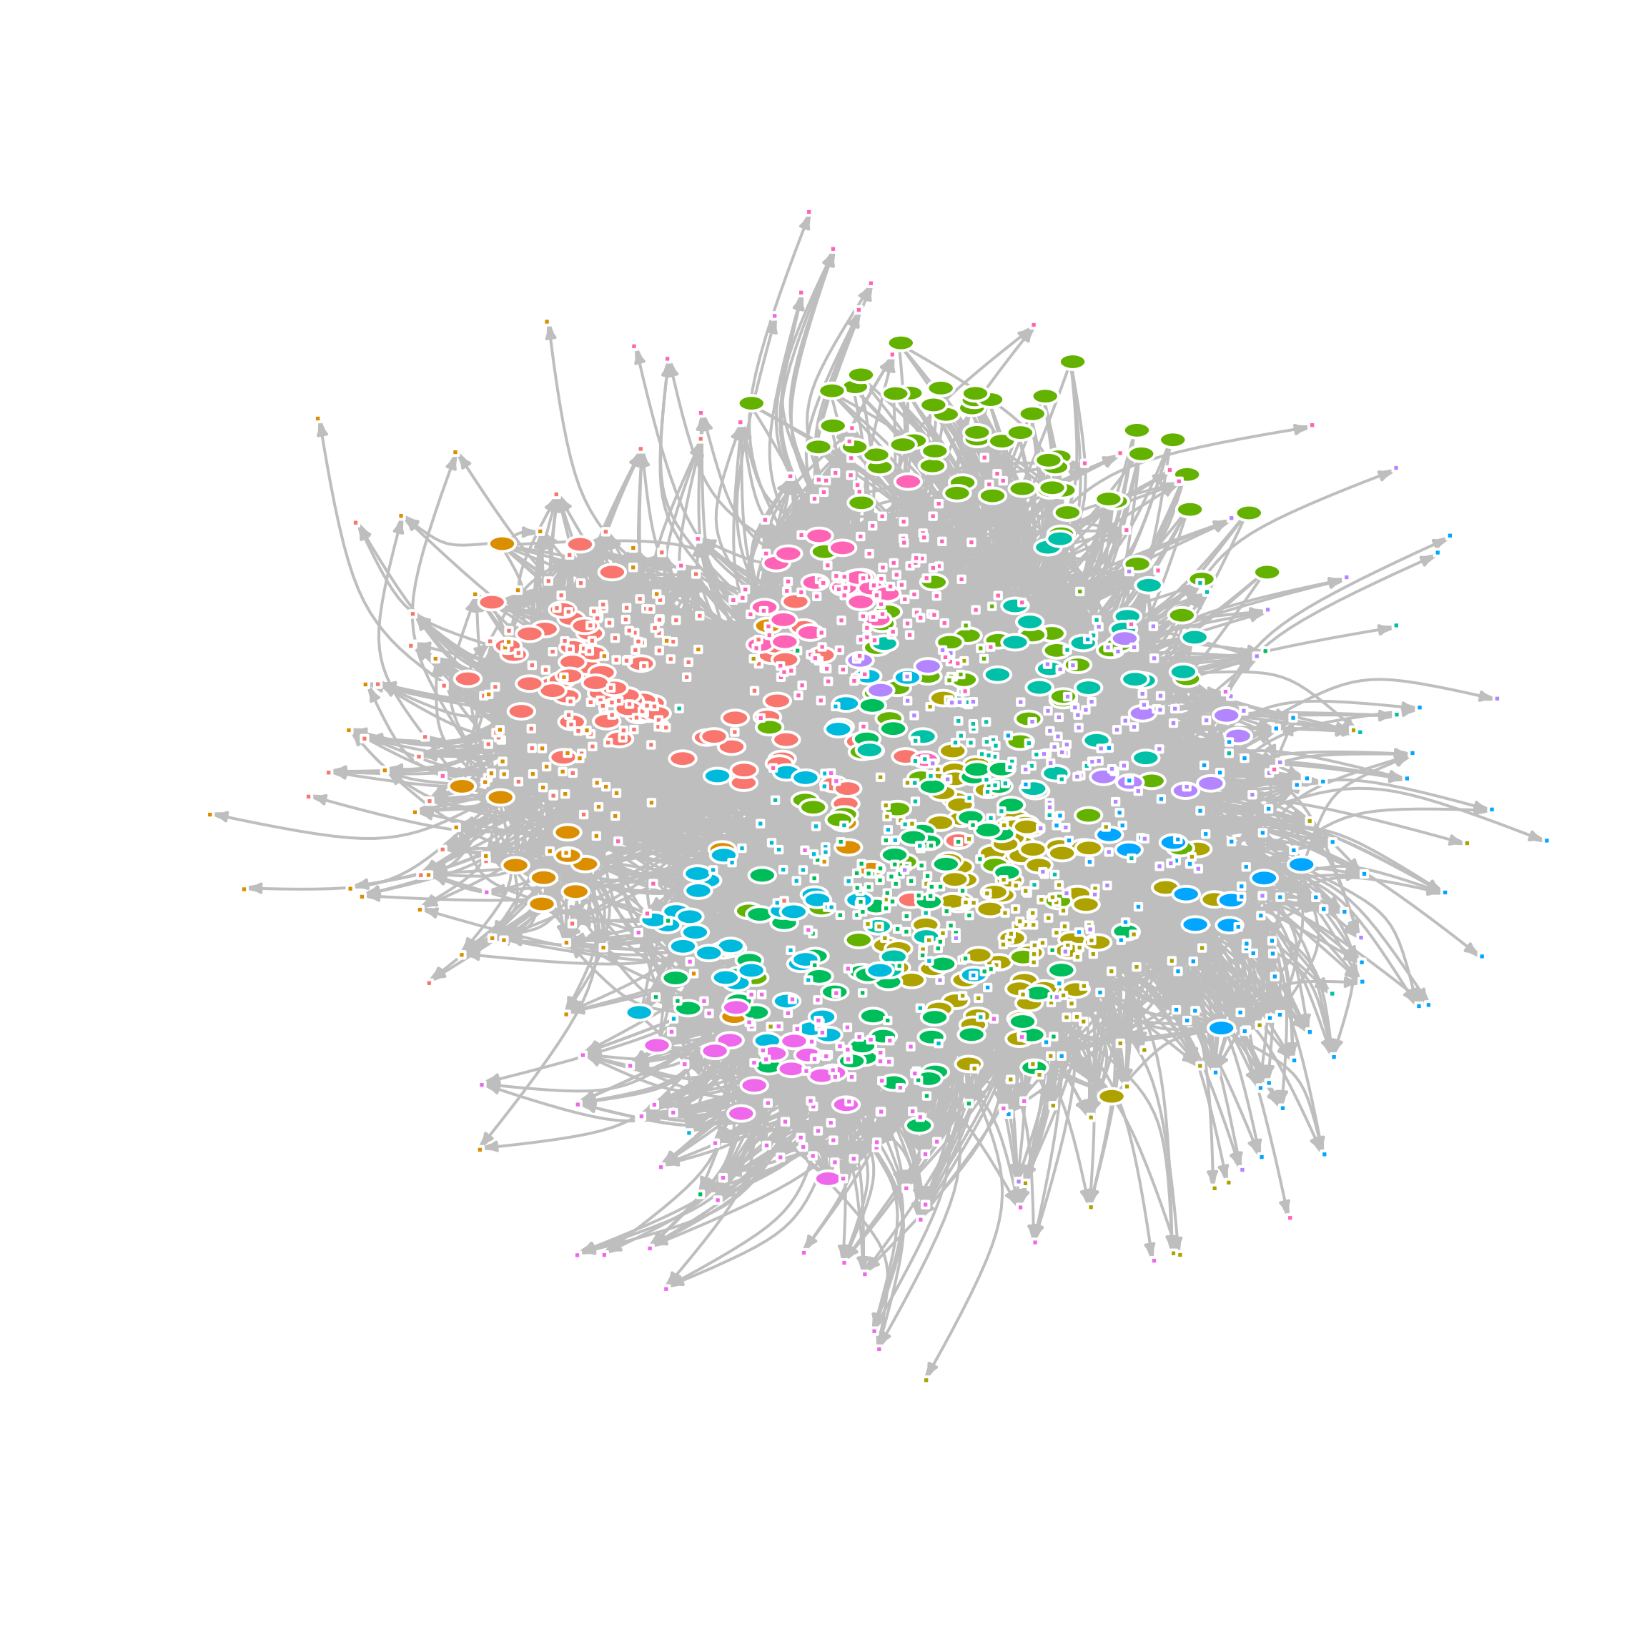
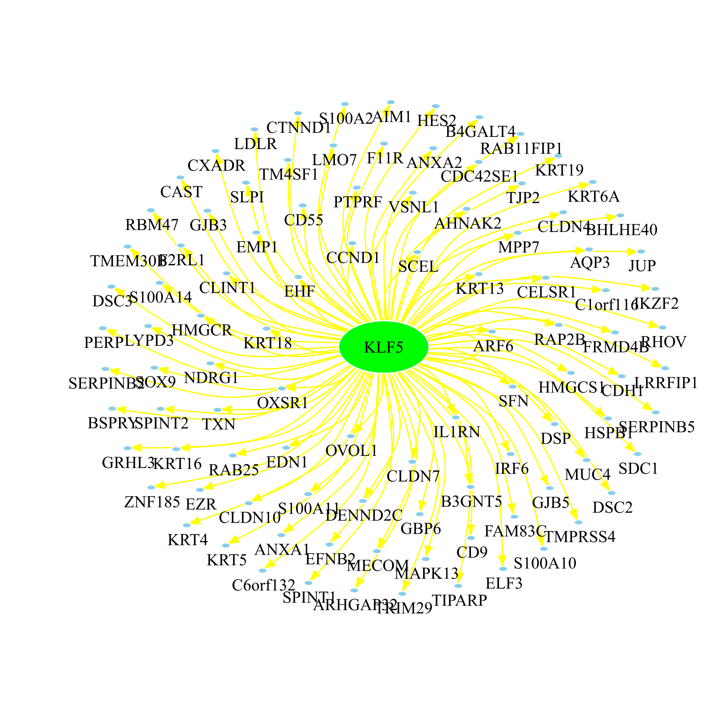
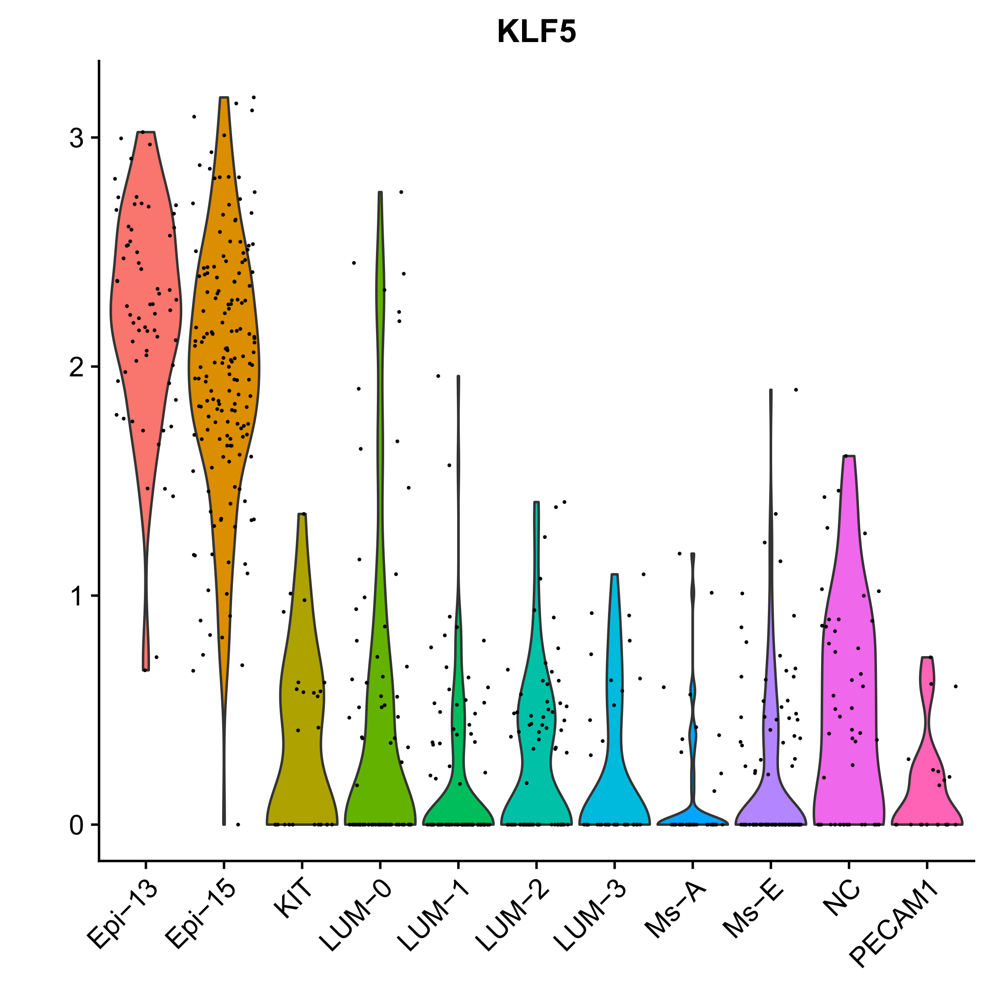
The transcriptional regulatory network
Notes:
100 target genes

Slide 11
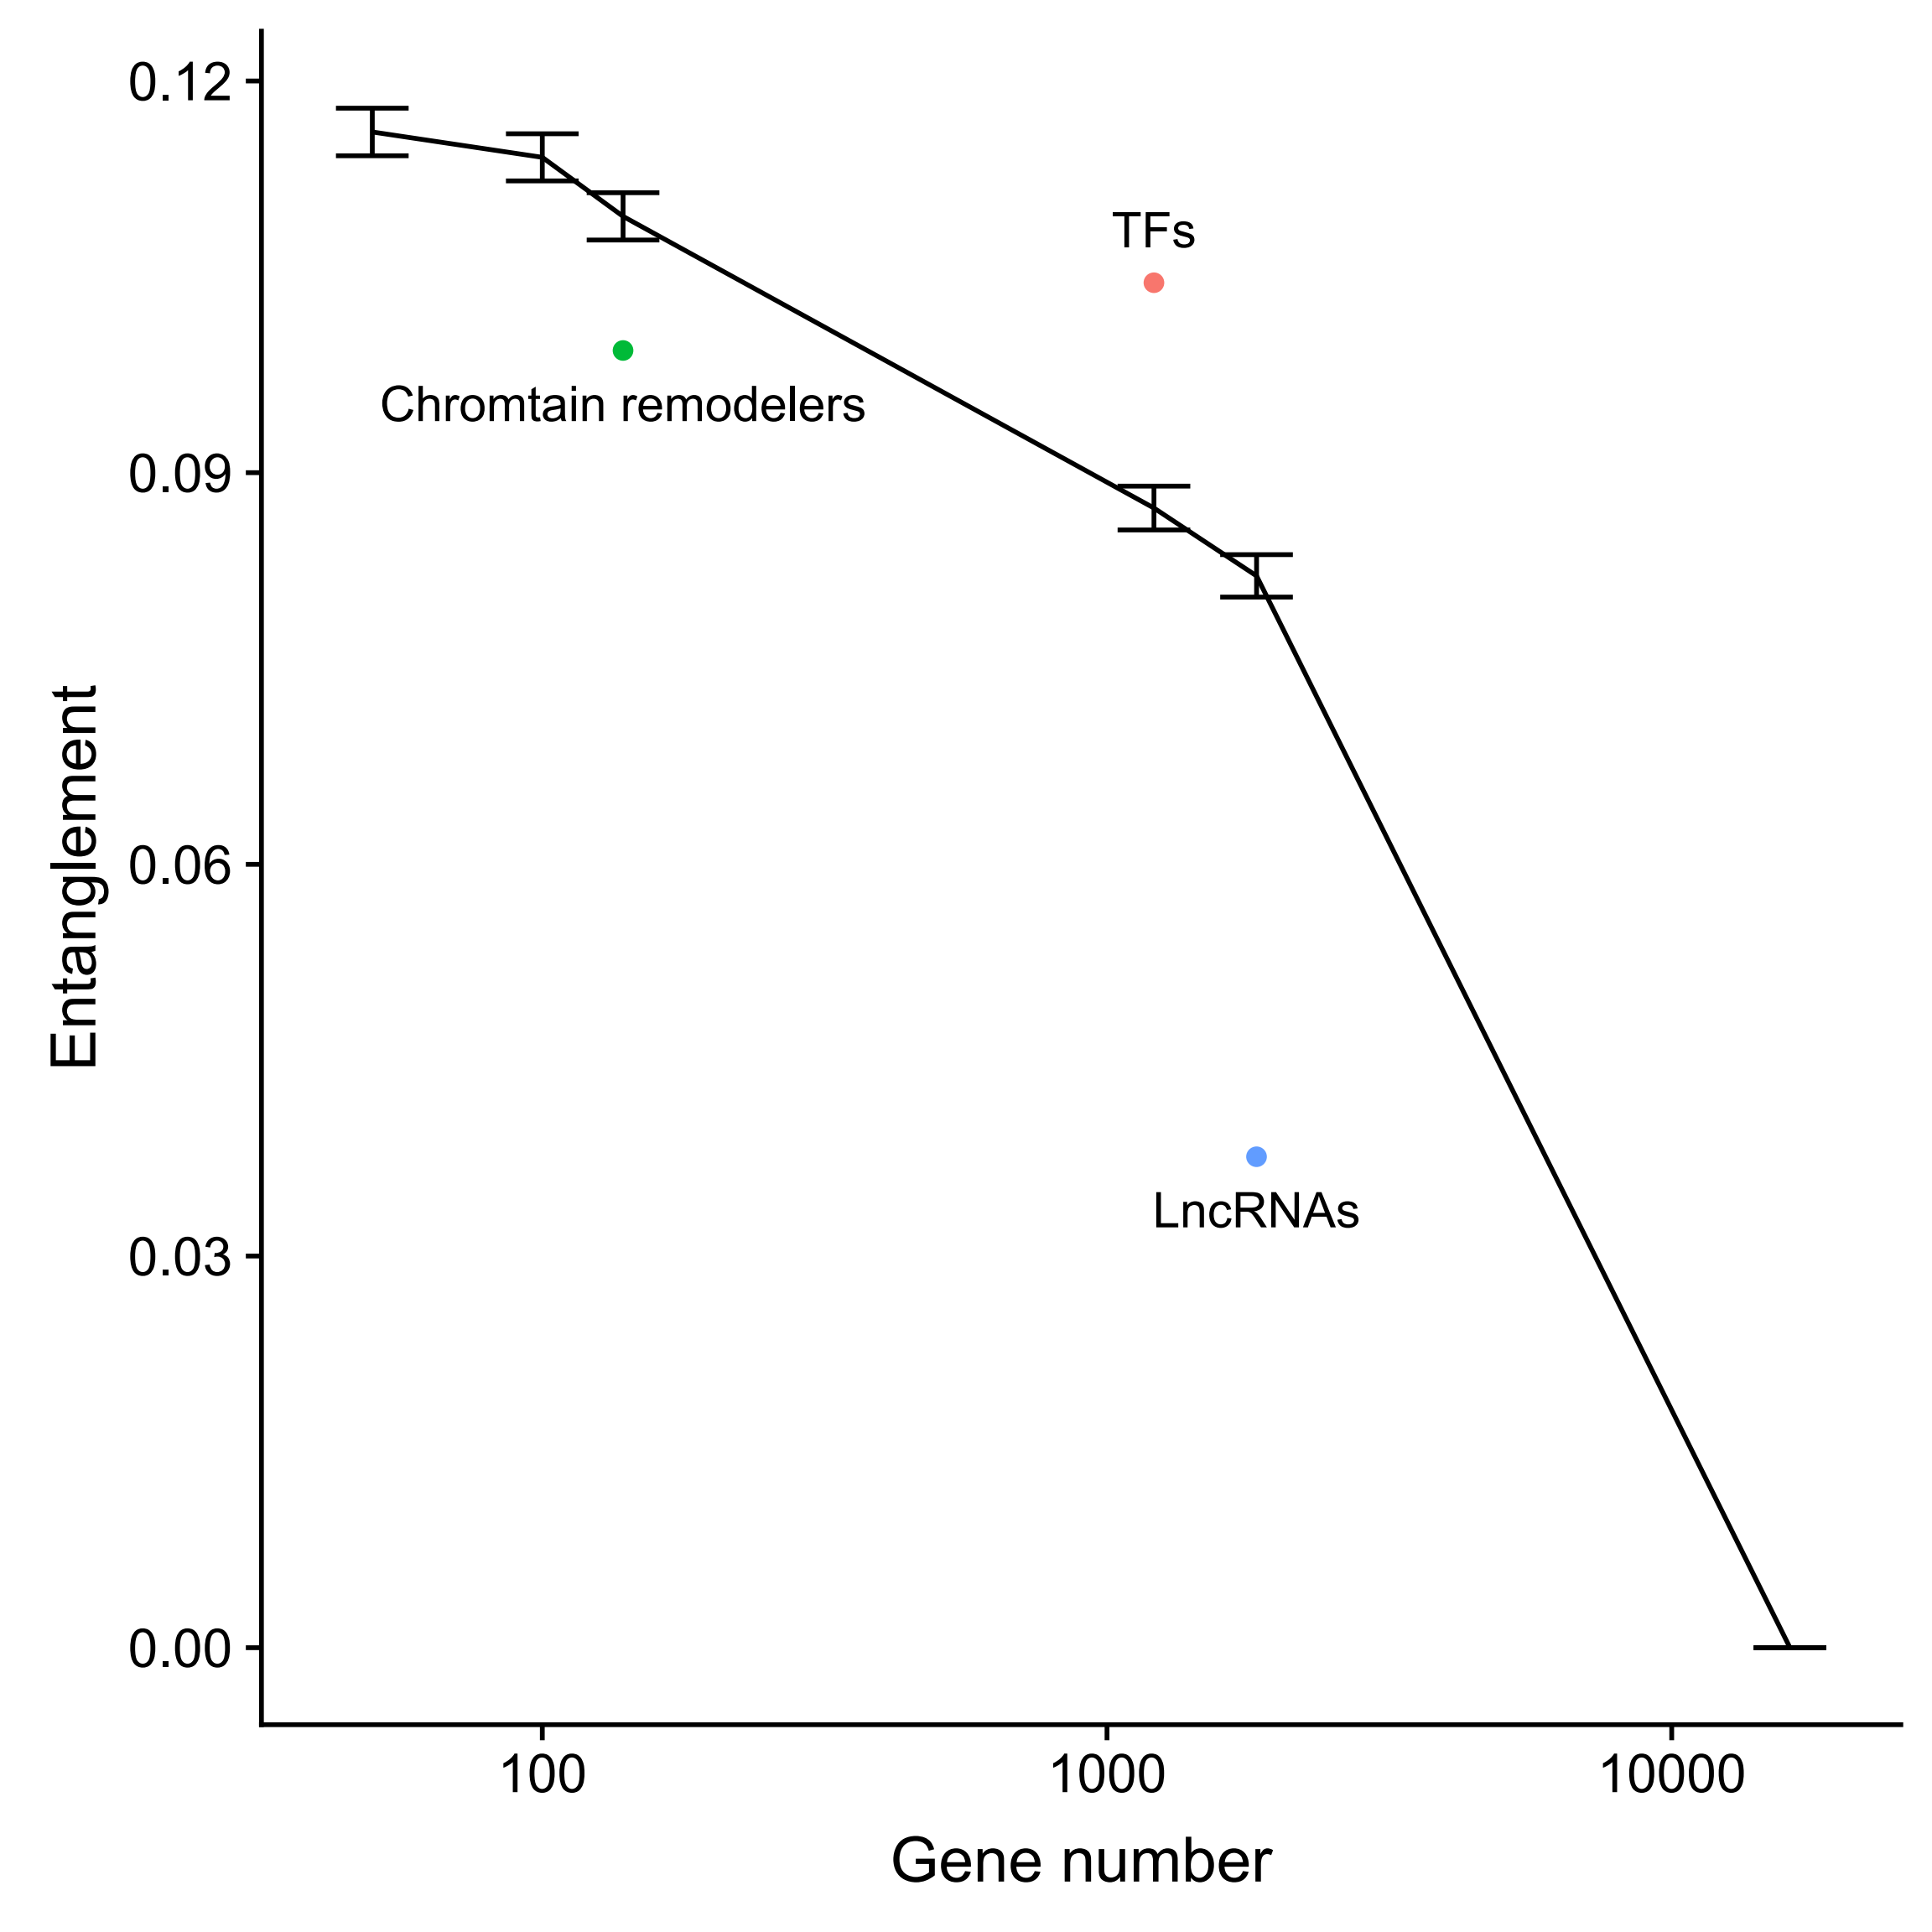
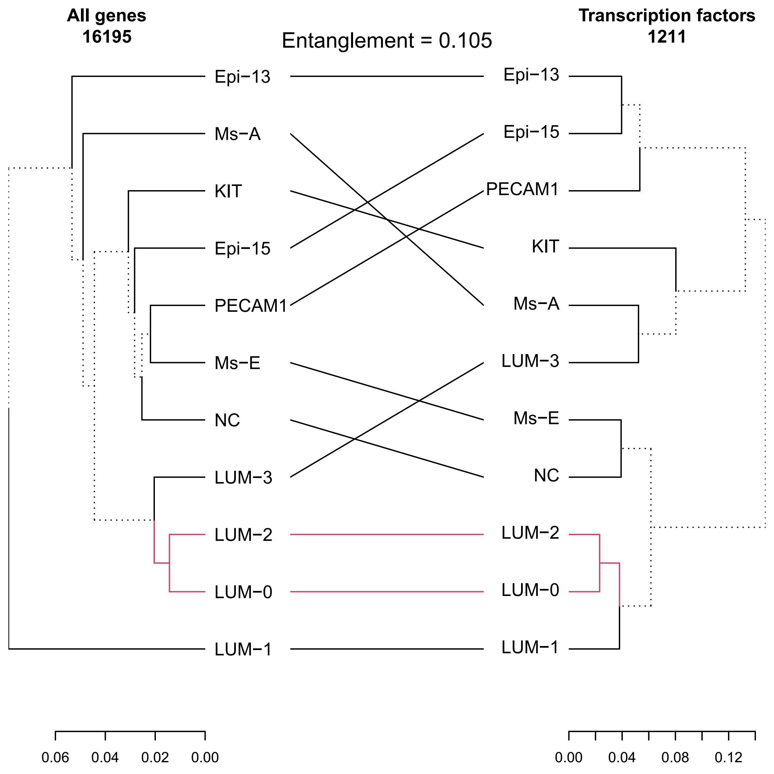
TFs don’t capture the pattern of the whole transcriptome
Notes:
100 target genes

Slide 12
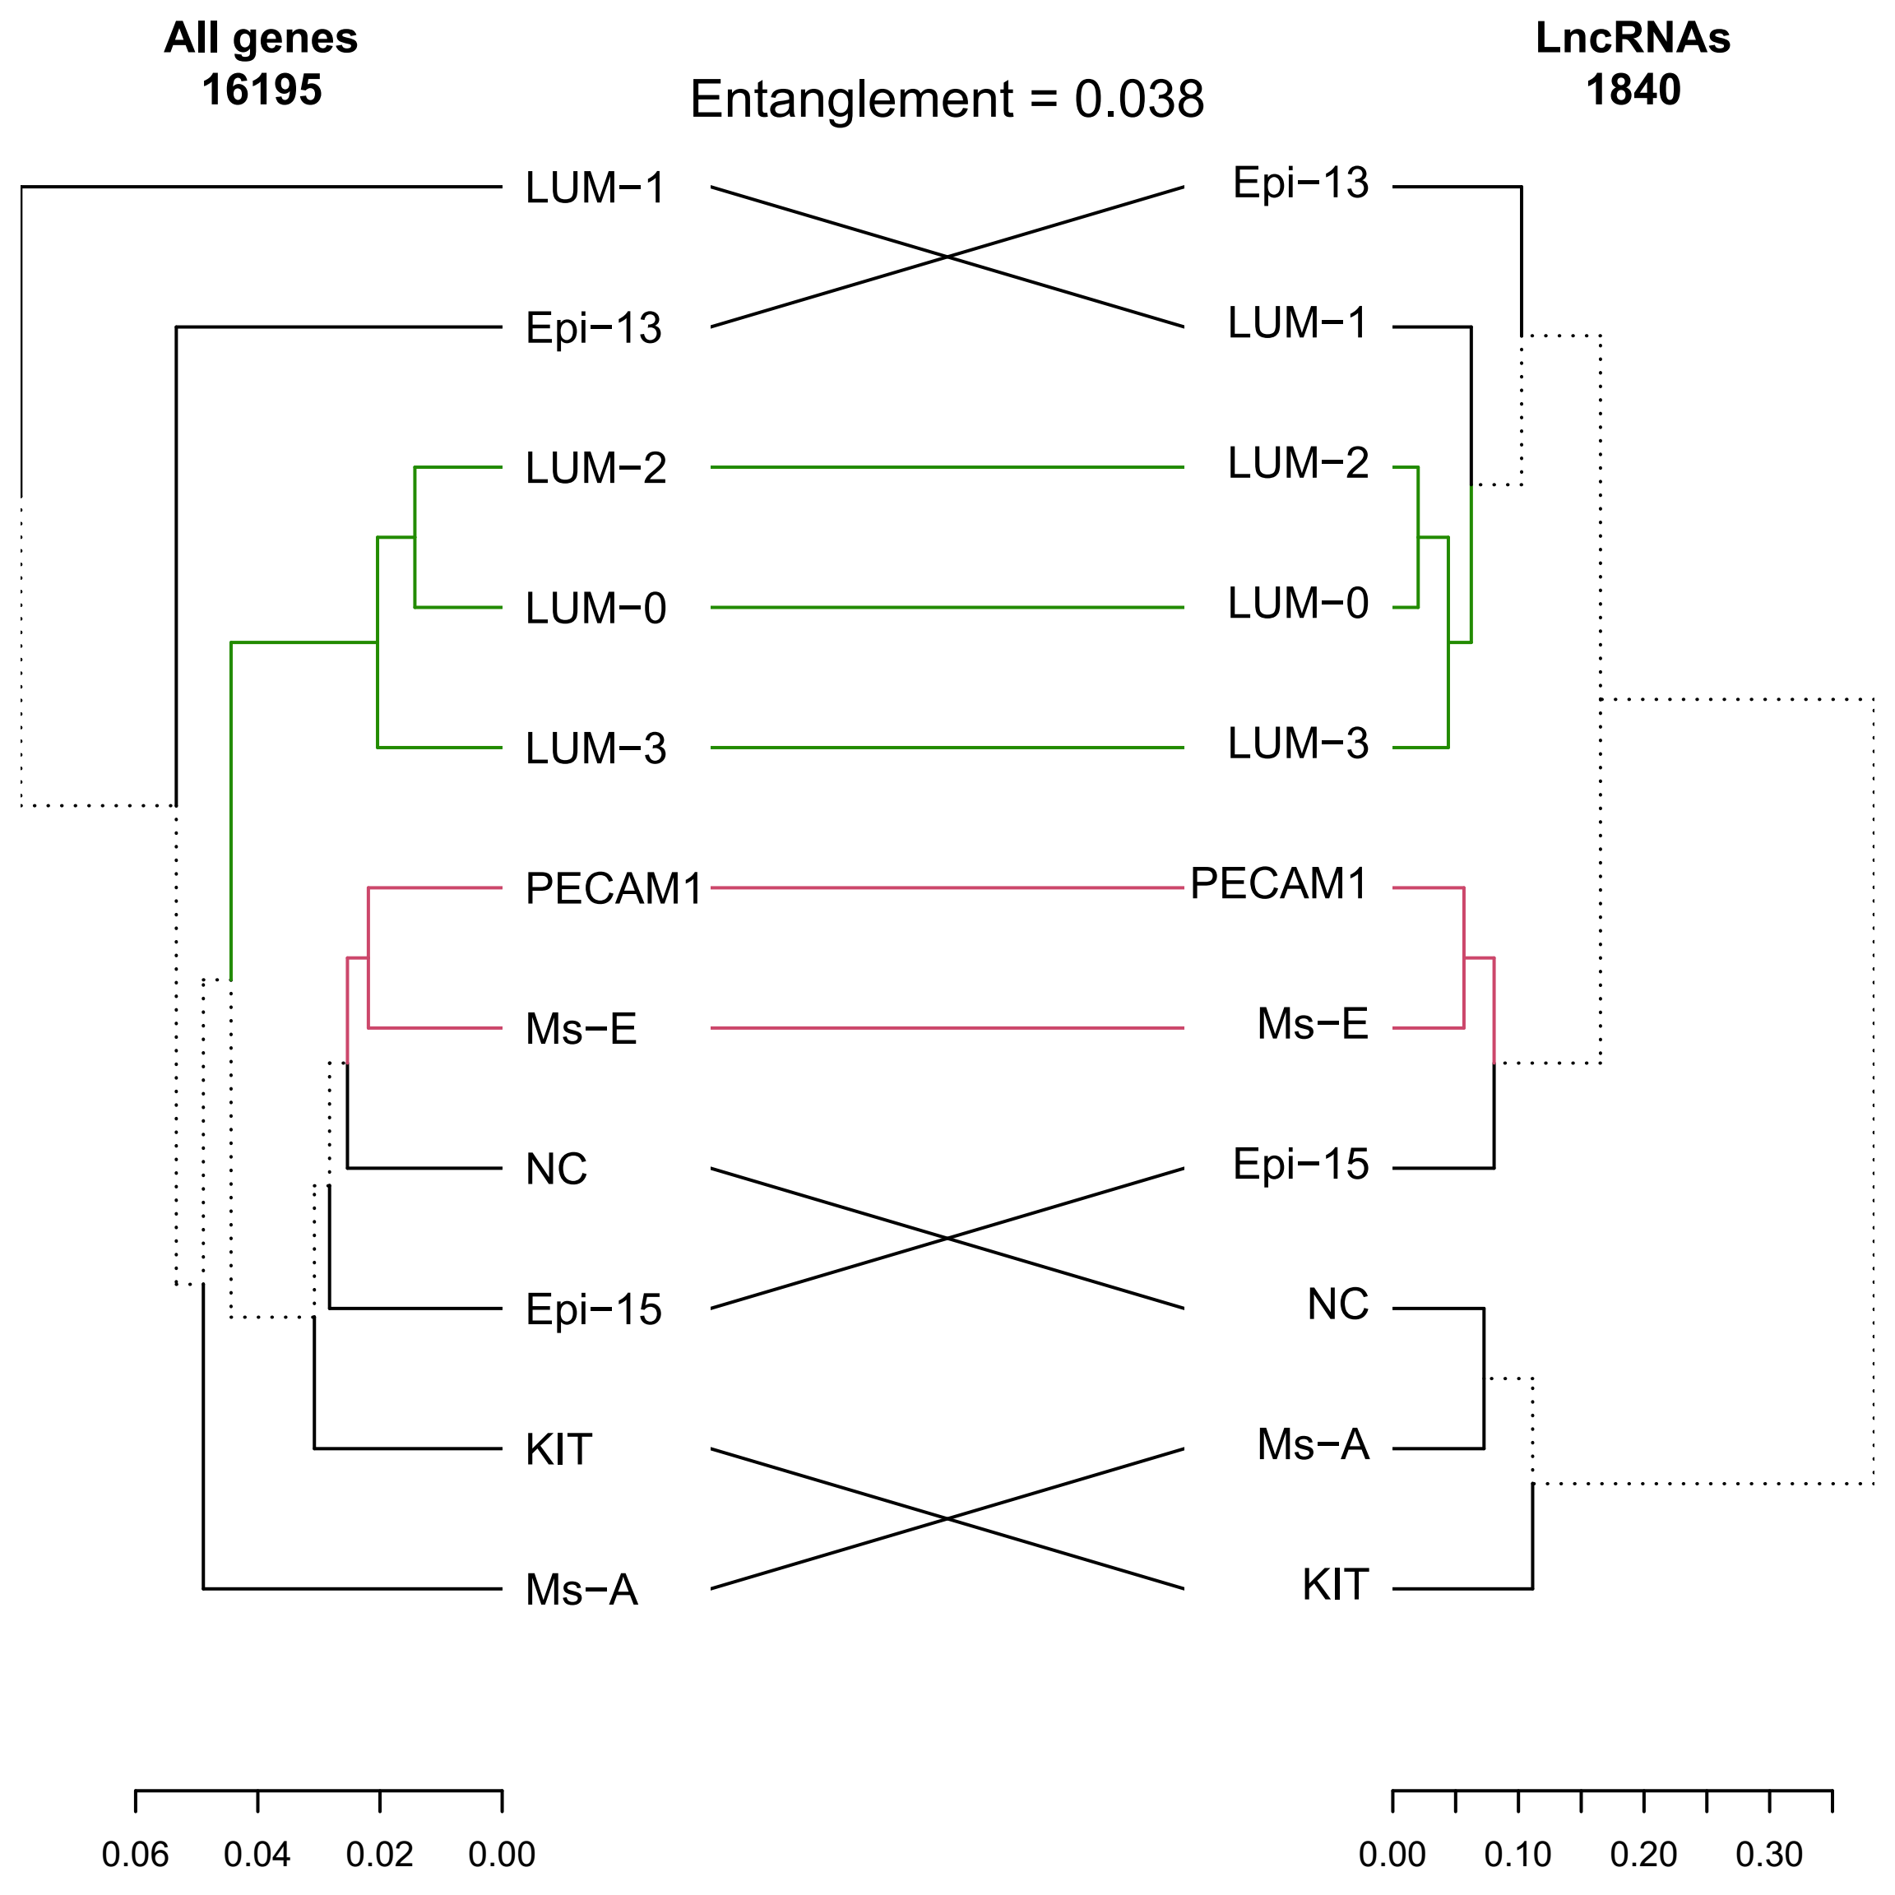
TFs don’t capture the pattern of the whole transcriptome
Notes:
100 target genes

Slide 13
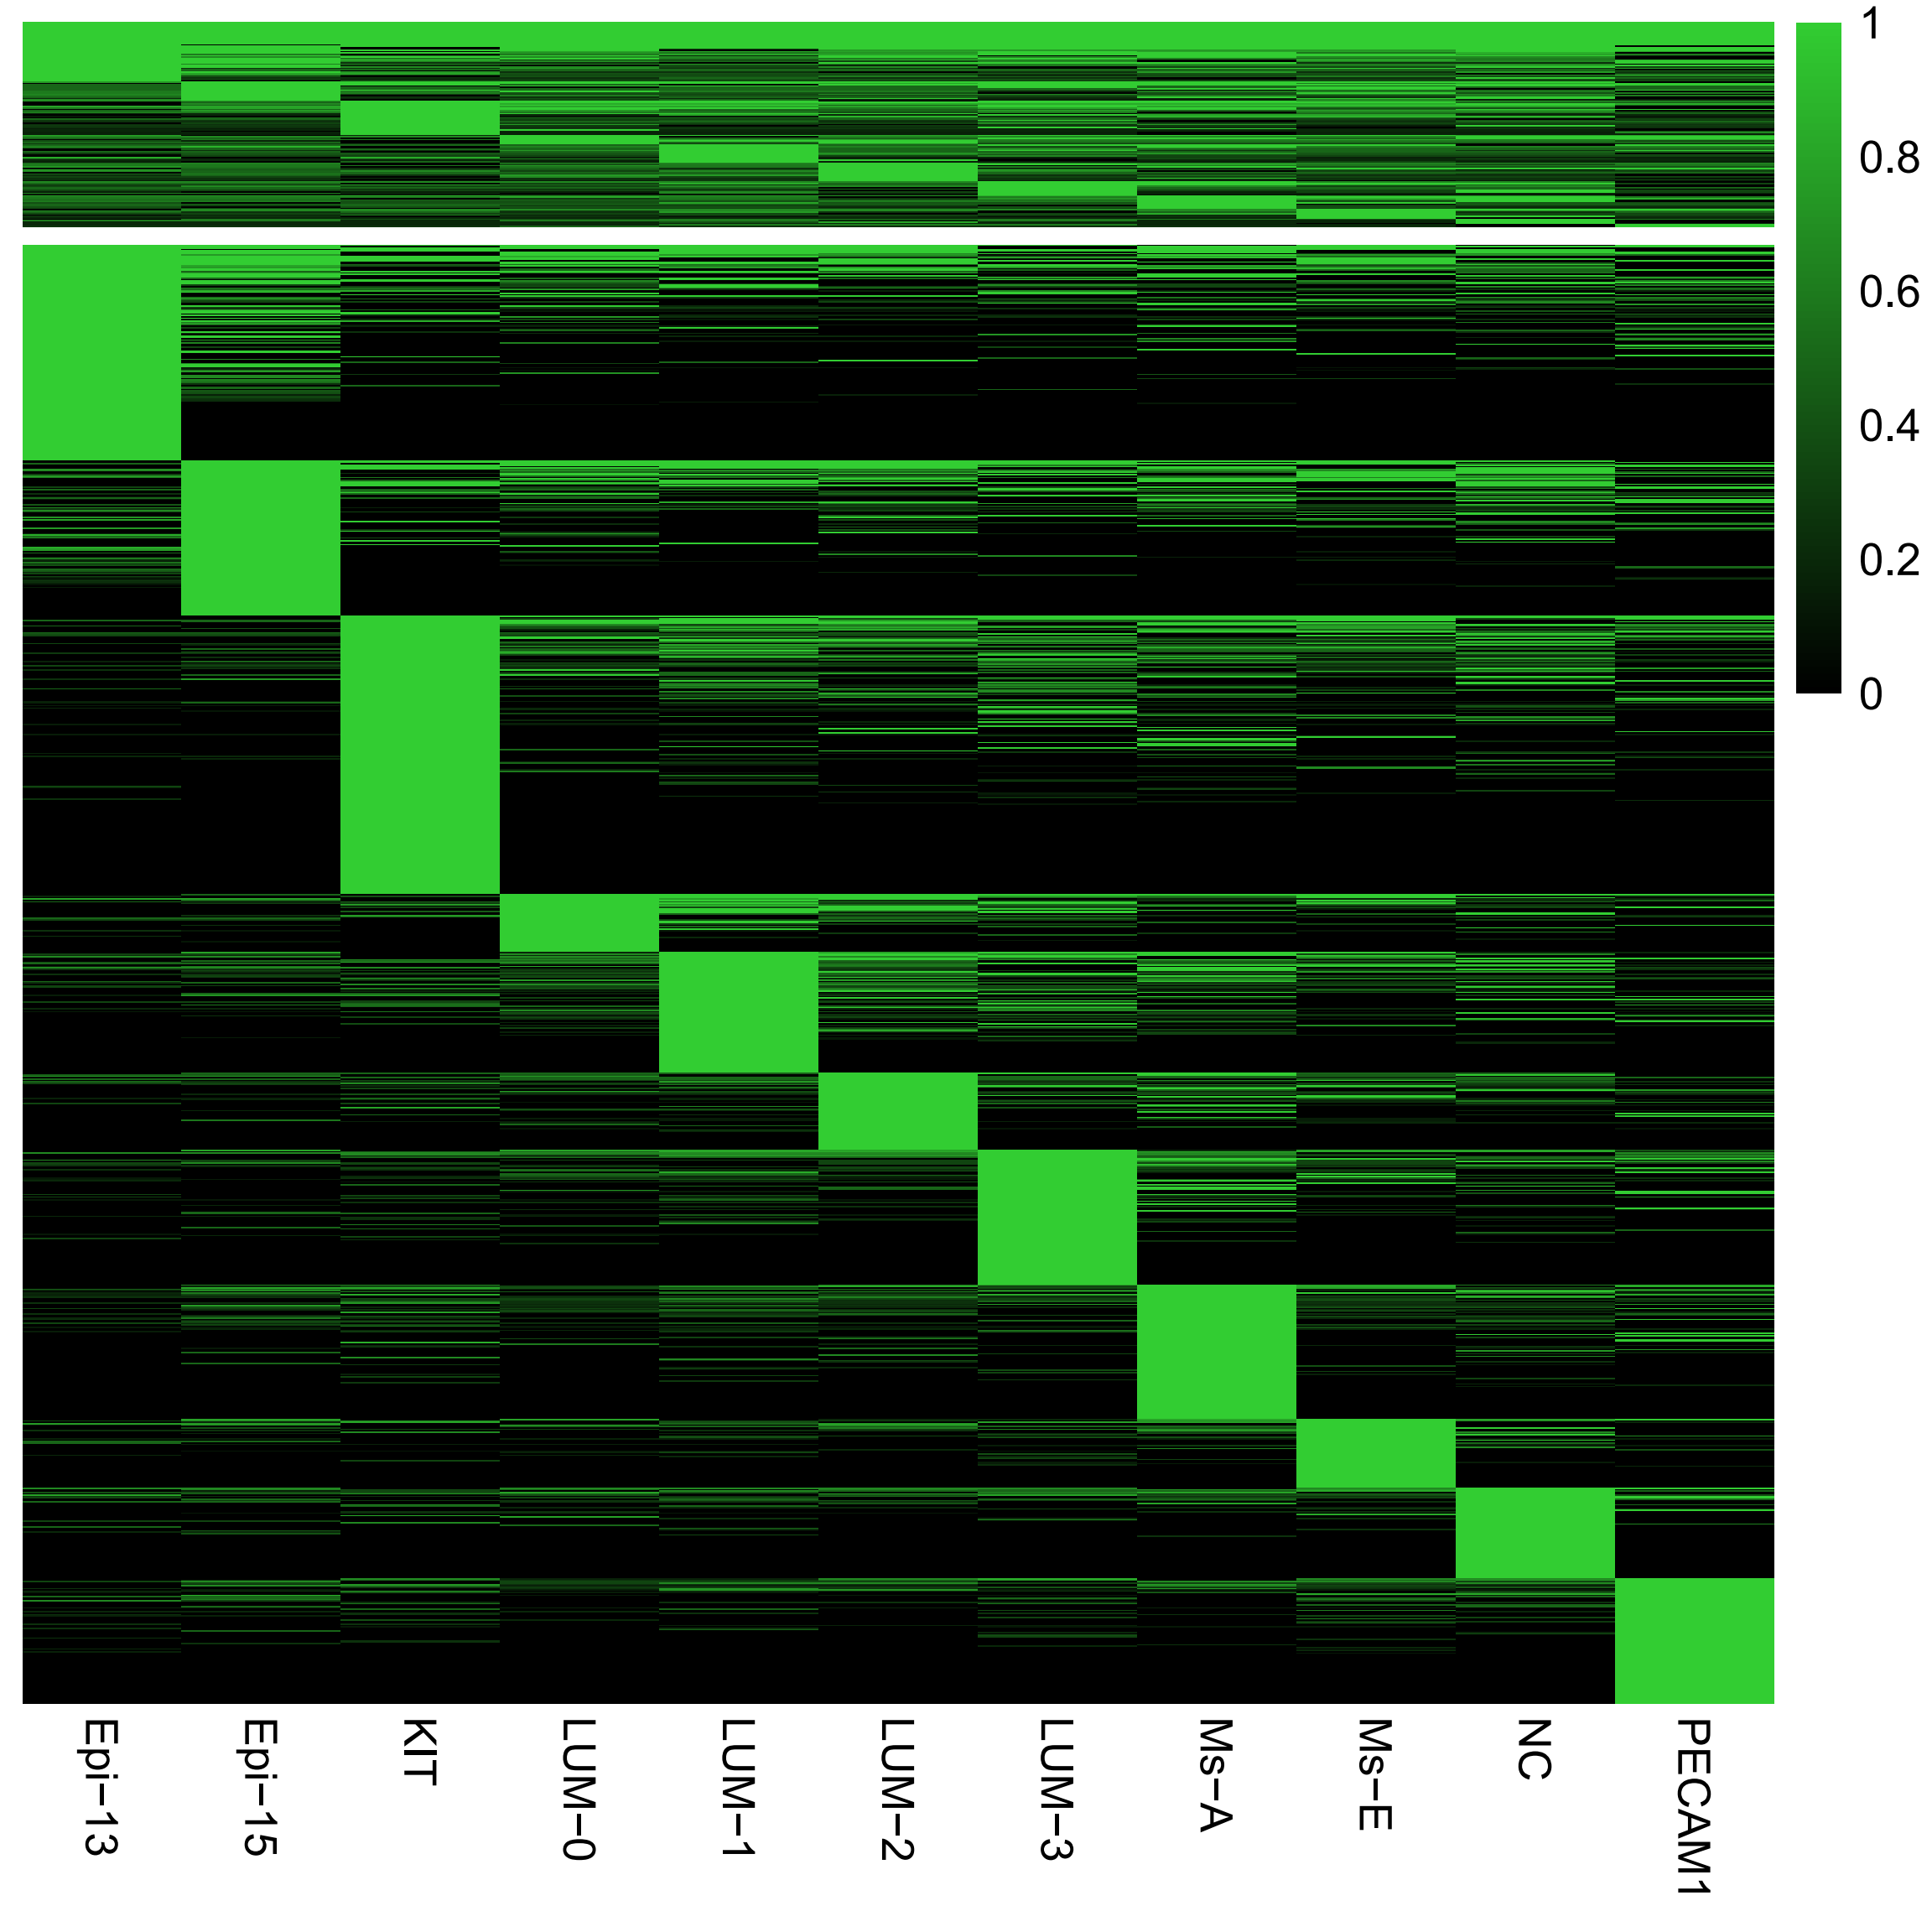
The two modes of transcriptional regulation
Divergent
Convergent
Transcription factors
Notes:
100 target genes

Slide 14
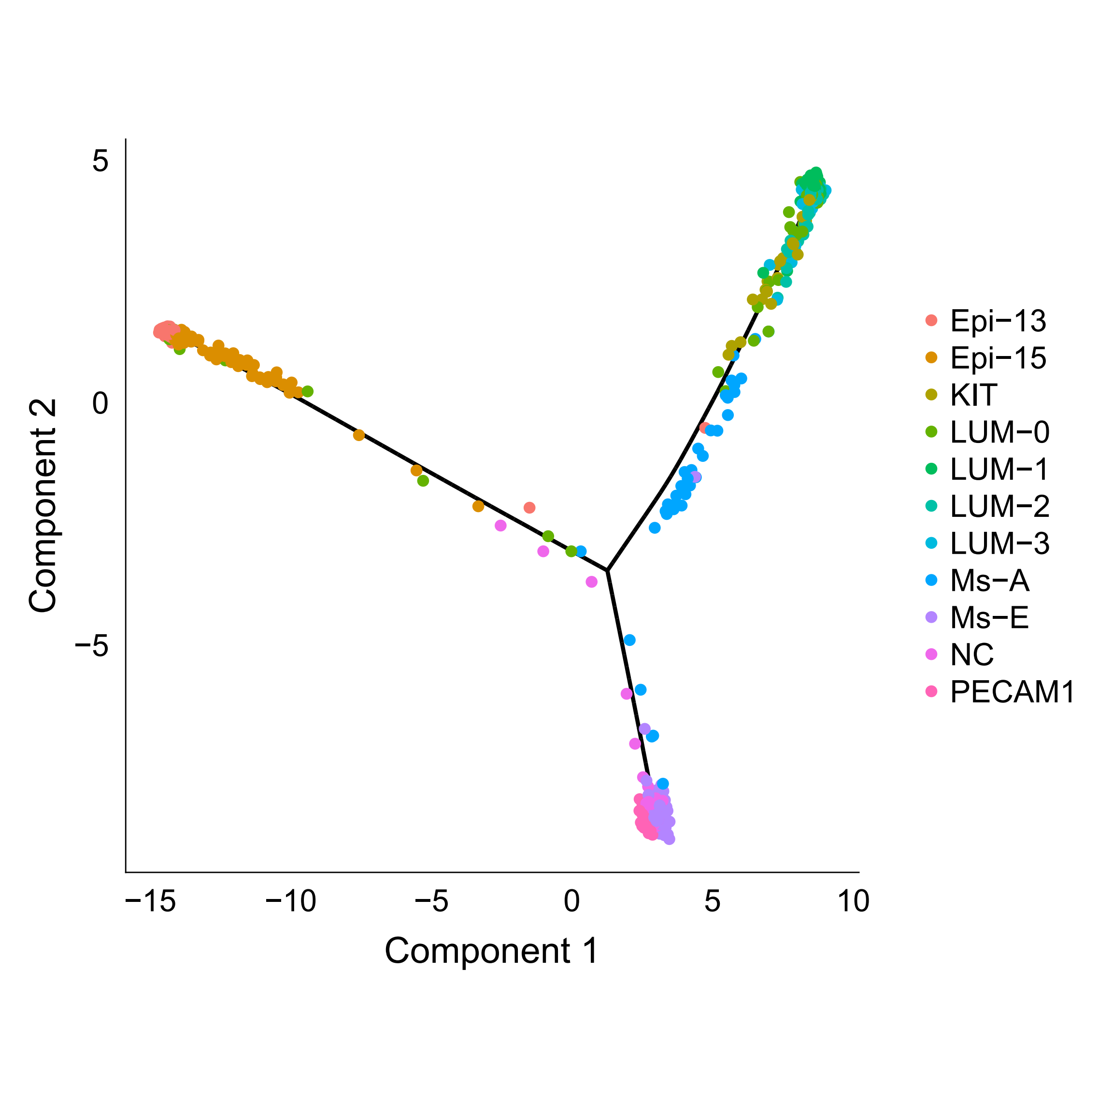
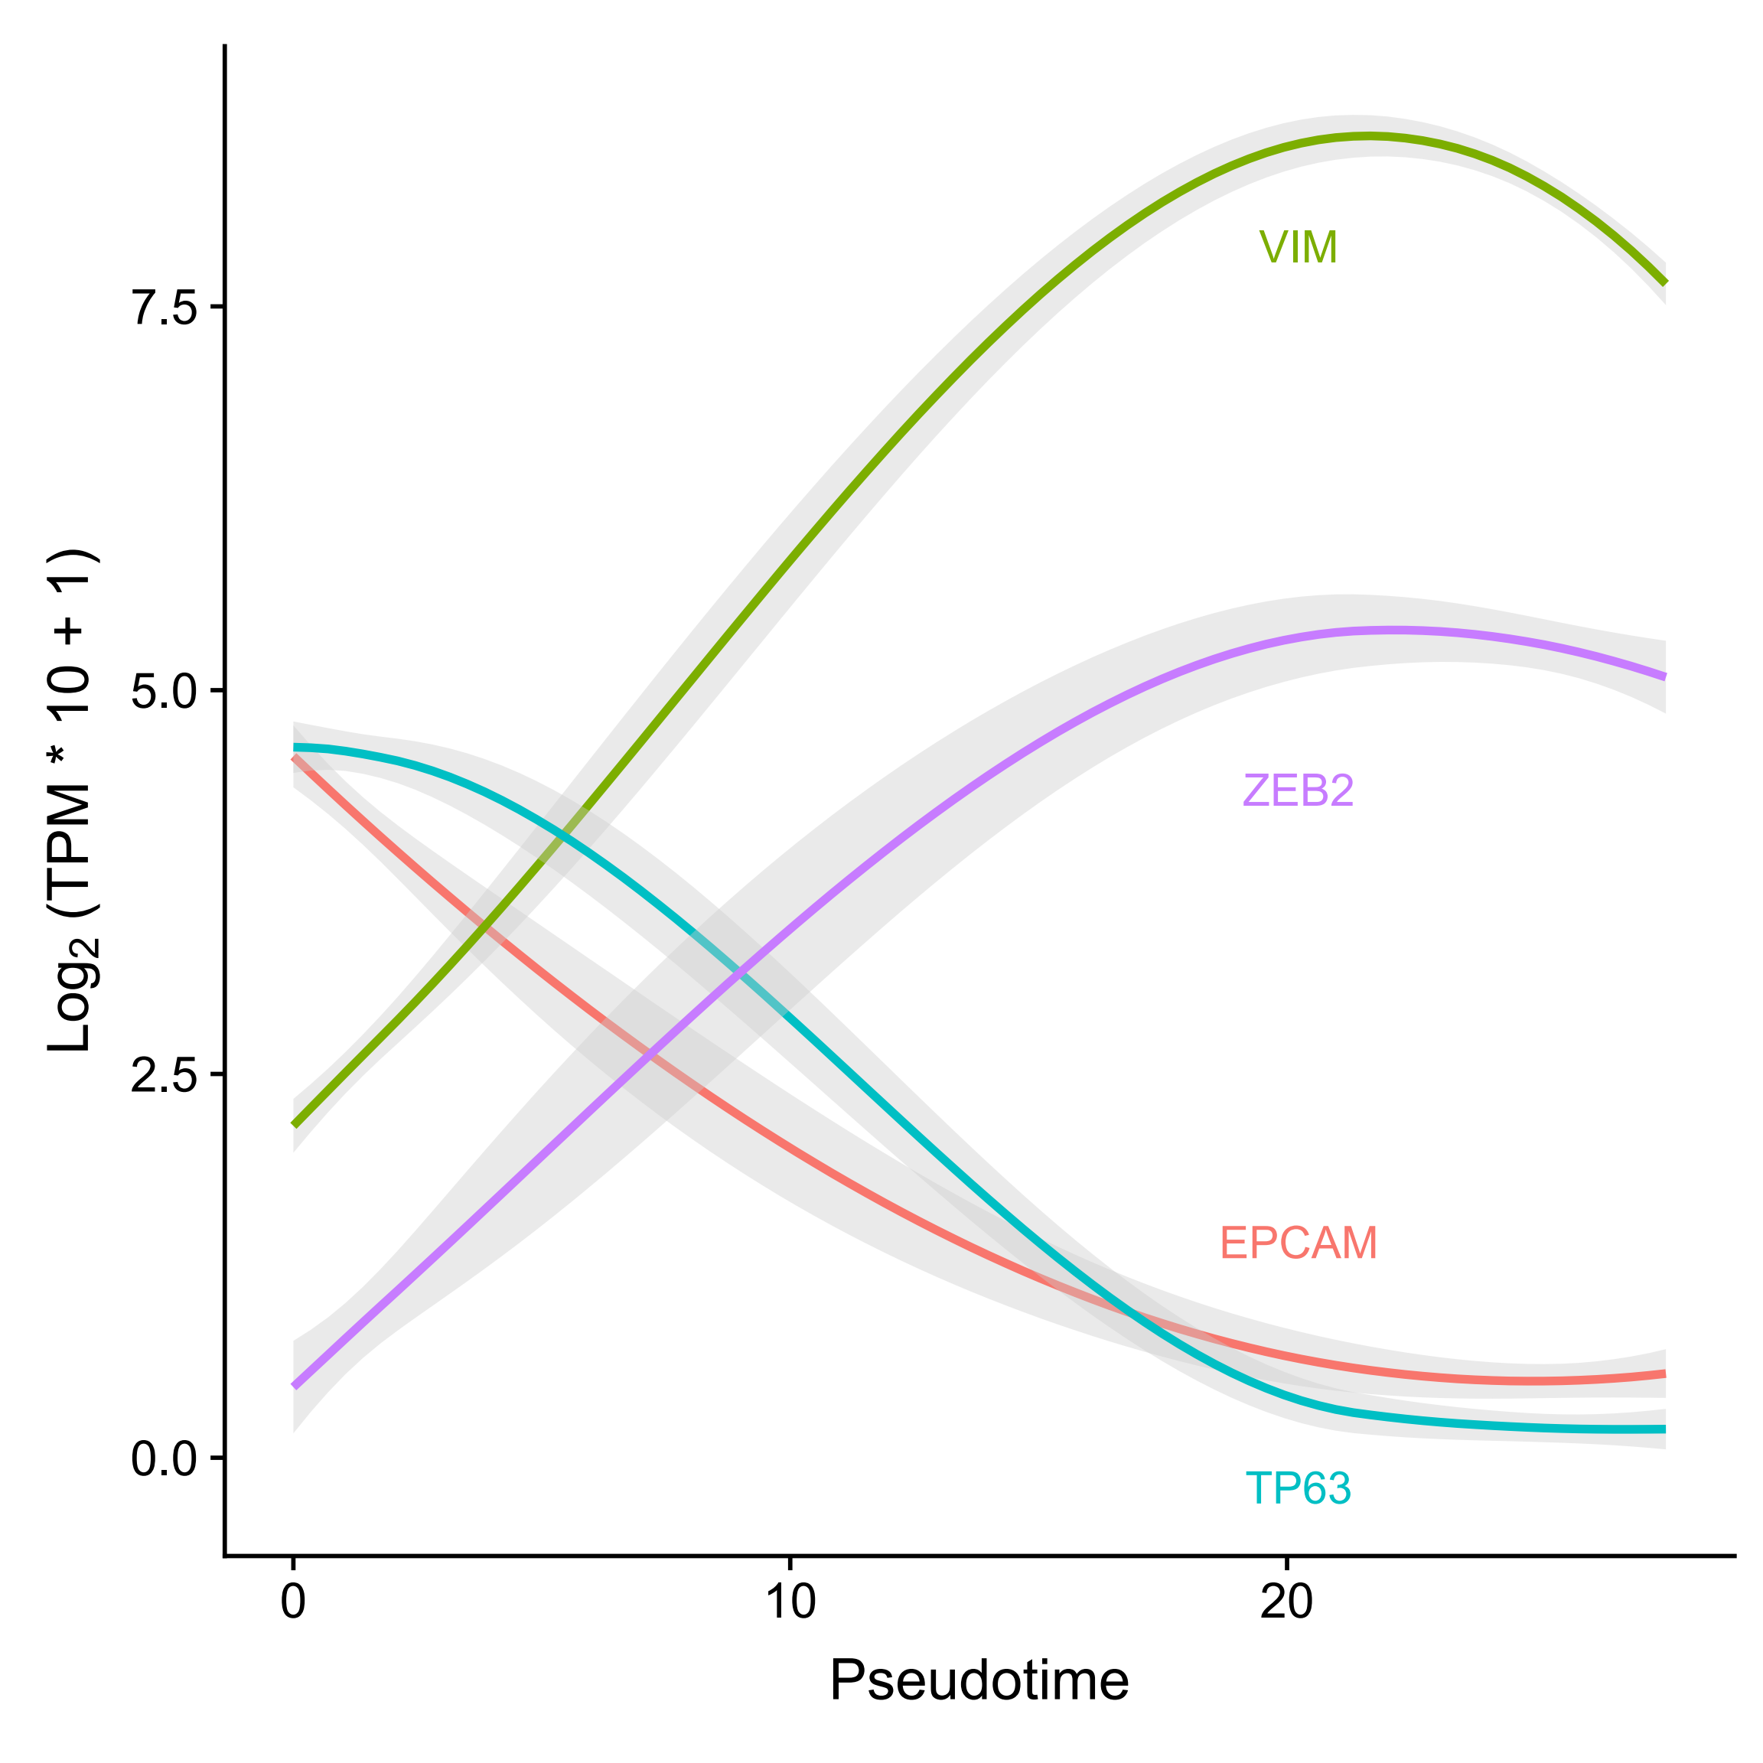
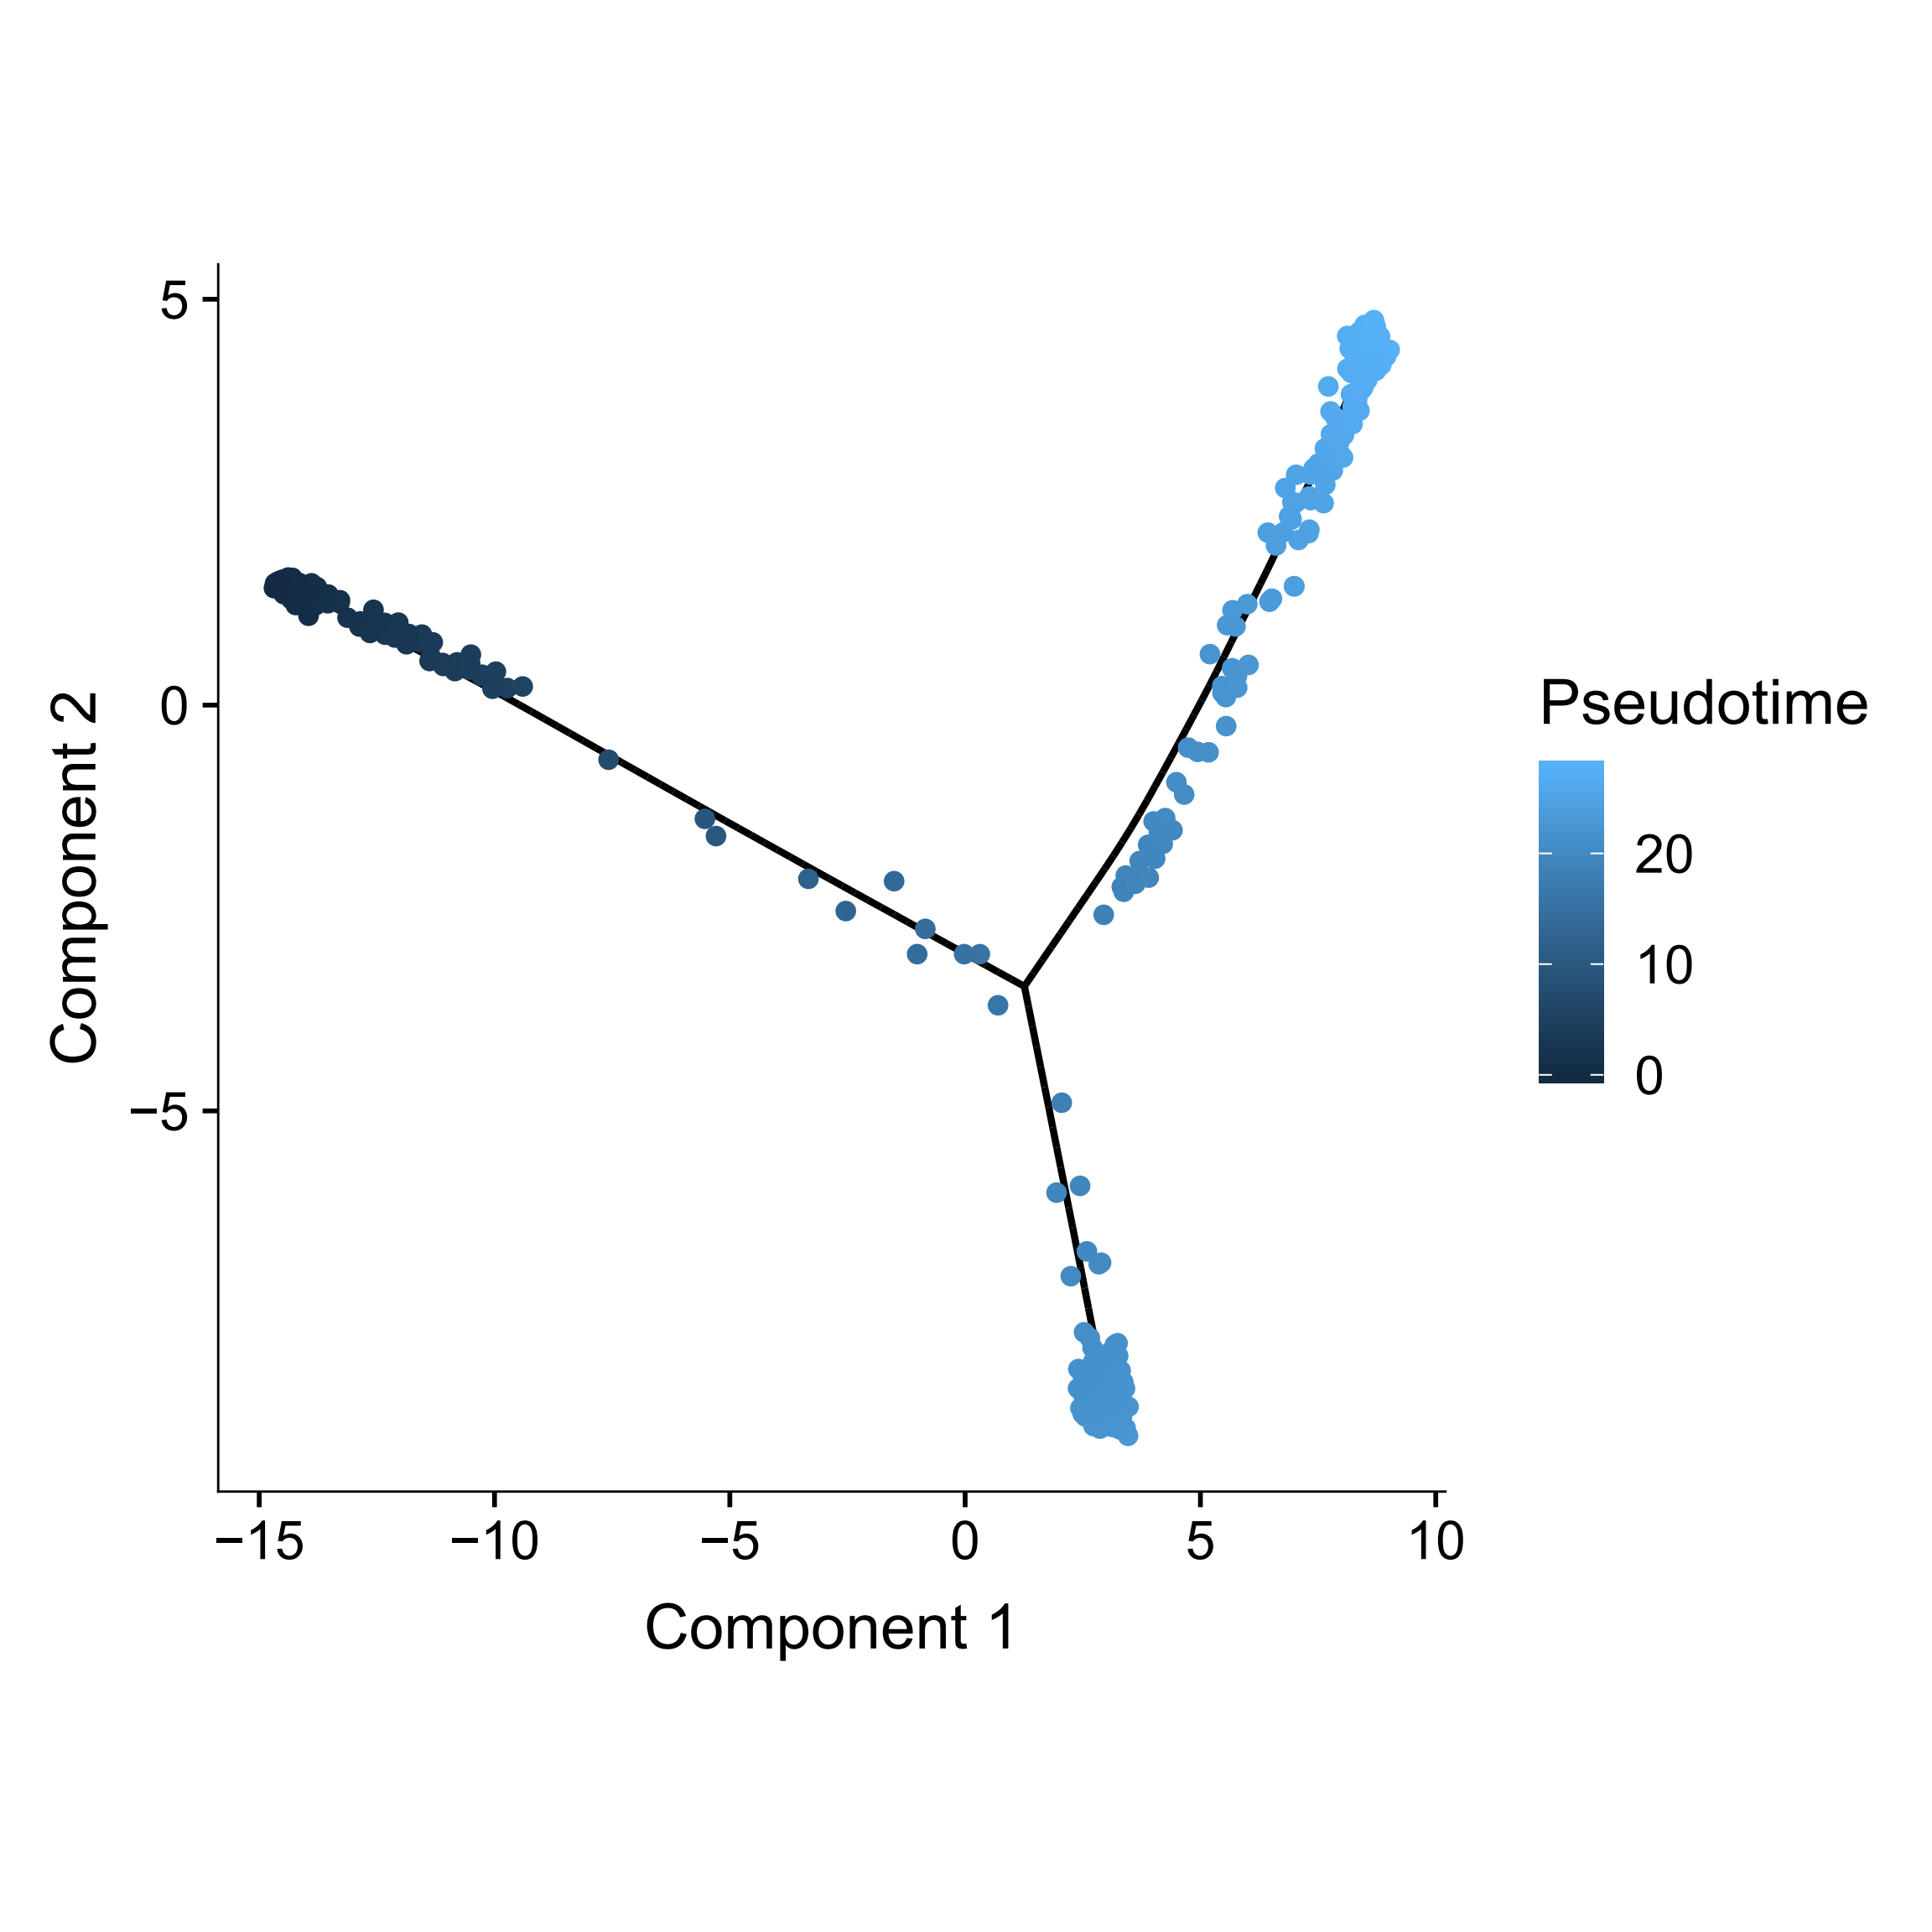
Spatial trajectory (epithelial-mesenchymal)
Epithelial <-> Mesenchymal
ZEB2 and TP63: The regulators of the epithelial-mesenchymal transition (EMT)
Vandewalle C et al., Nucleic Acids Res., 2005; Yoh KE et al., Proc Natl Acad Sci U S A. 2016

Slide 15
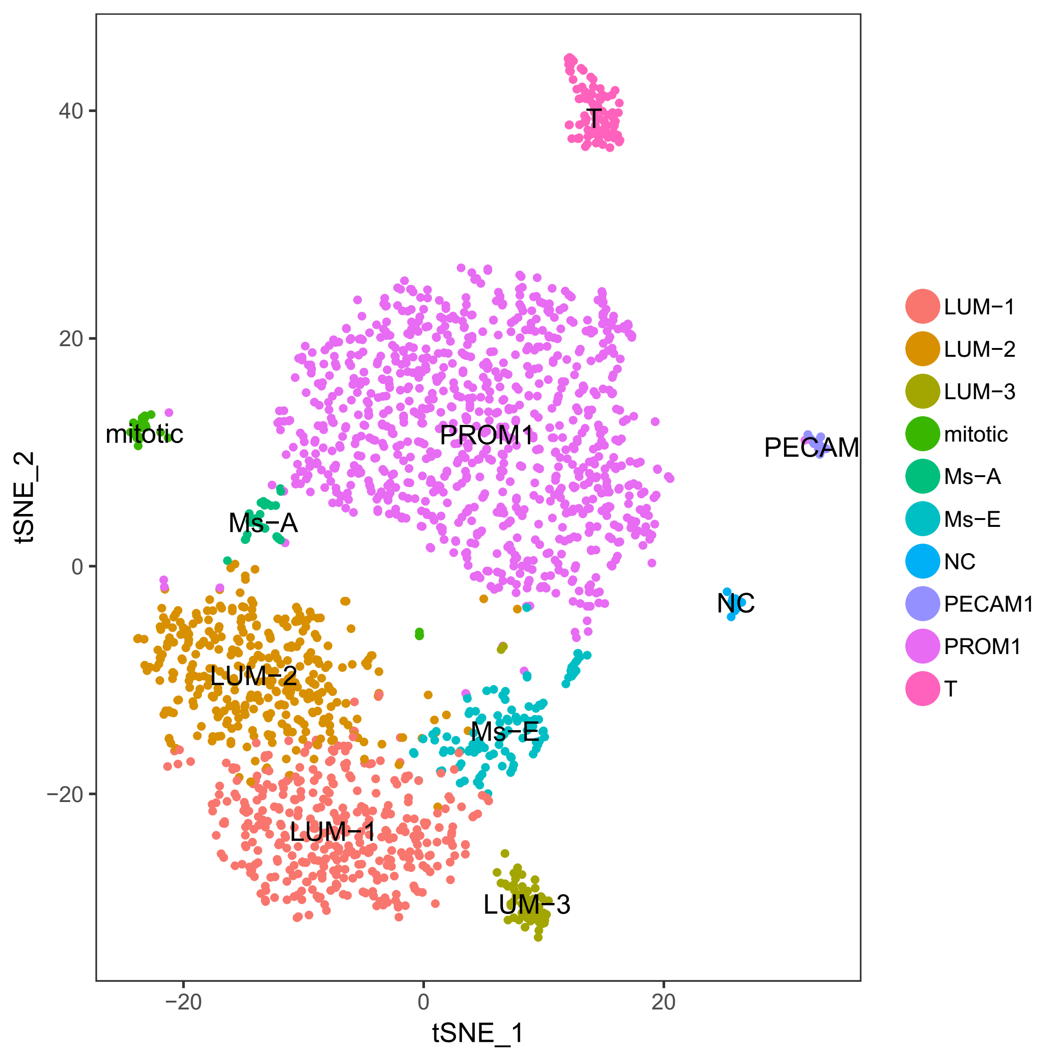
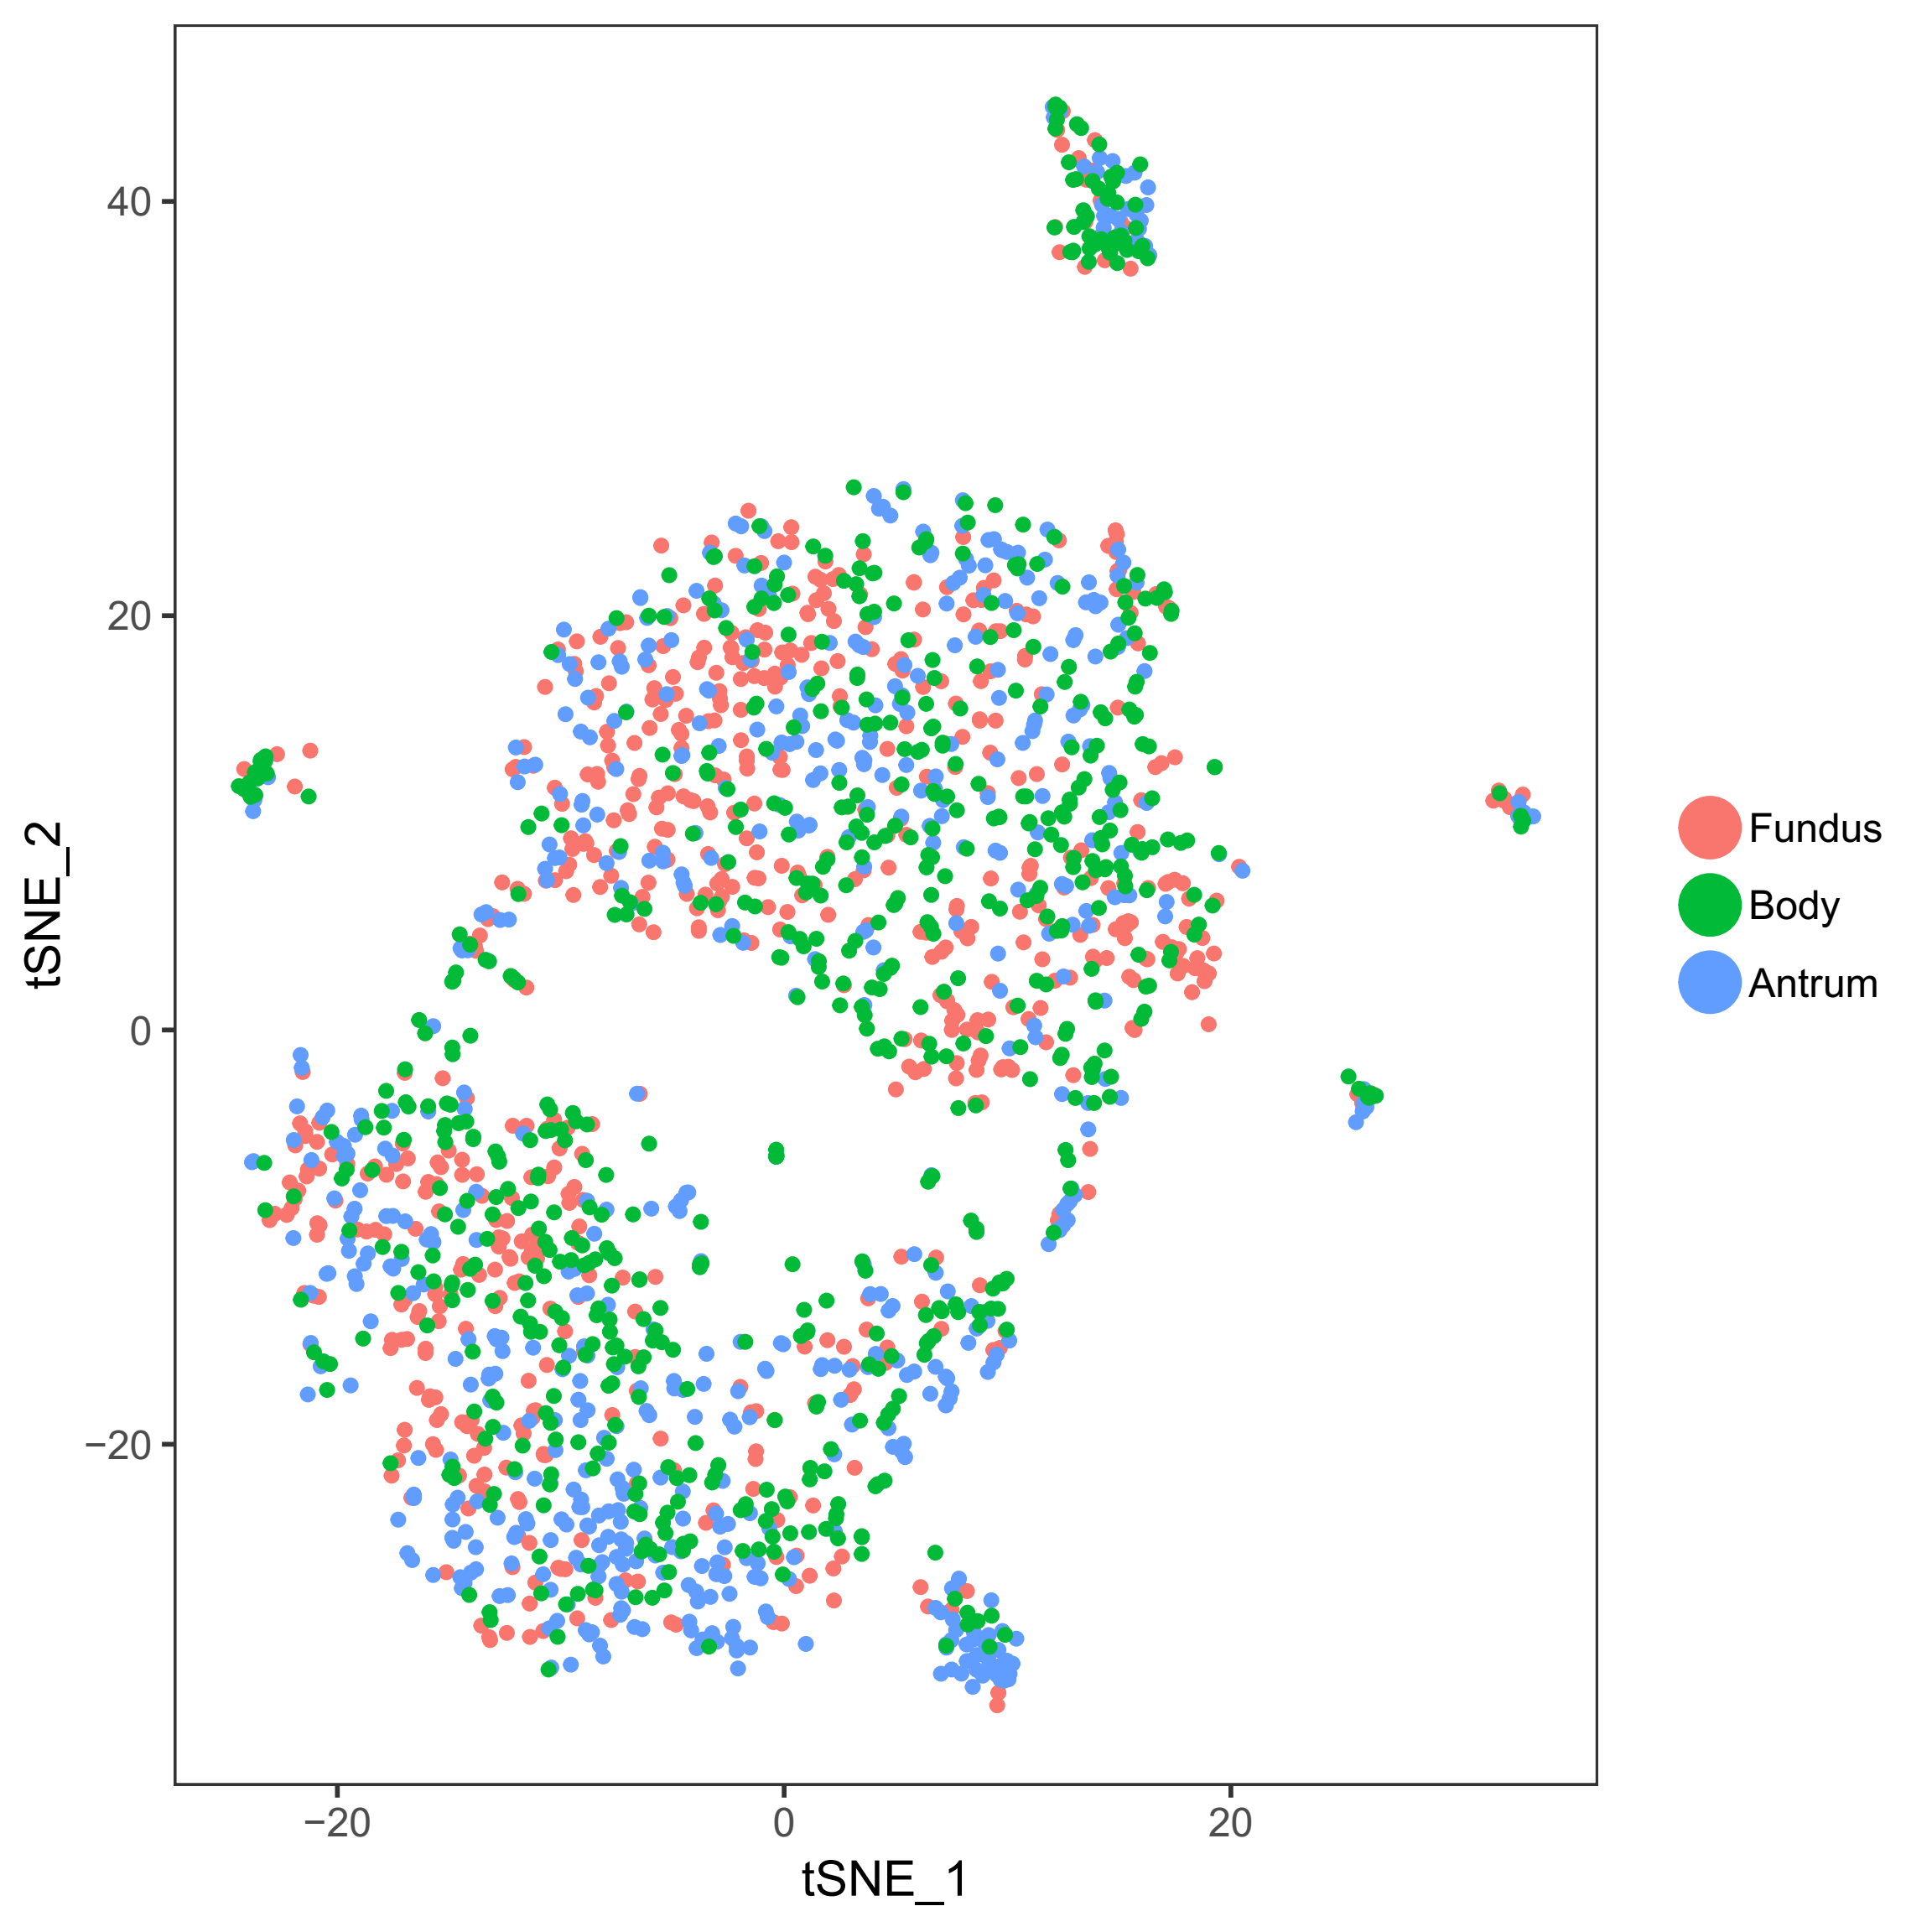
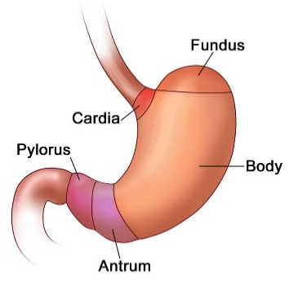
2. Stomach (胃)
There are 10 cell types for 1983 cells.
The stomach diagram chart is downloaded from https://courses.lumenlearning.com.

Slide 16
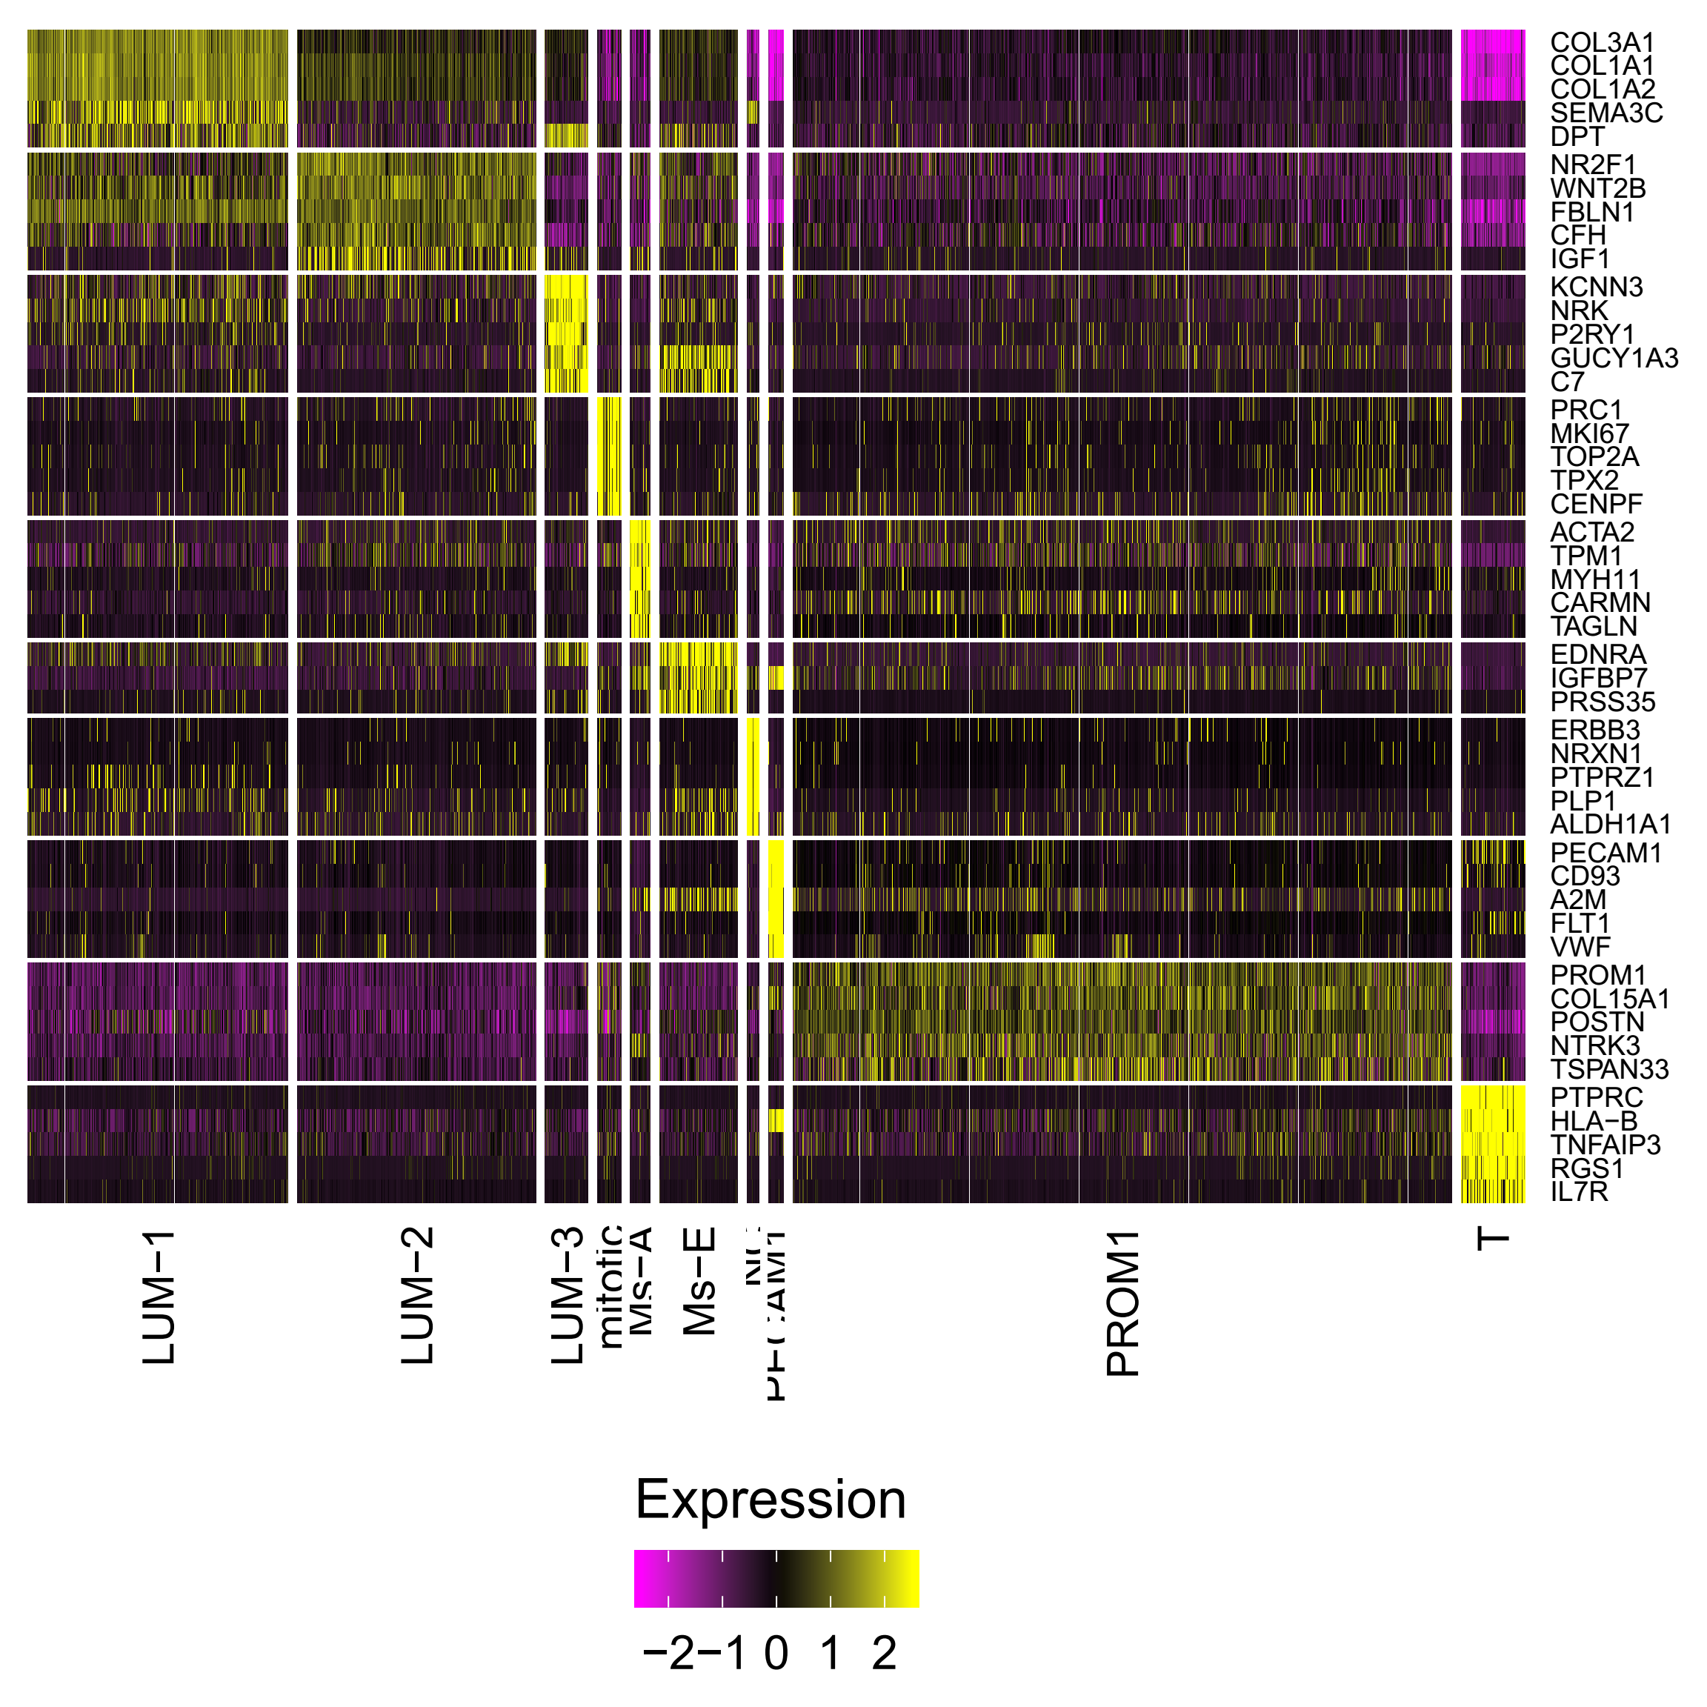
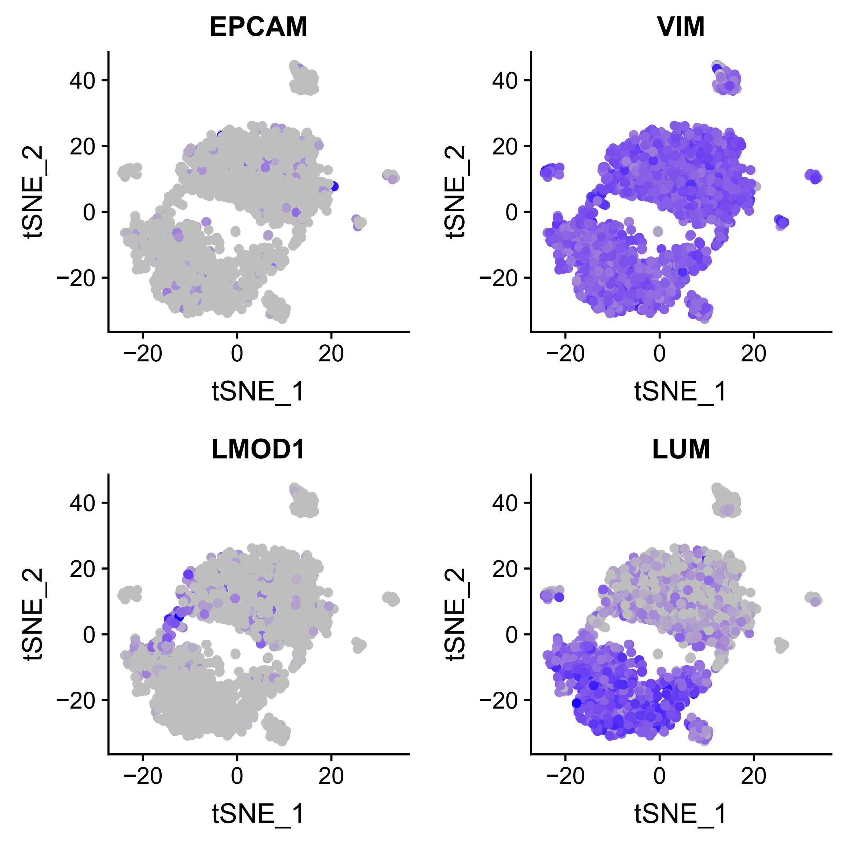
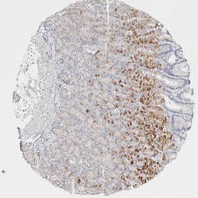
Expression of signature genes
EPCAM
The staining figure was downloaded from HPA.

Slide 17
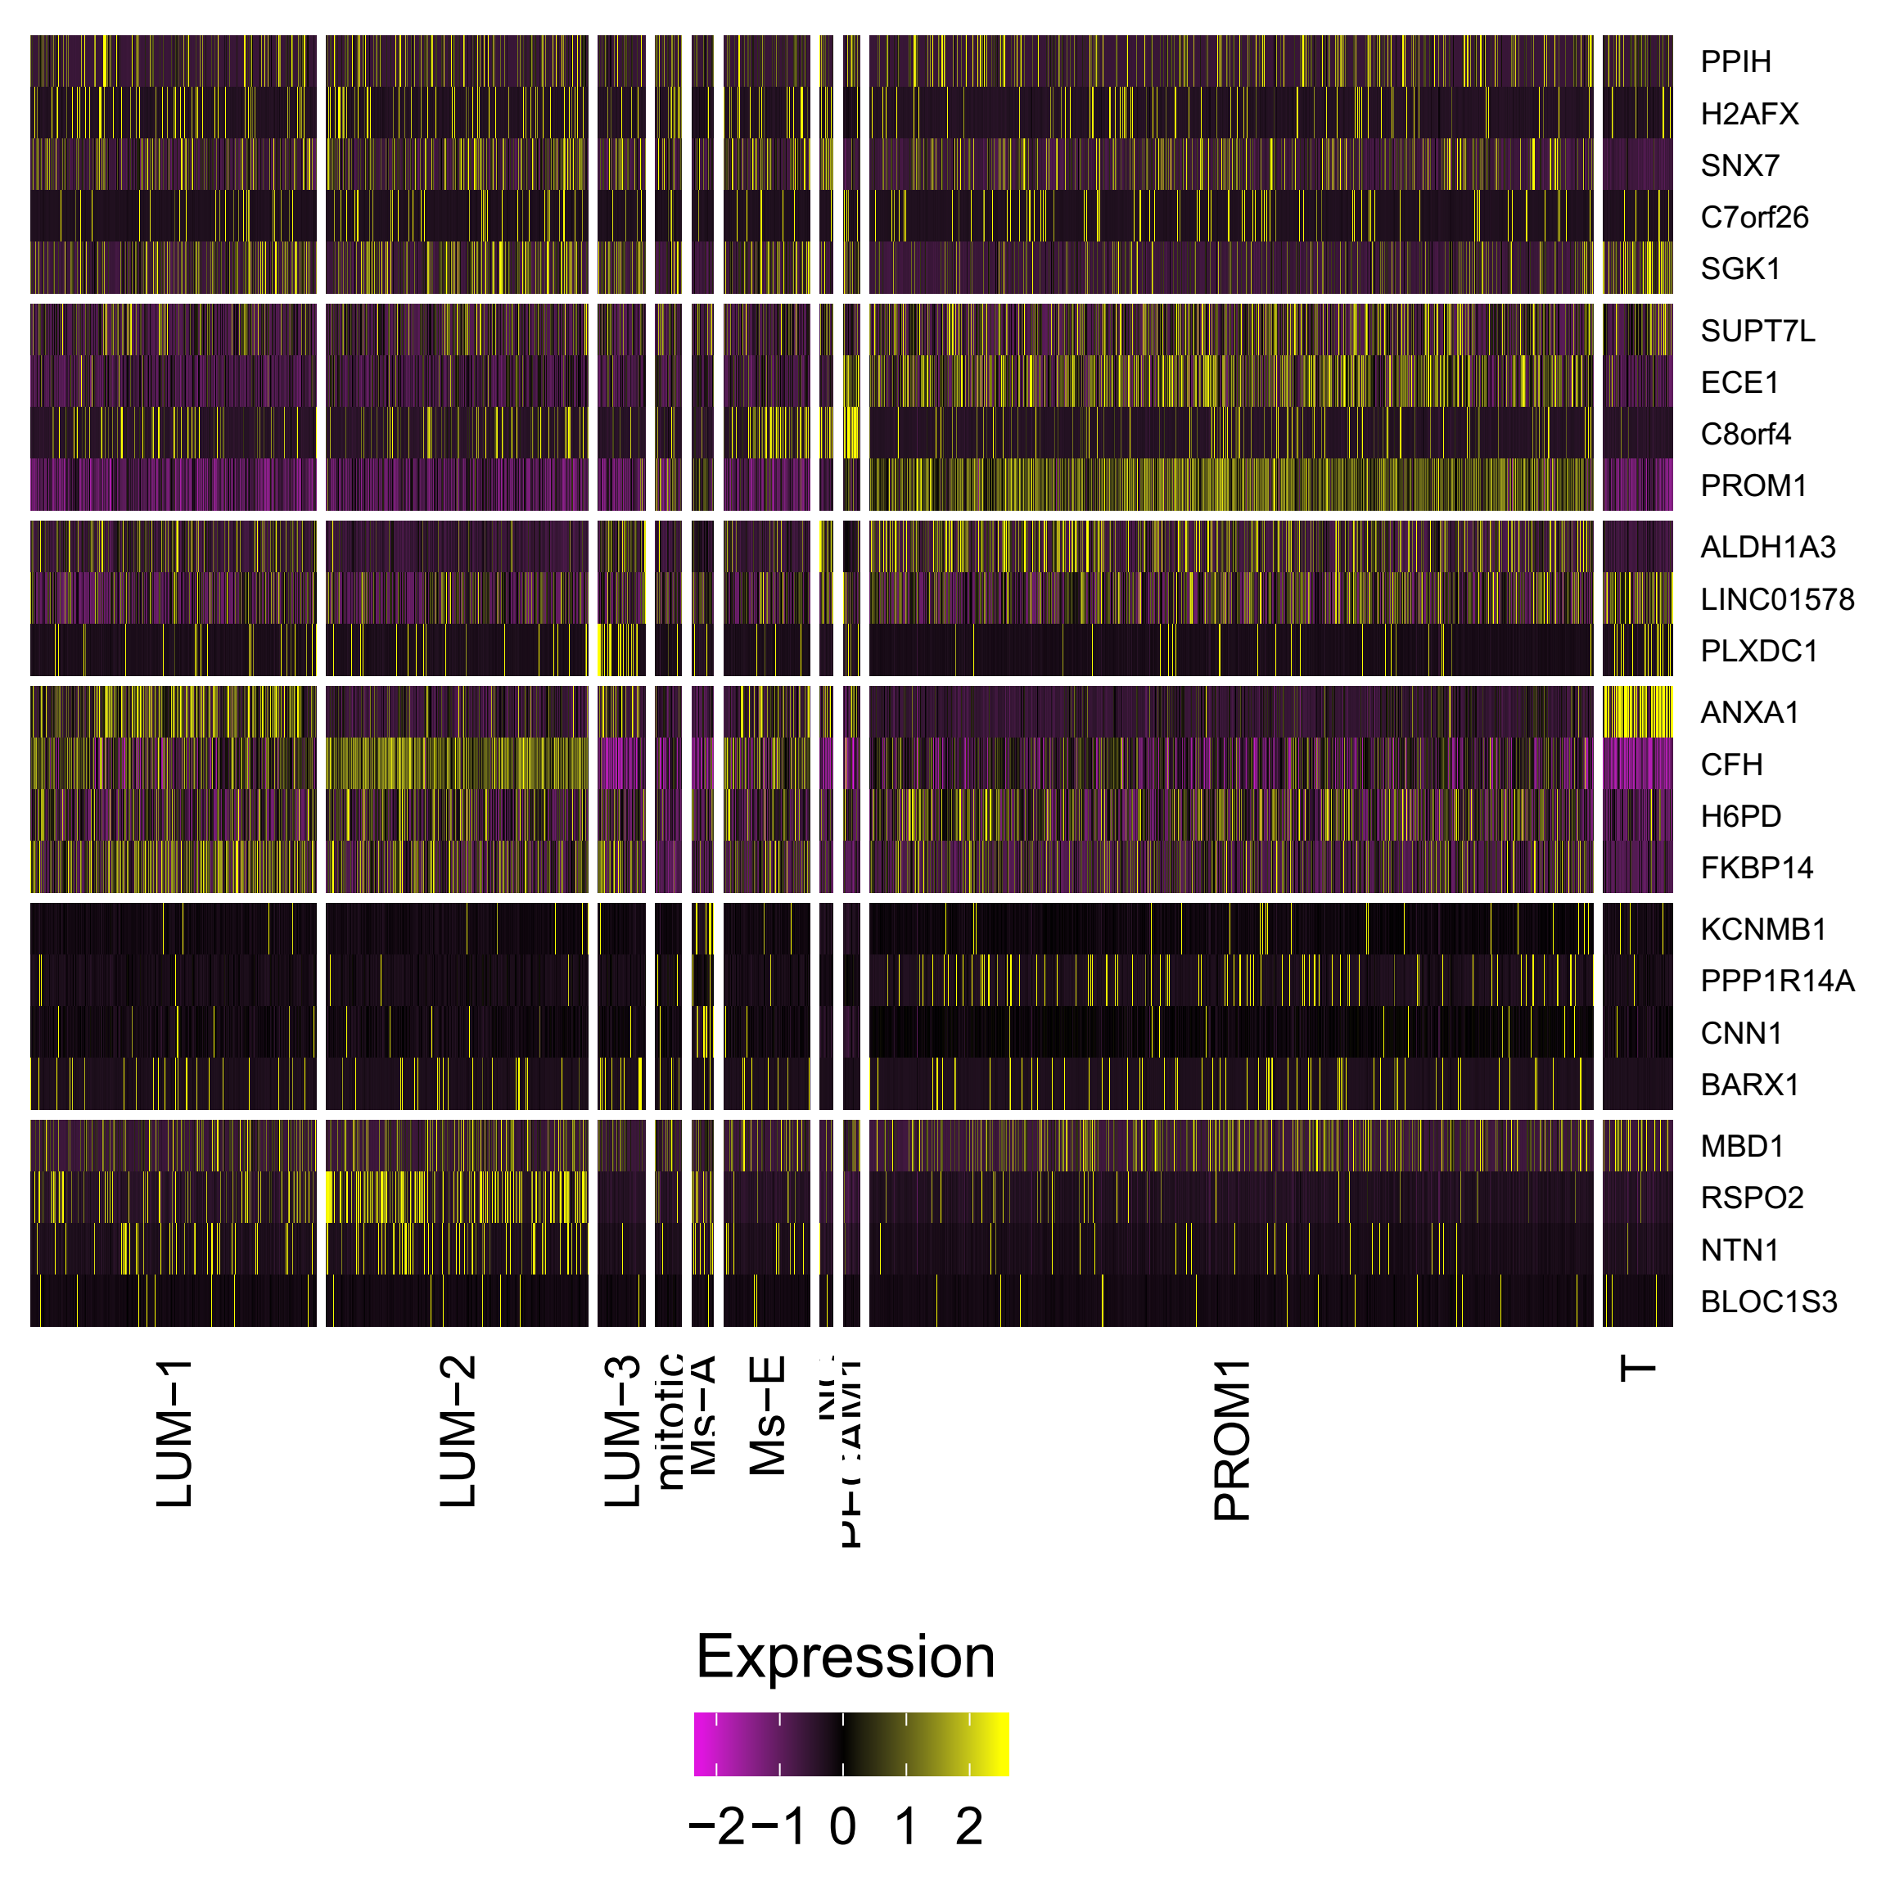
Comparison of cell types in the previous work
Gao S et al., Nat Cell Biol, 2018

Slide 18
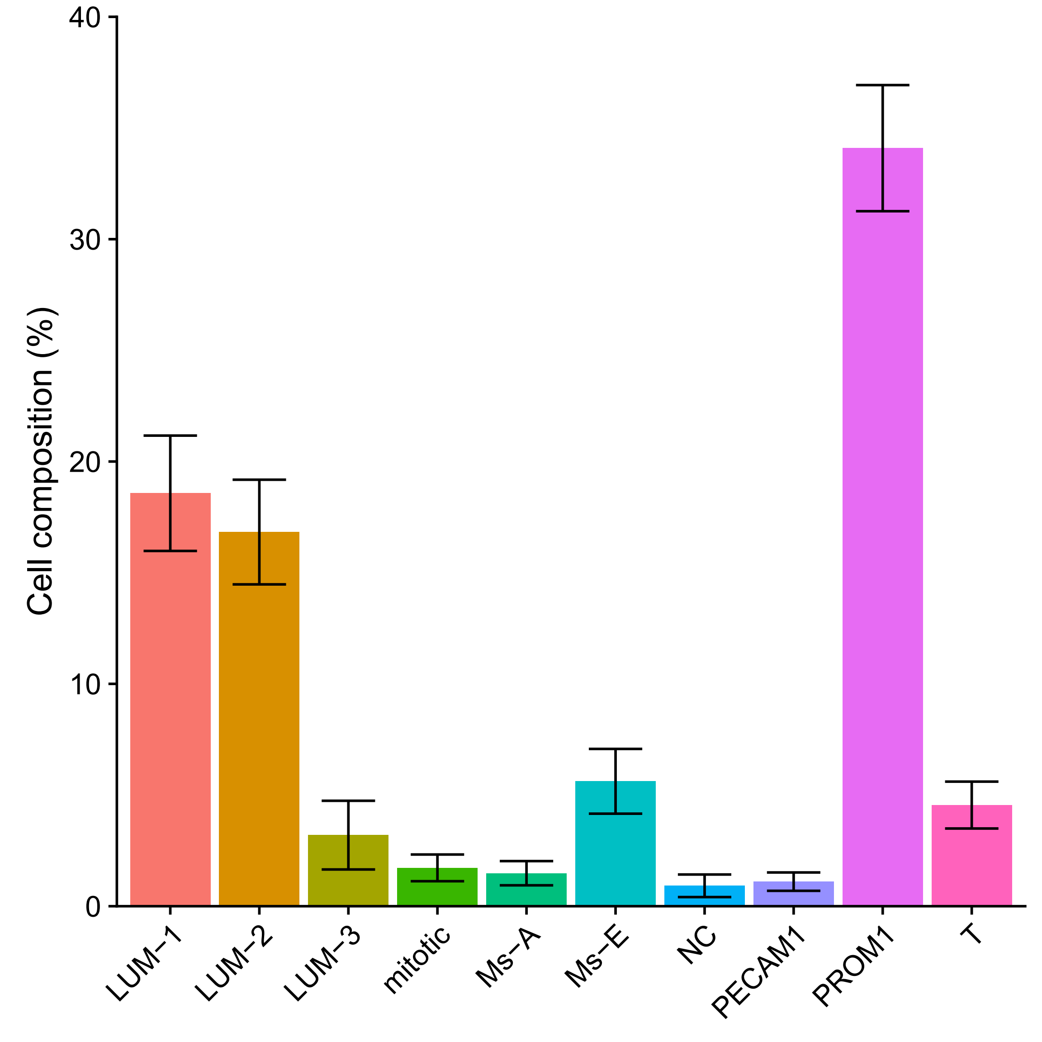
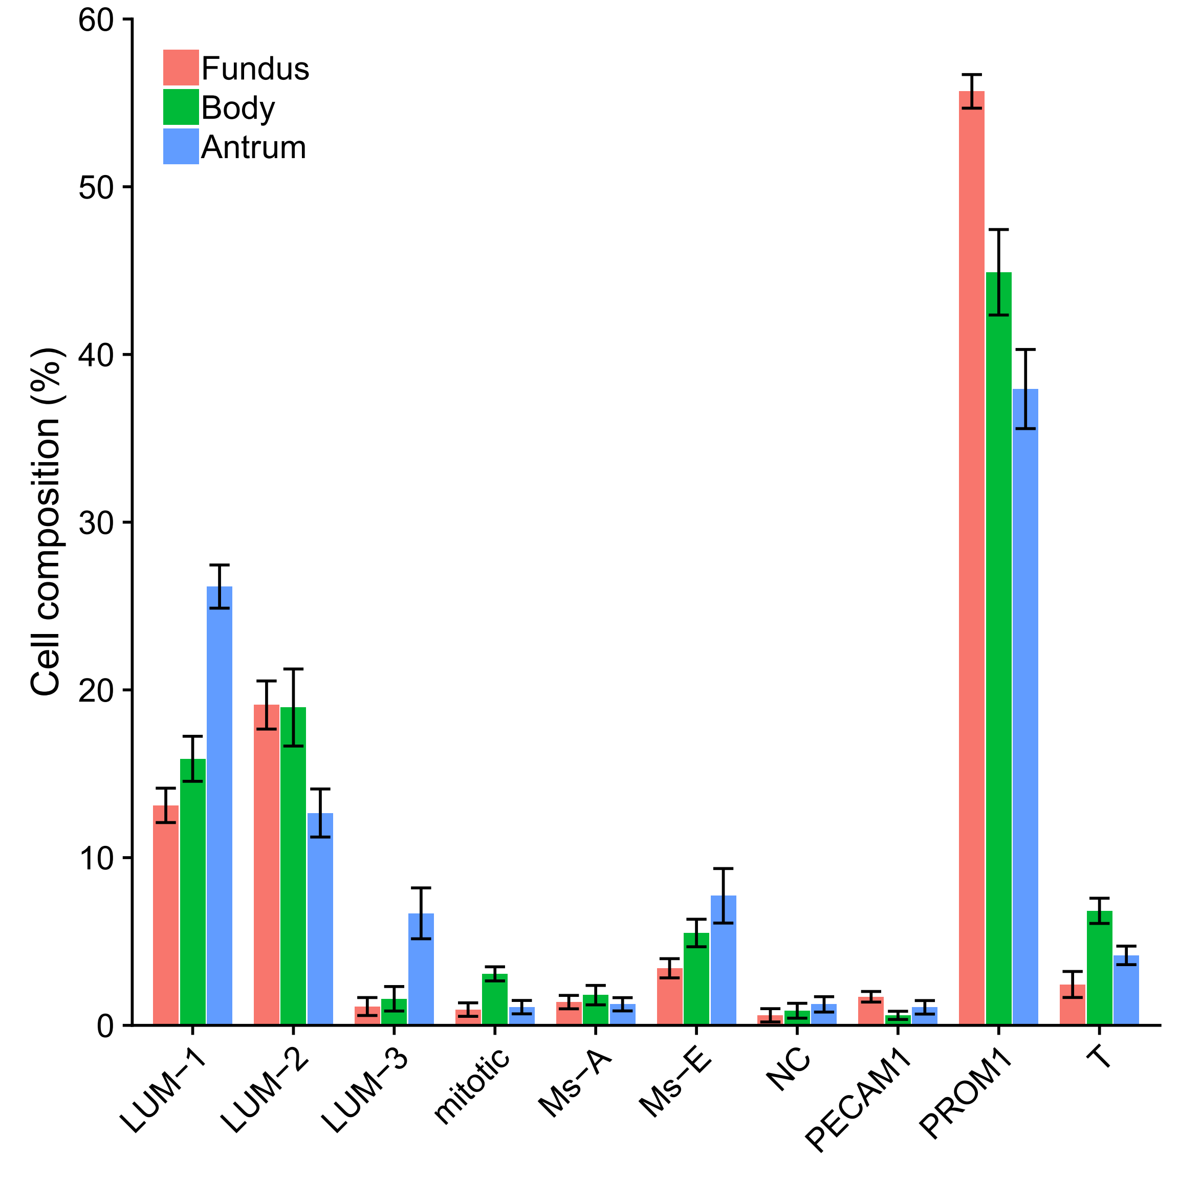
Cell type composition
PROM1⁺ cells are the major cells in stomach.
Different cell types showed distinct distribution in stomach regions.

Slide 19
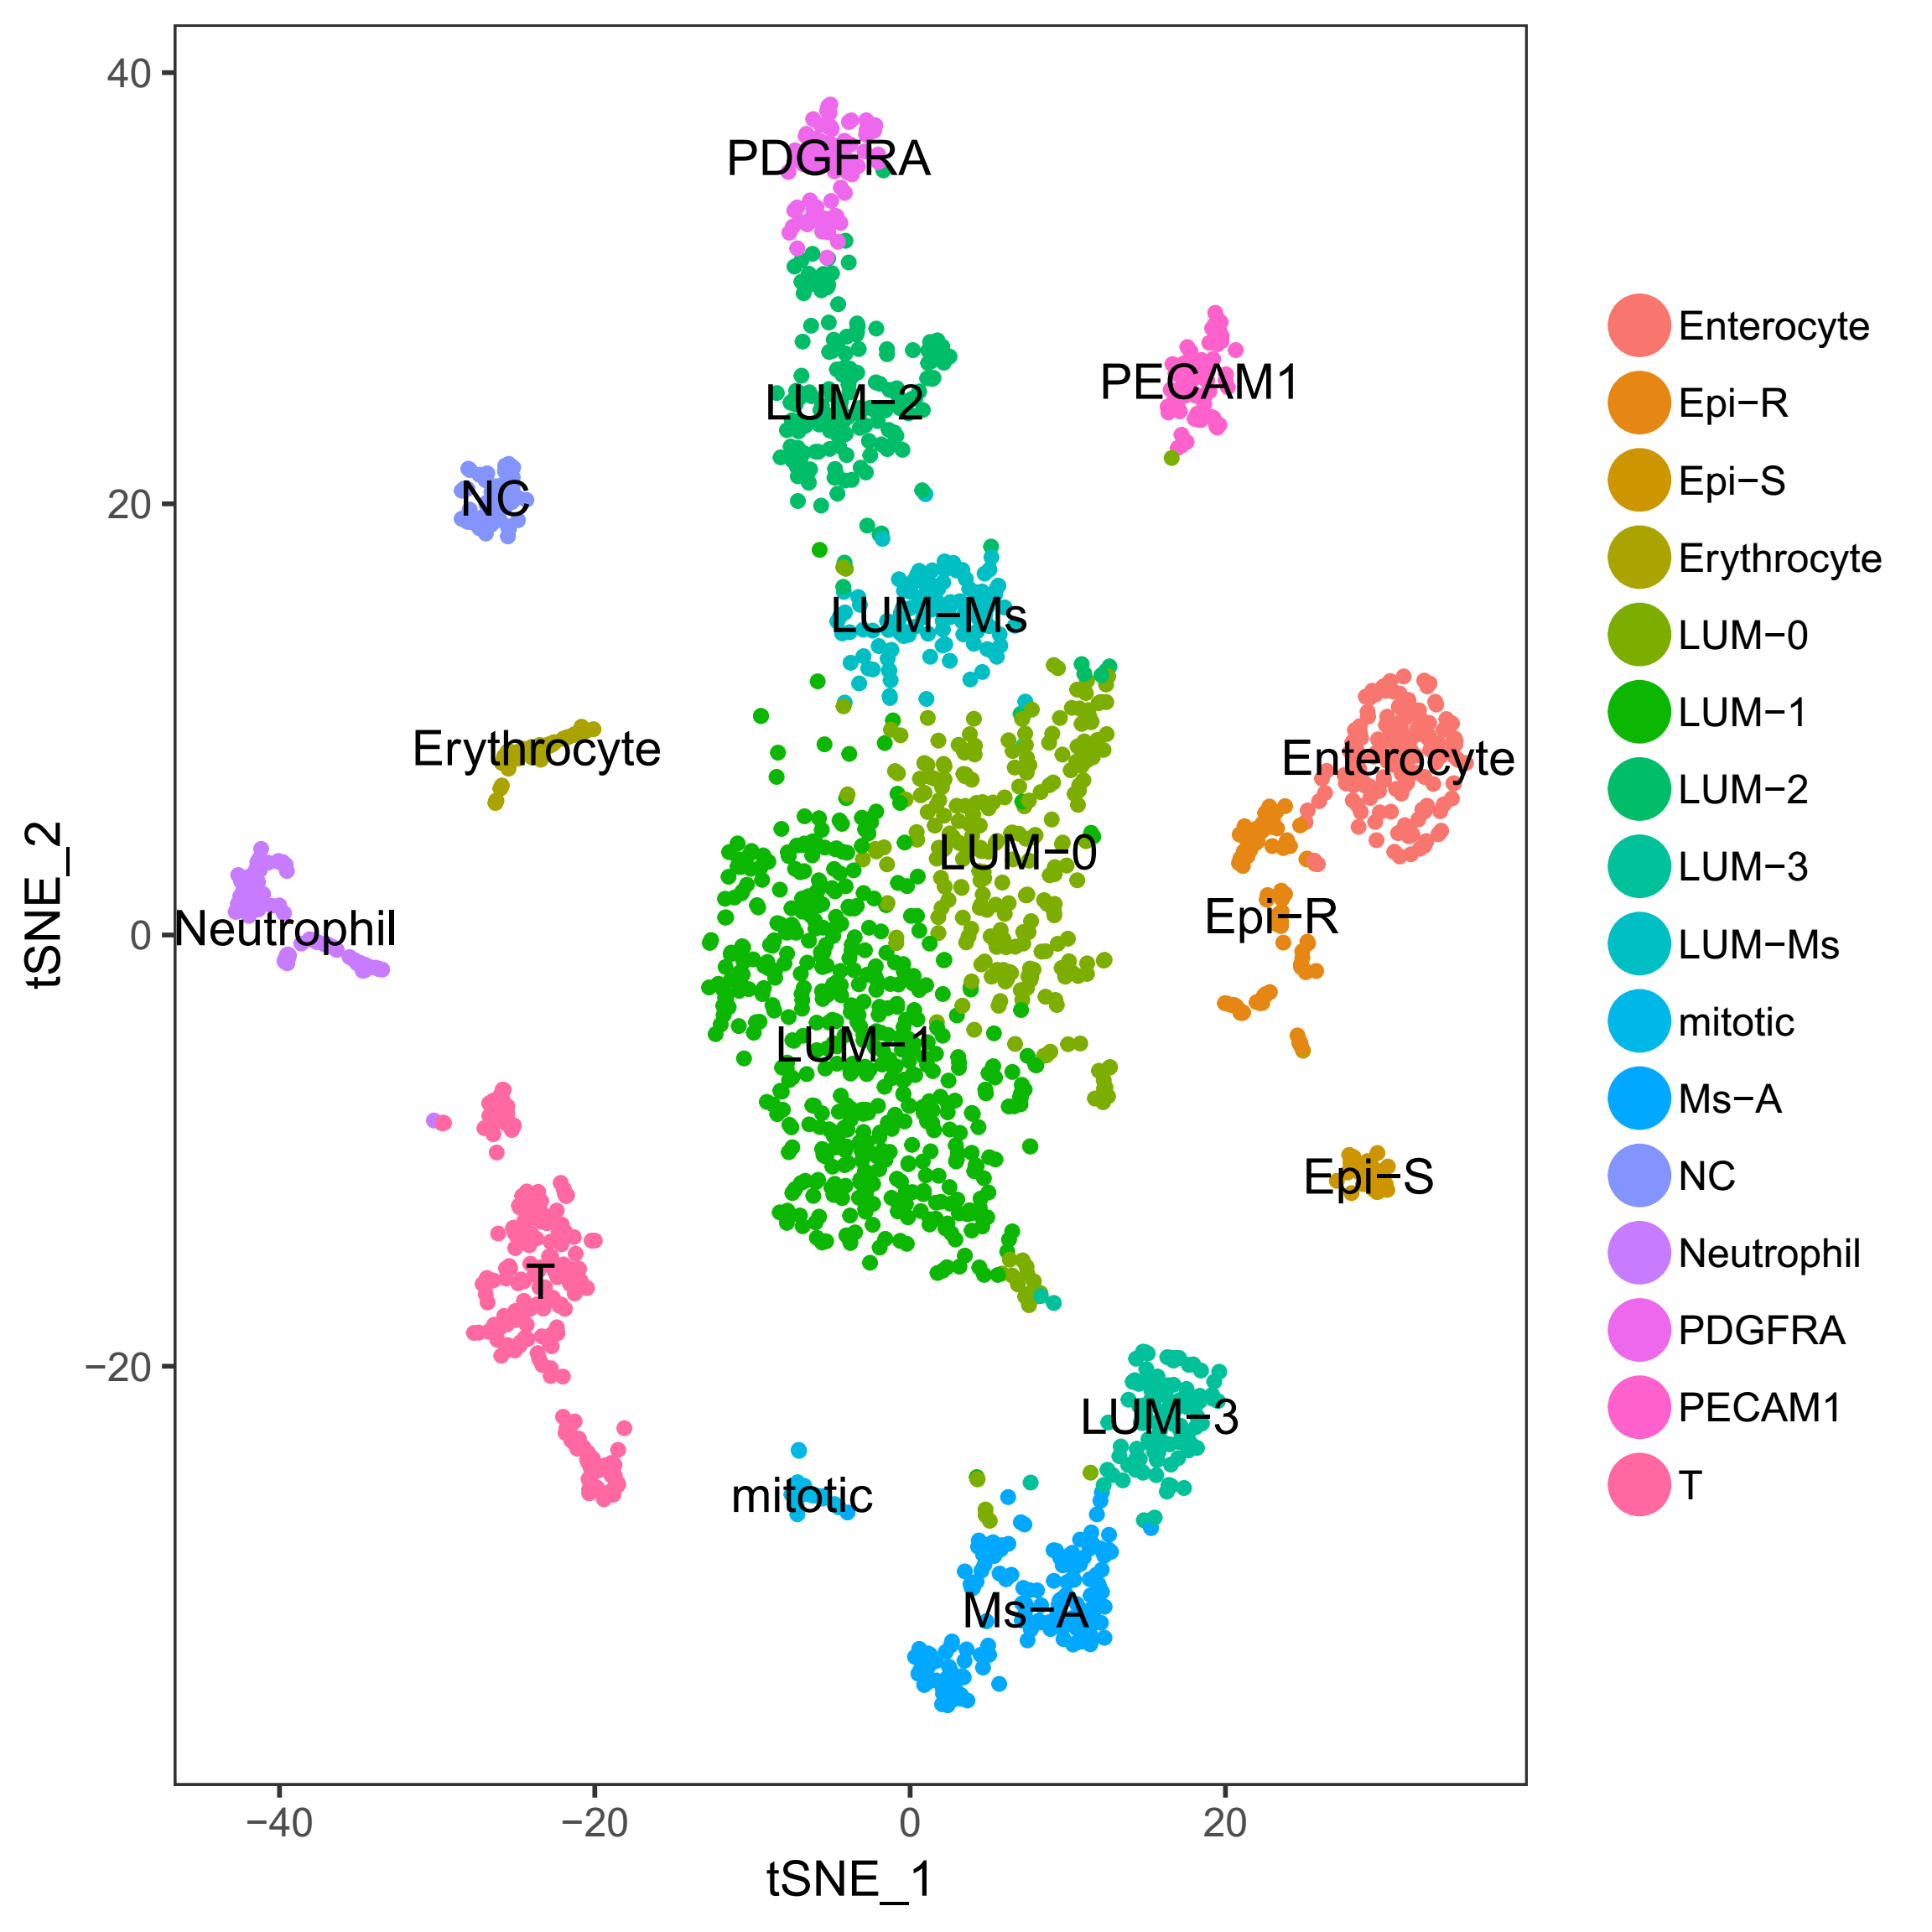
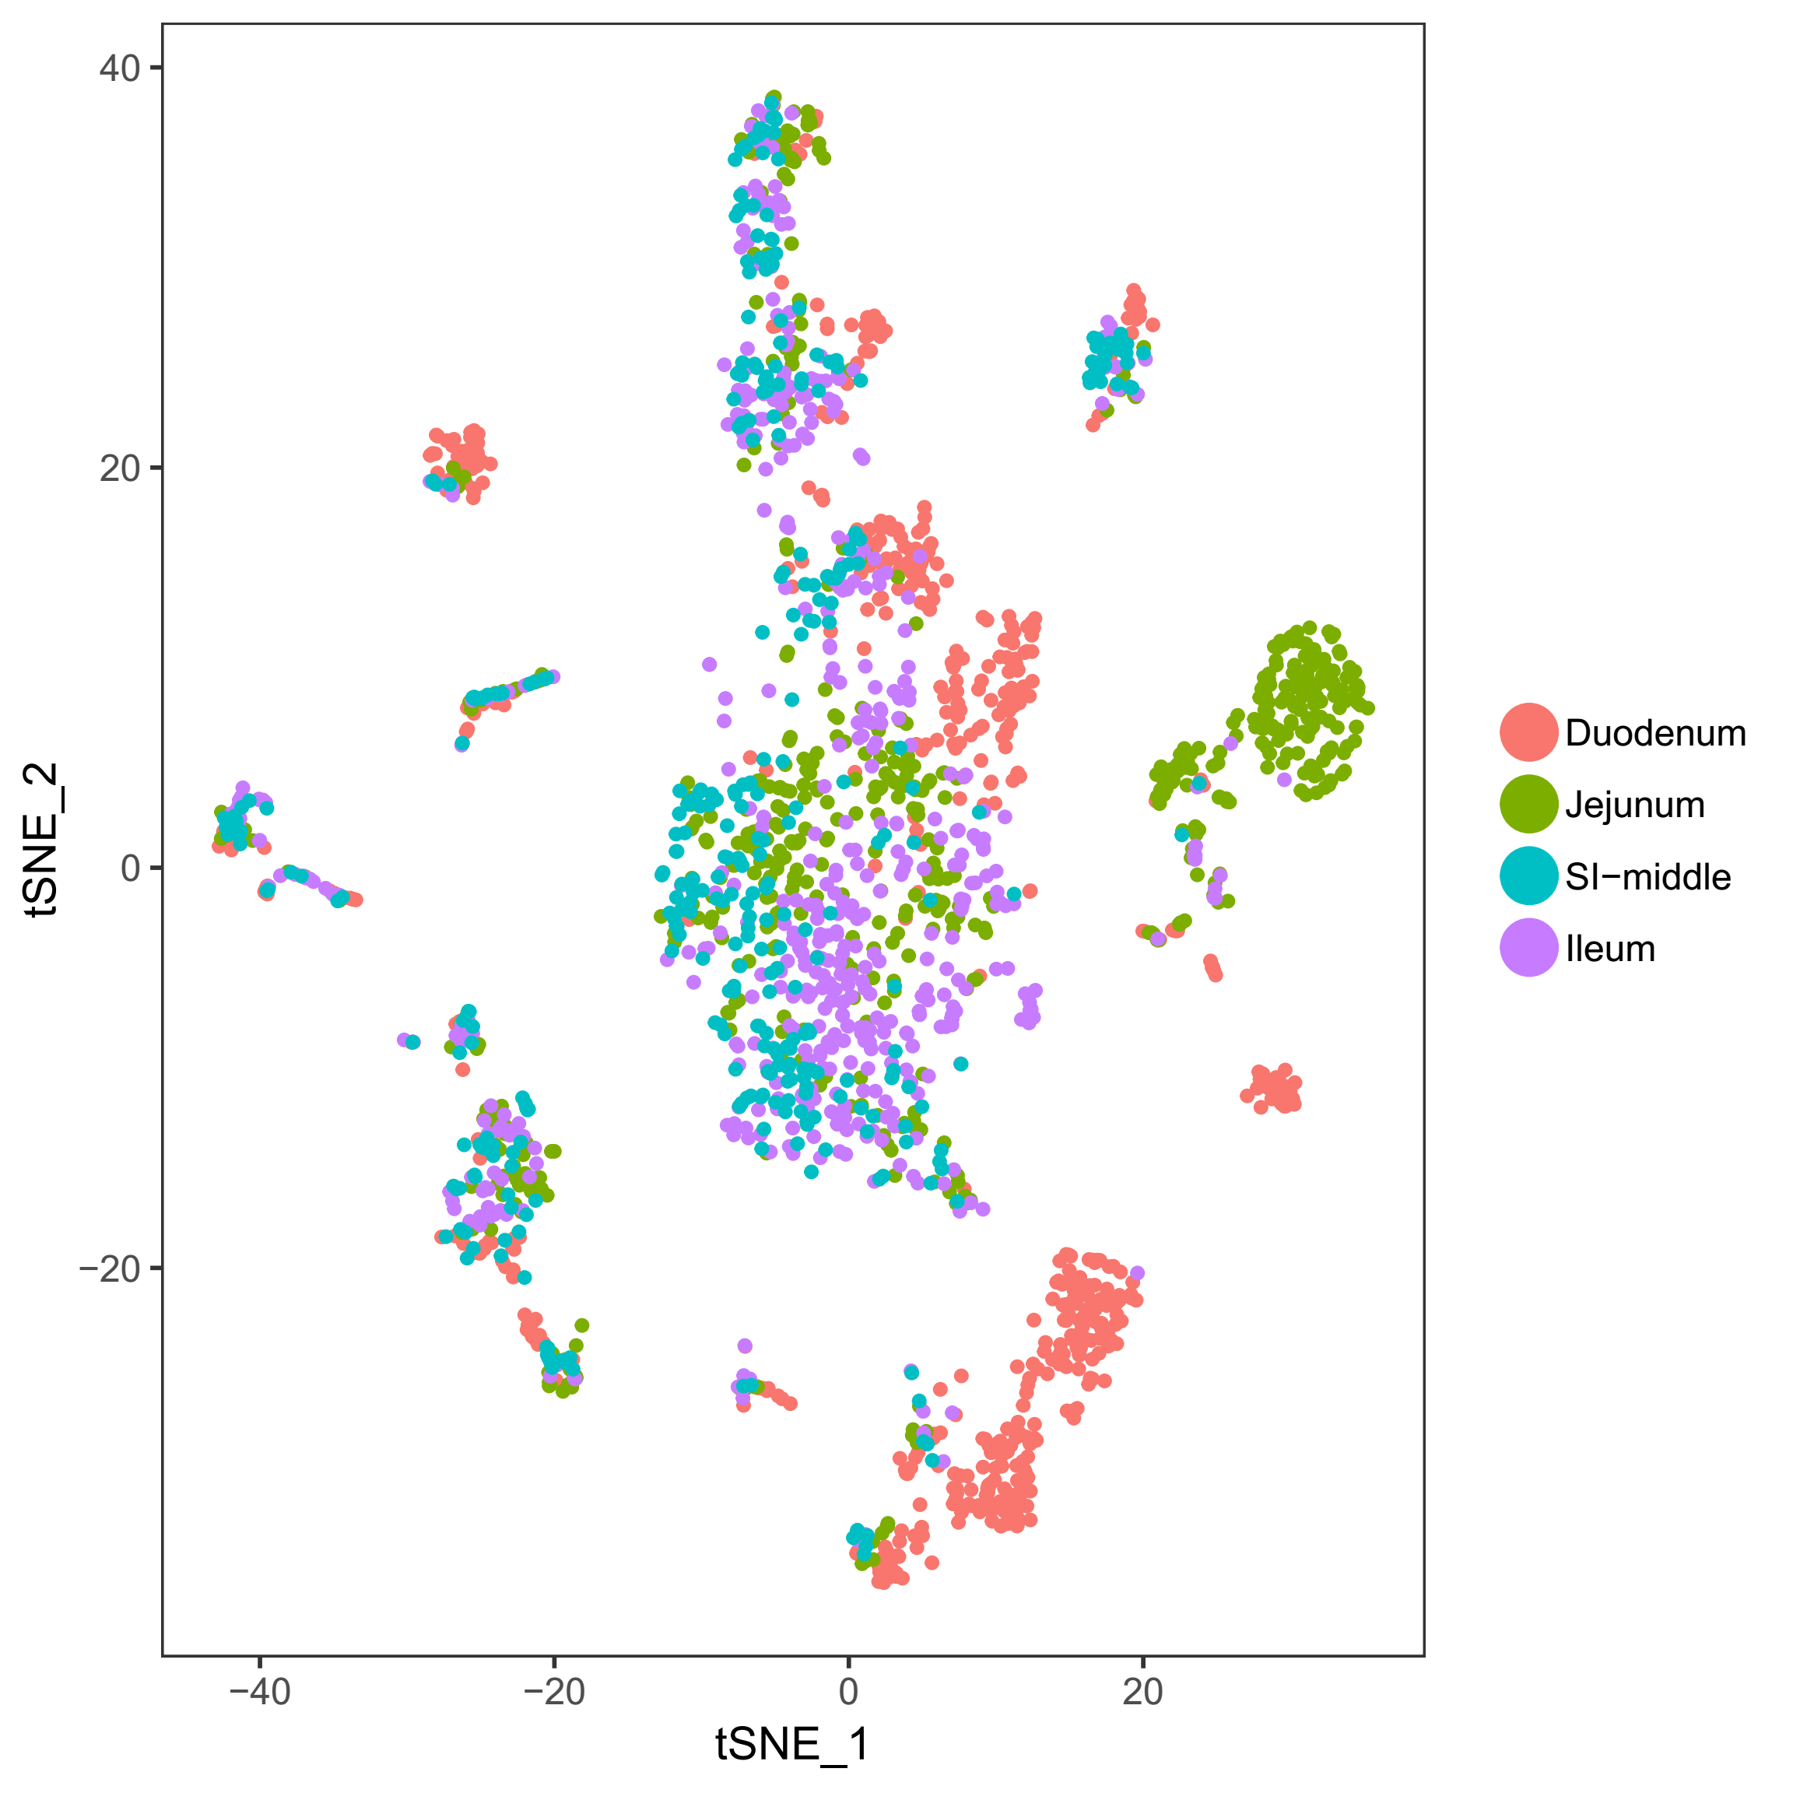

3. Small intestine (SI) (小肠)
There are 16 cell types for 2235 cells.
Most of the enterocytes are derived from the upper segment of SI.

Slide 20
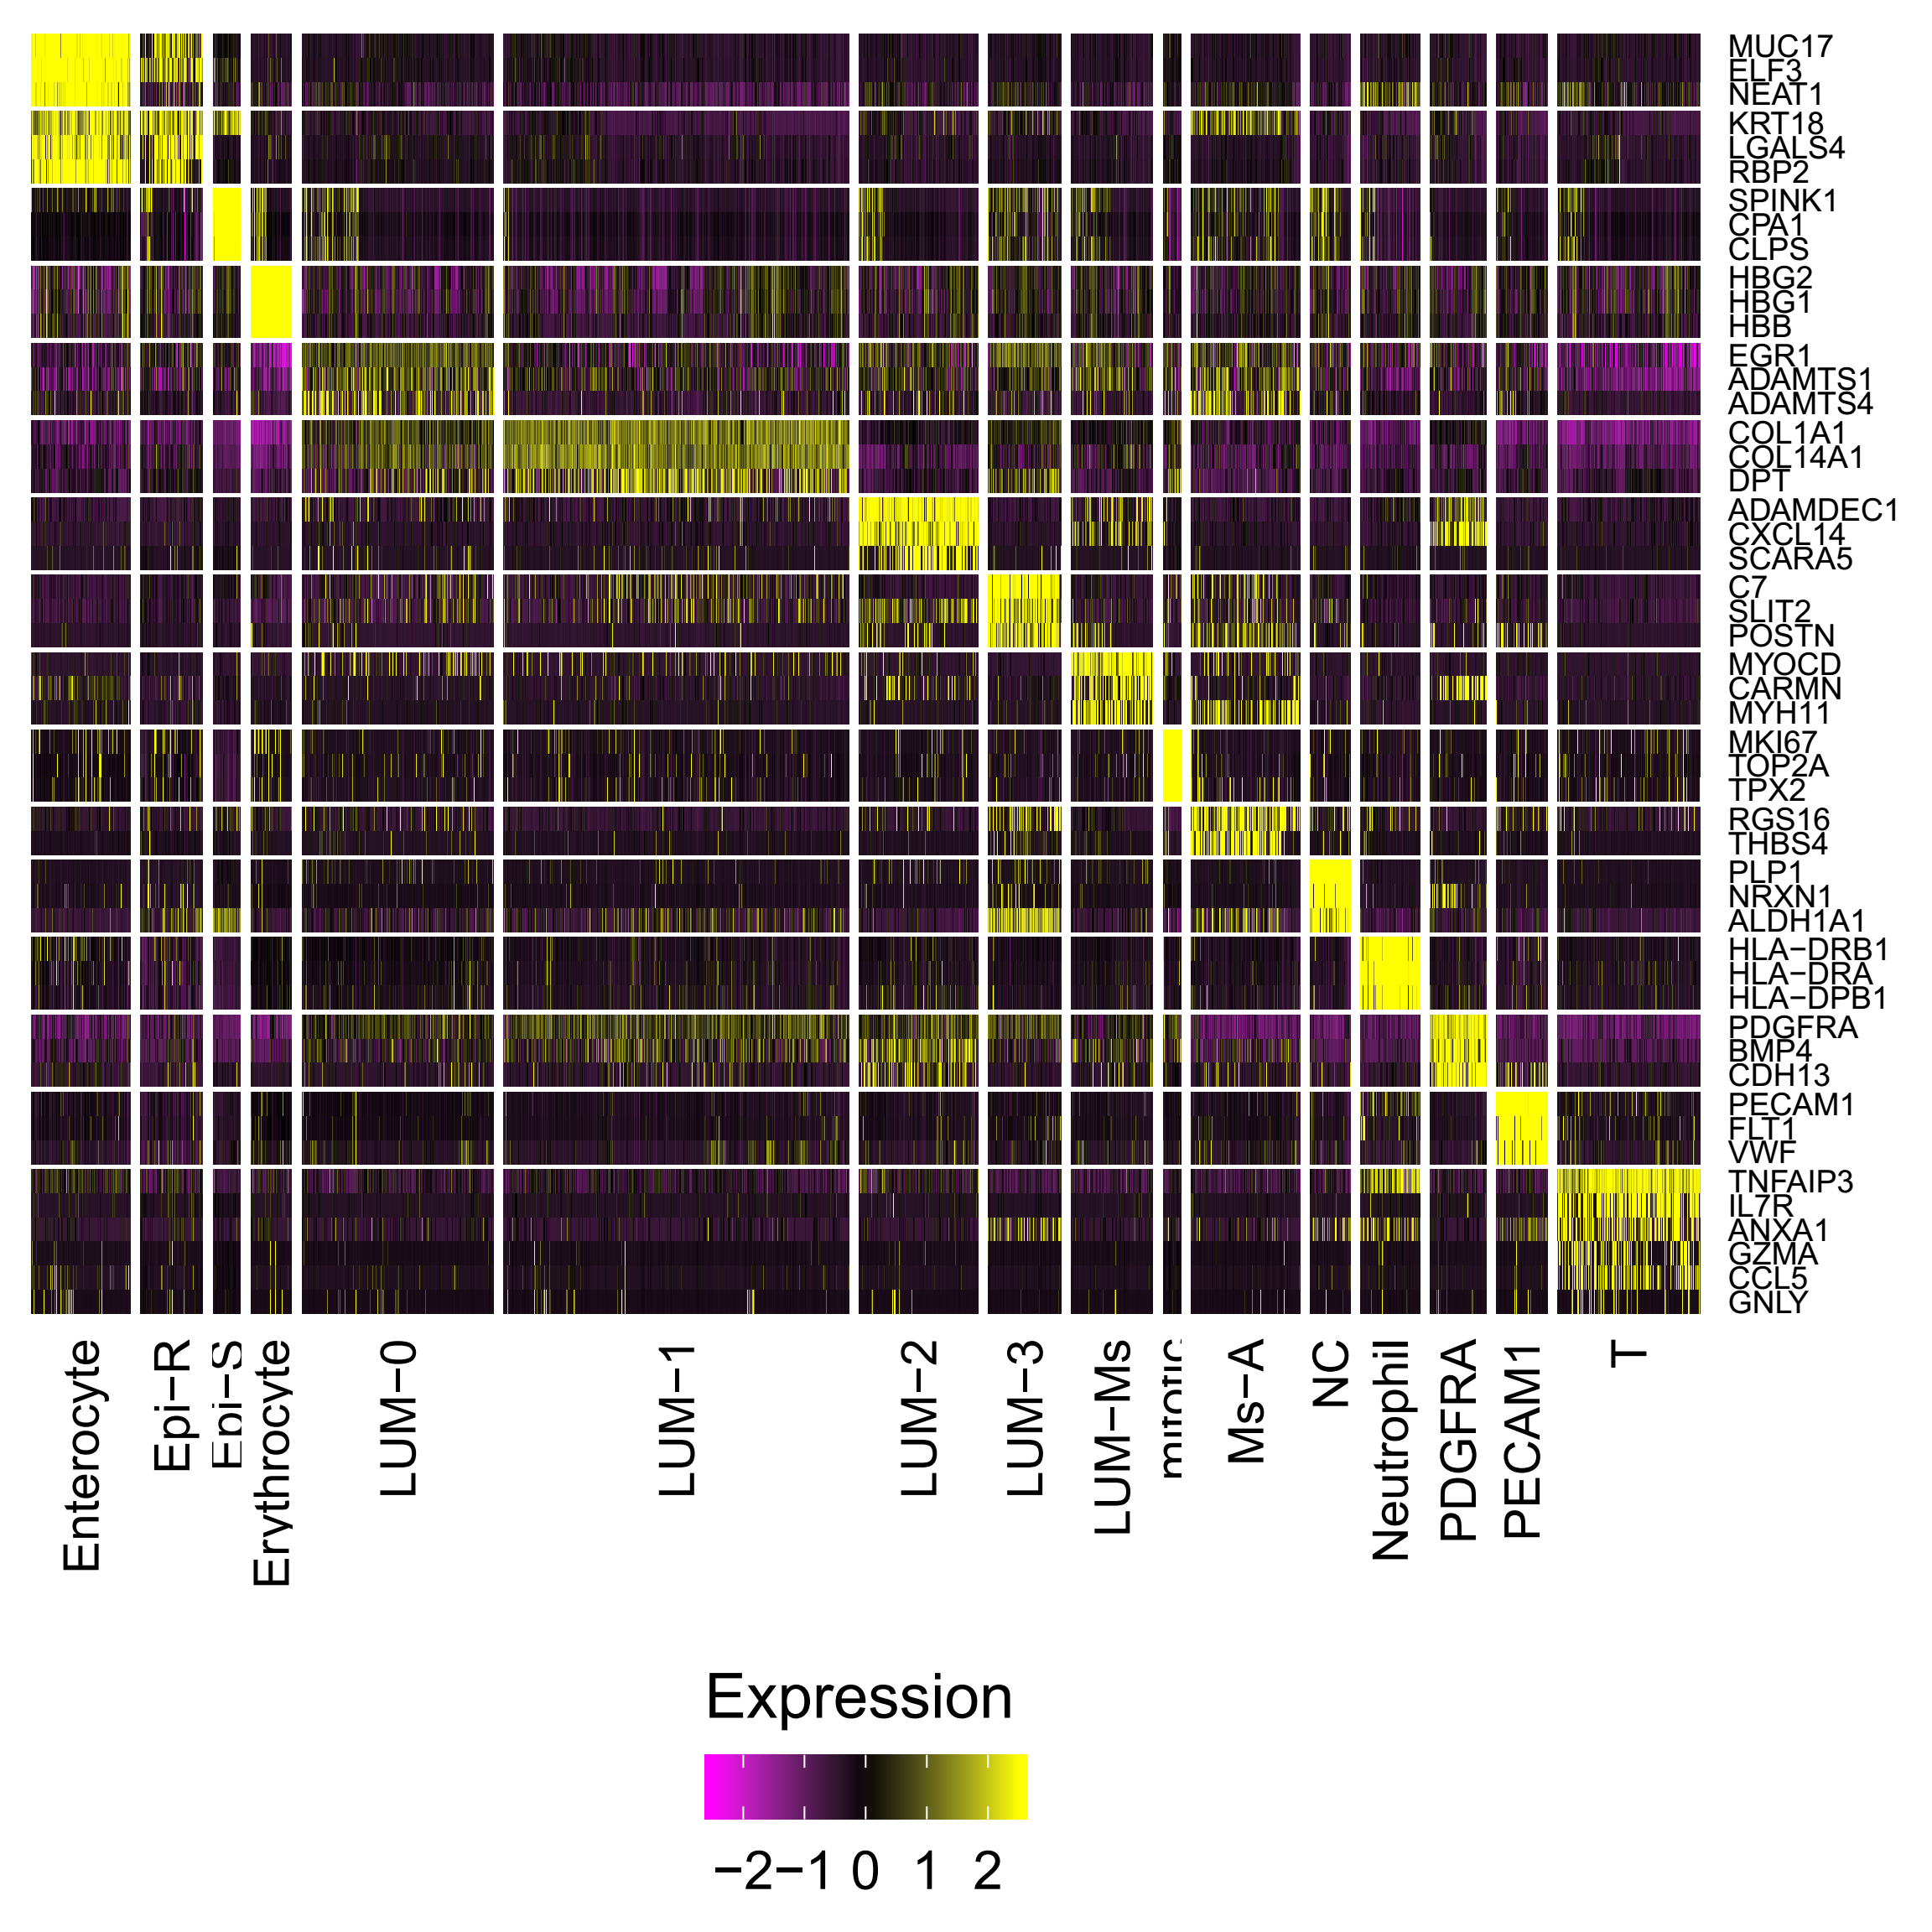
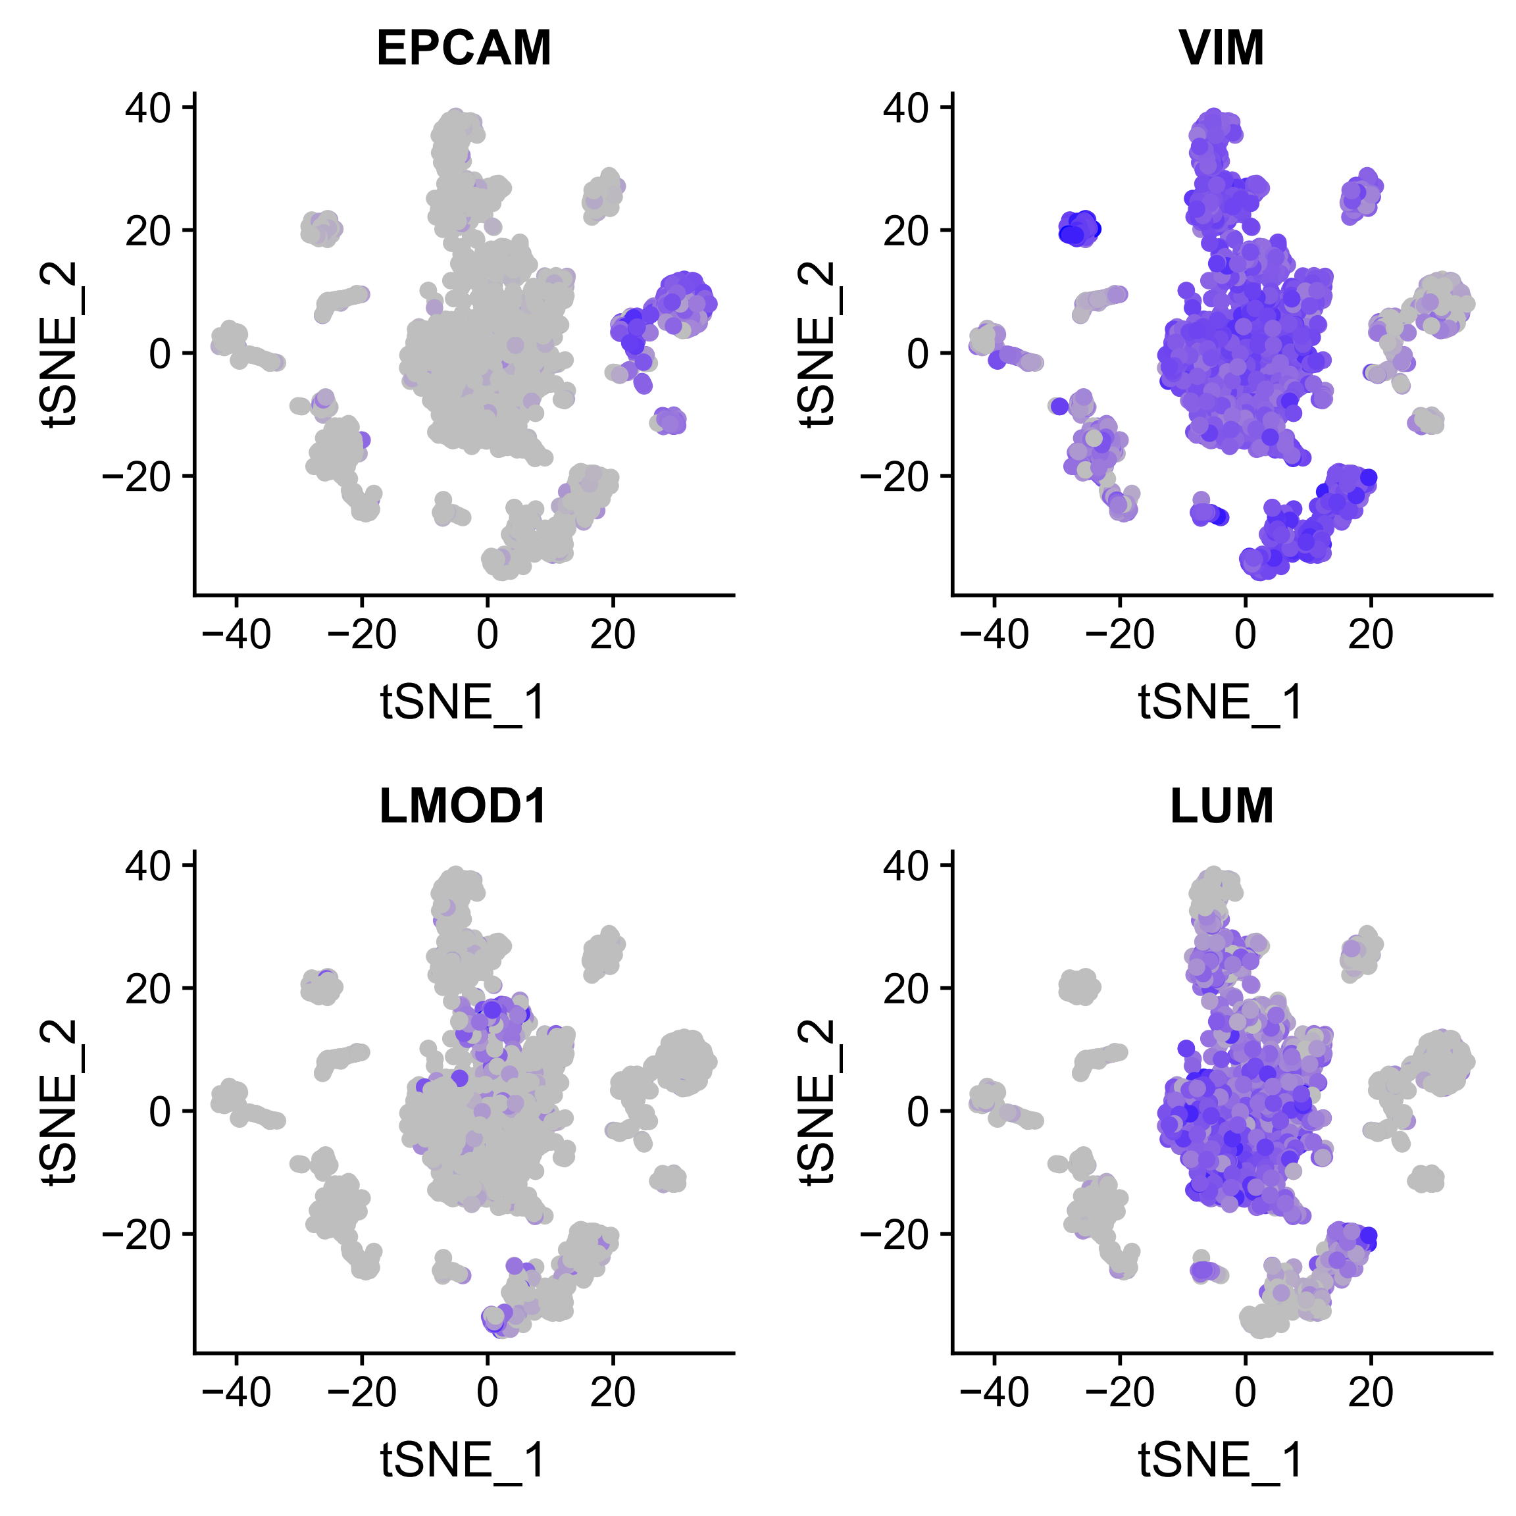
Expression of signature genes

Slide 21
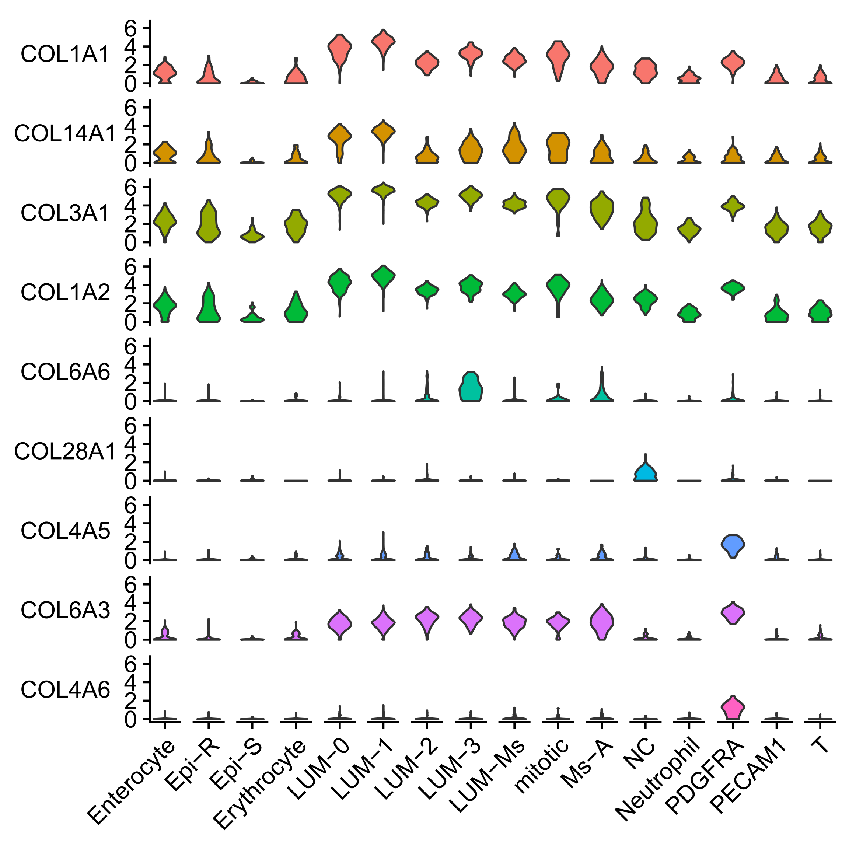
Cell type identification of small intestine

Slide 22
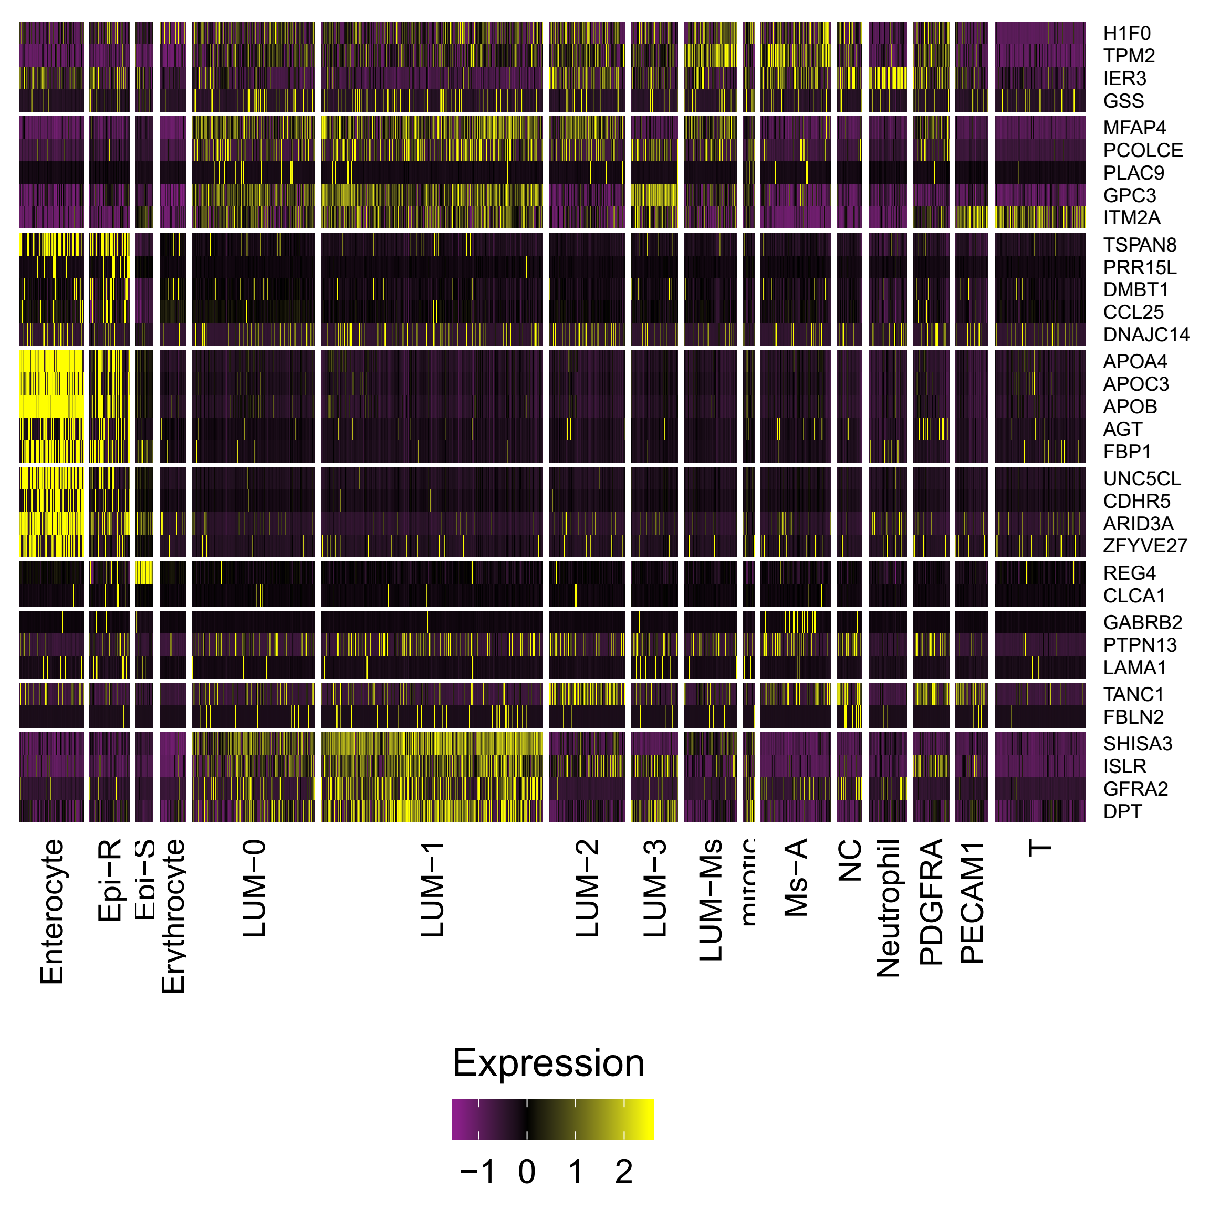
Comparison of cell types in the previous work
Gao S et al., Nat Cell Biol, 2018

Slide 23
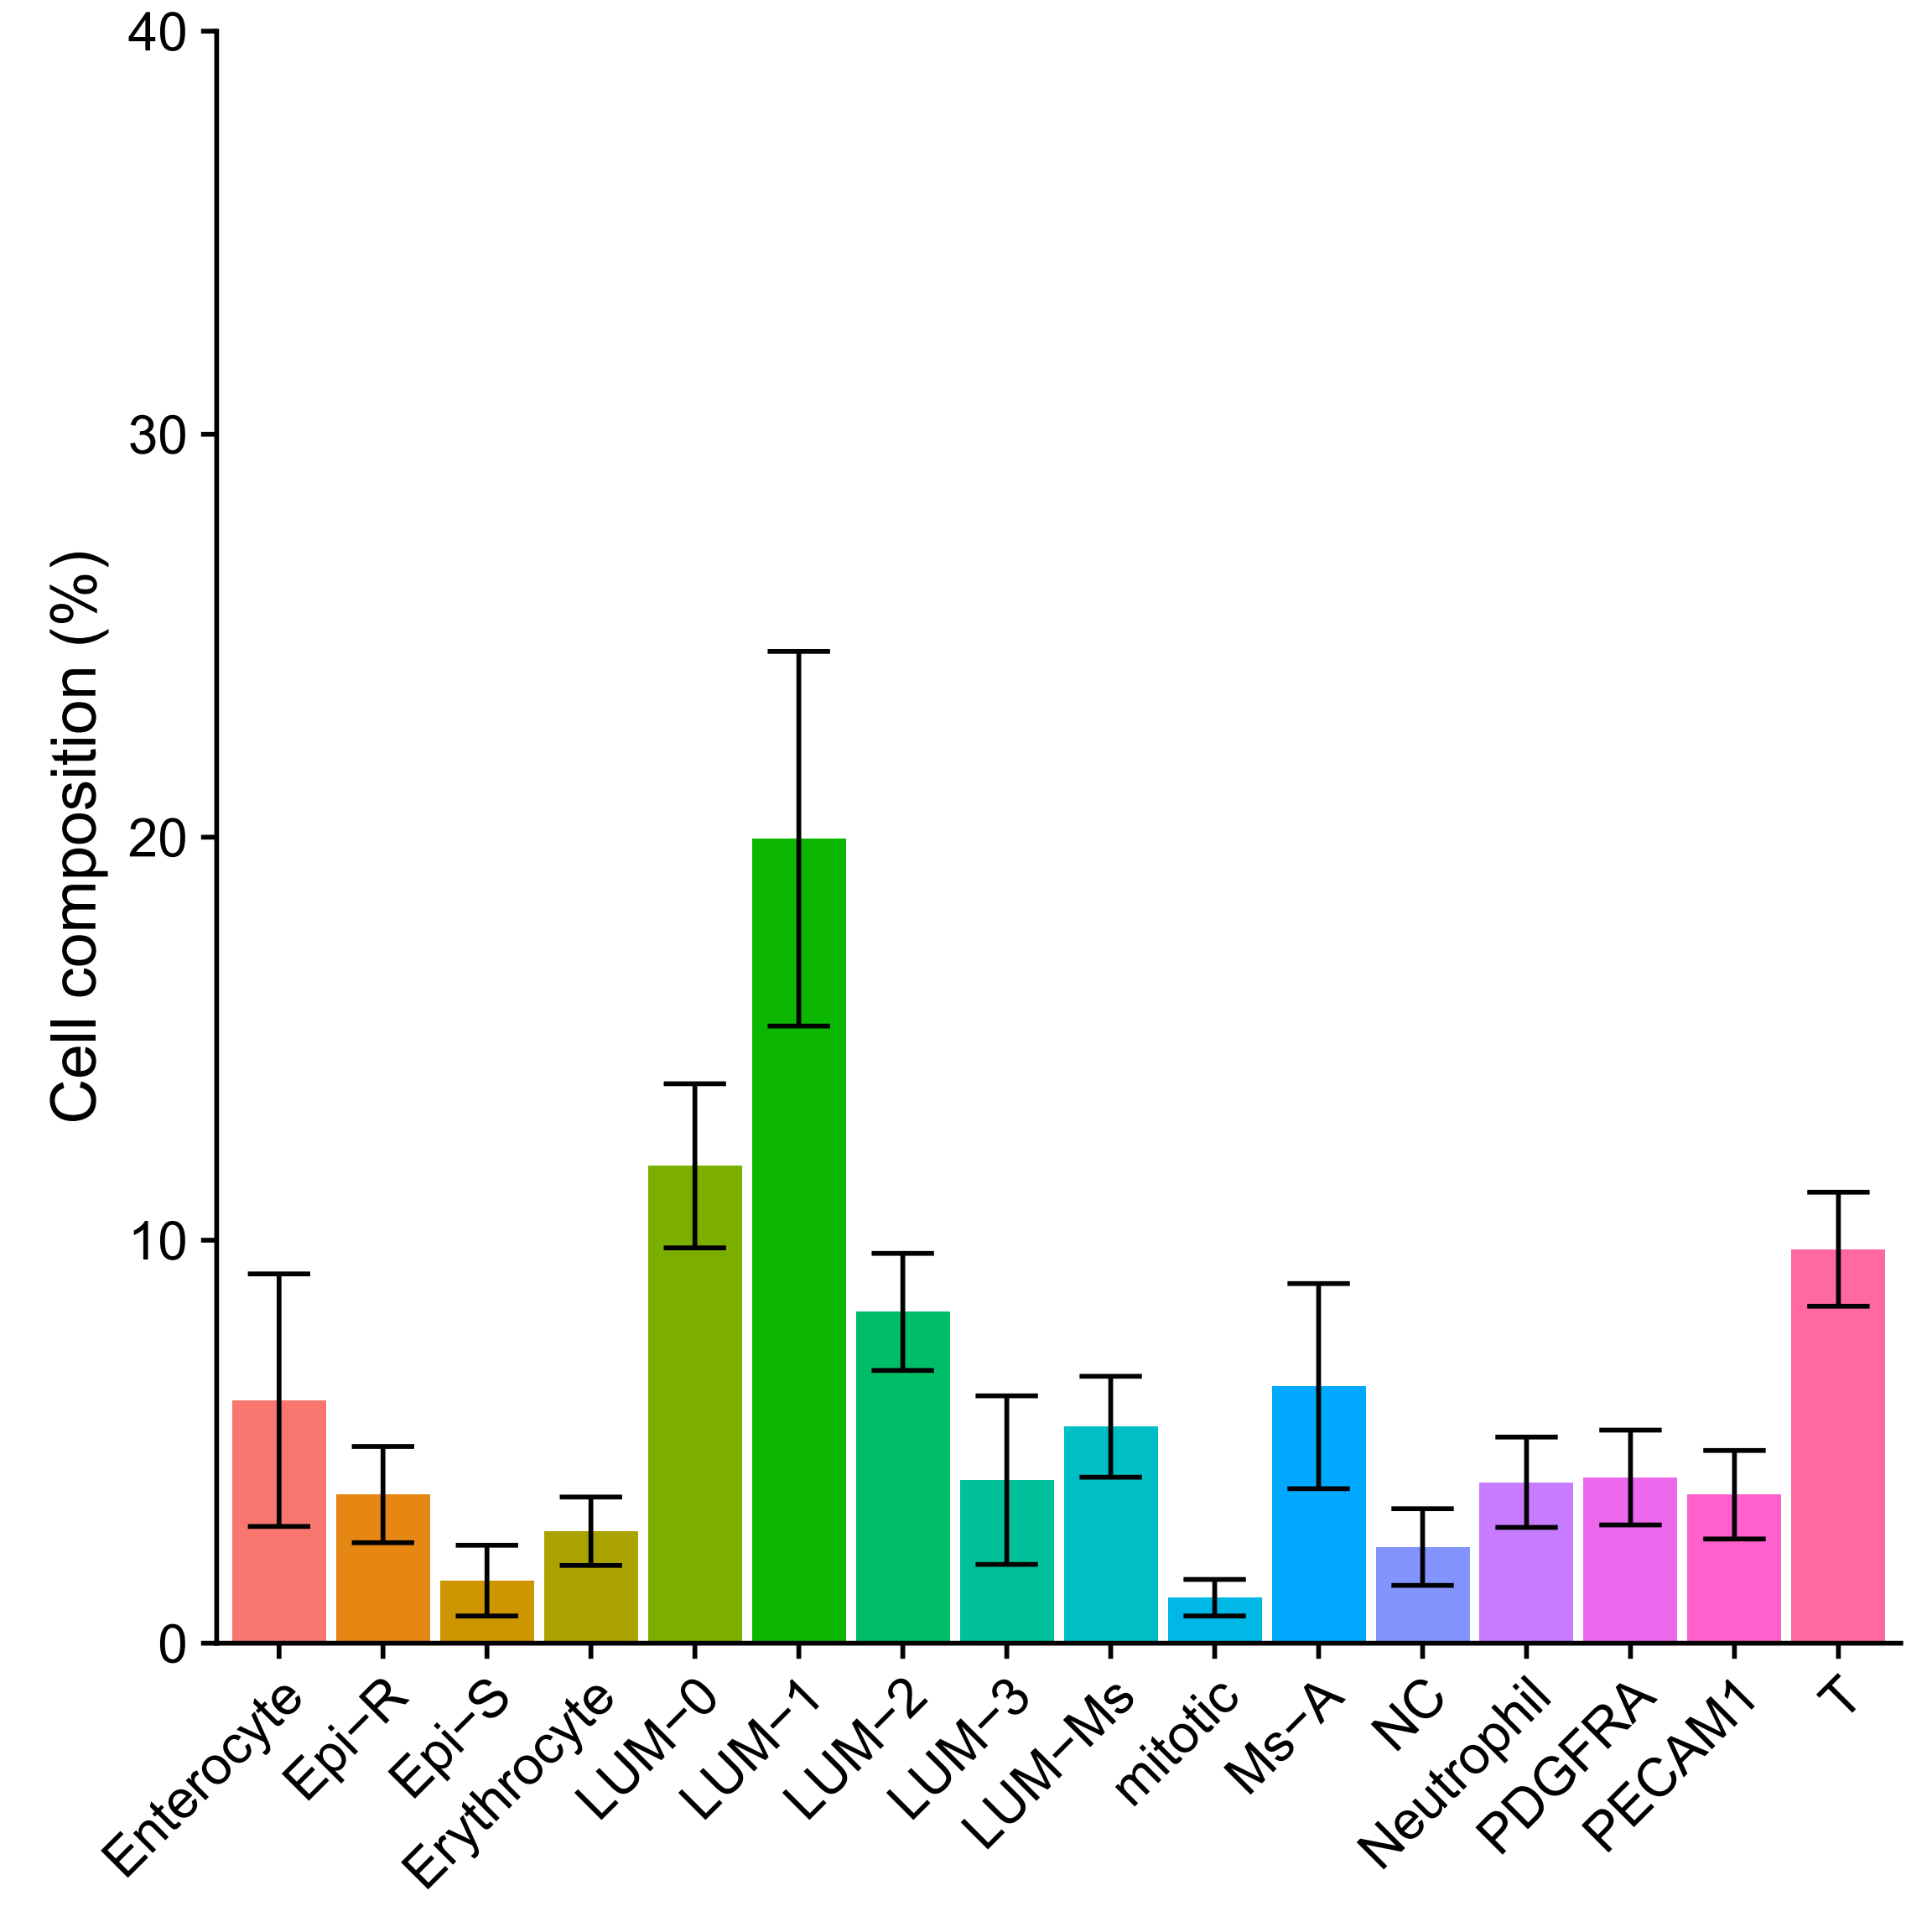
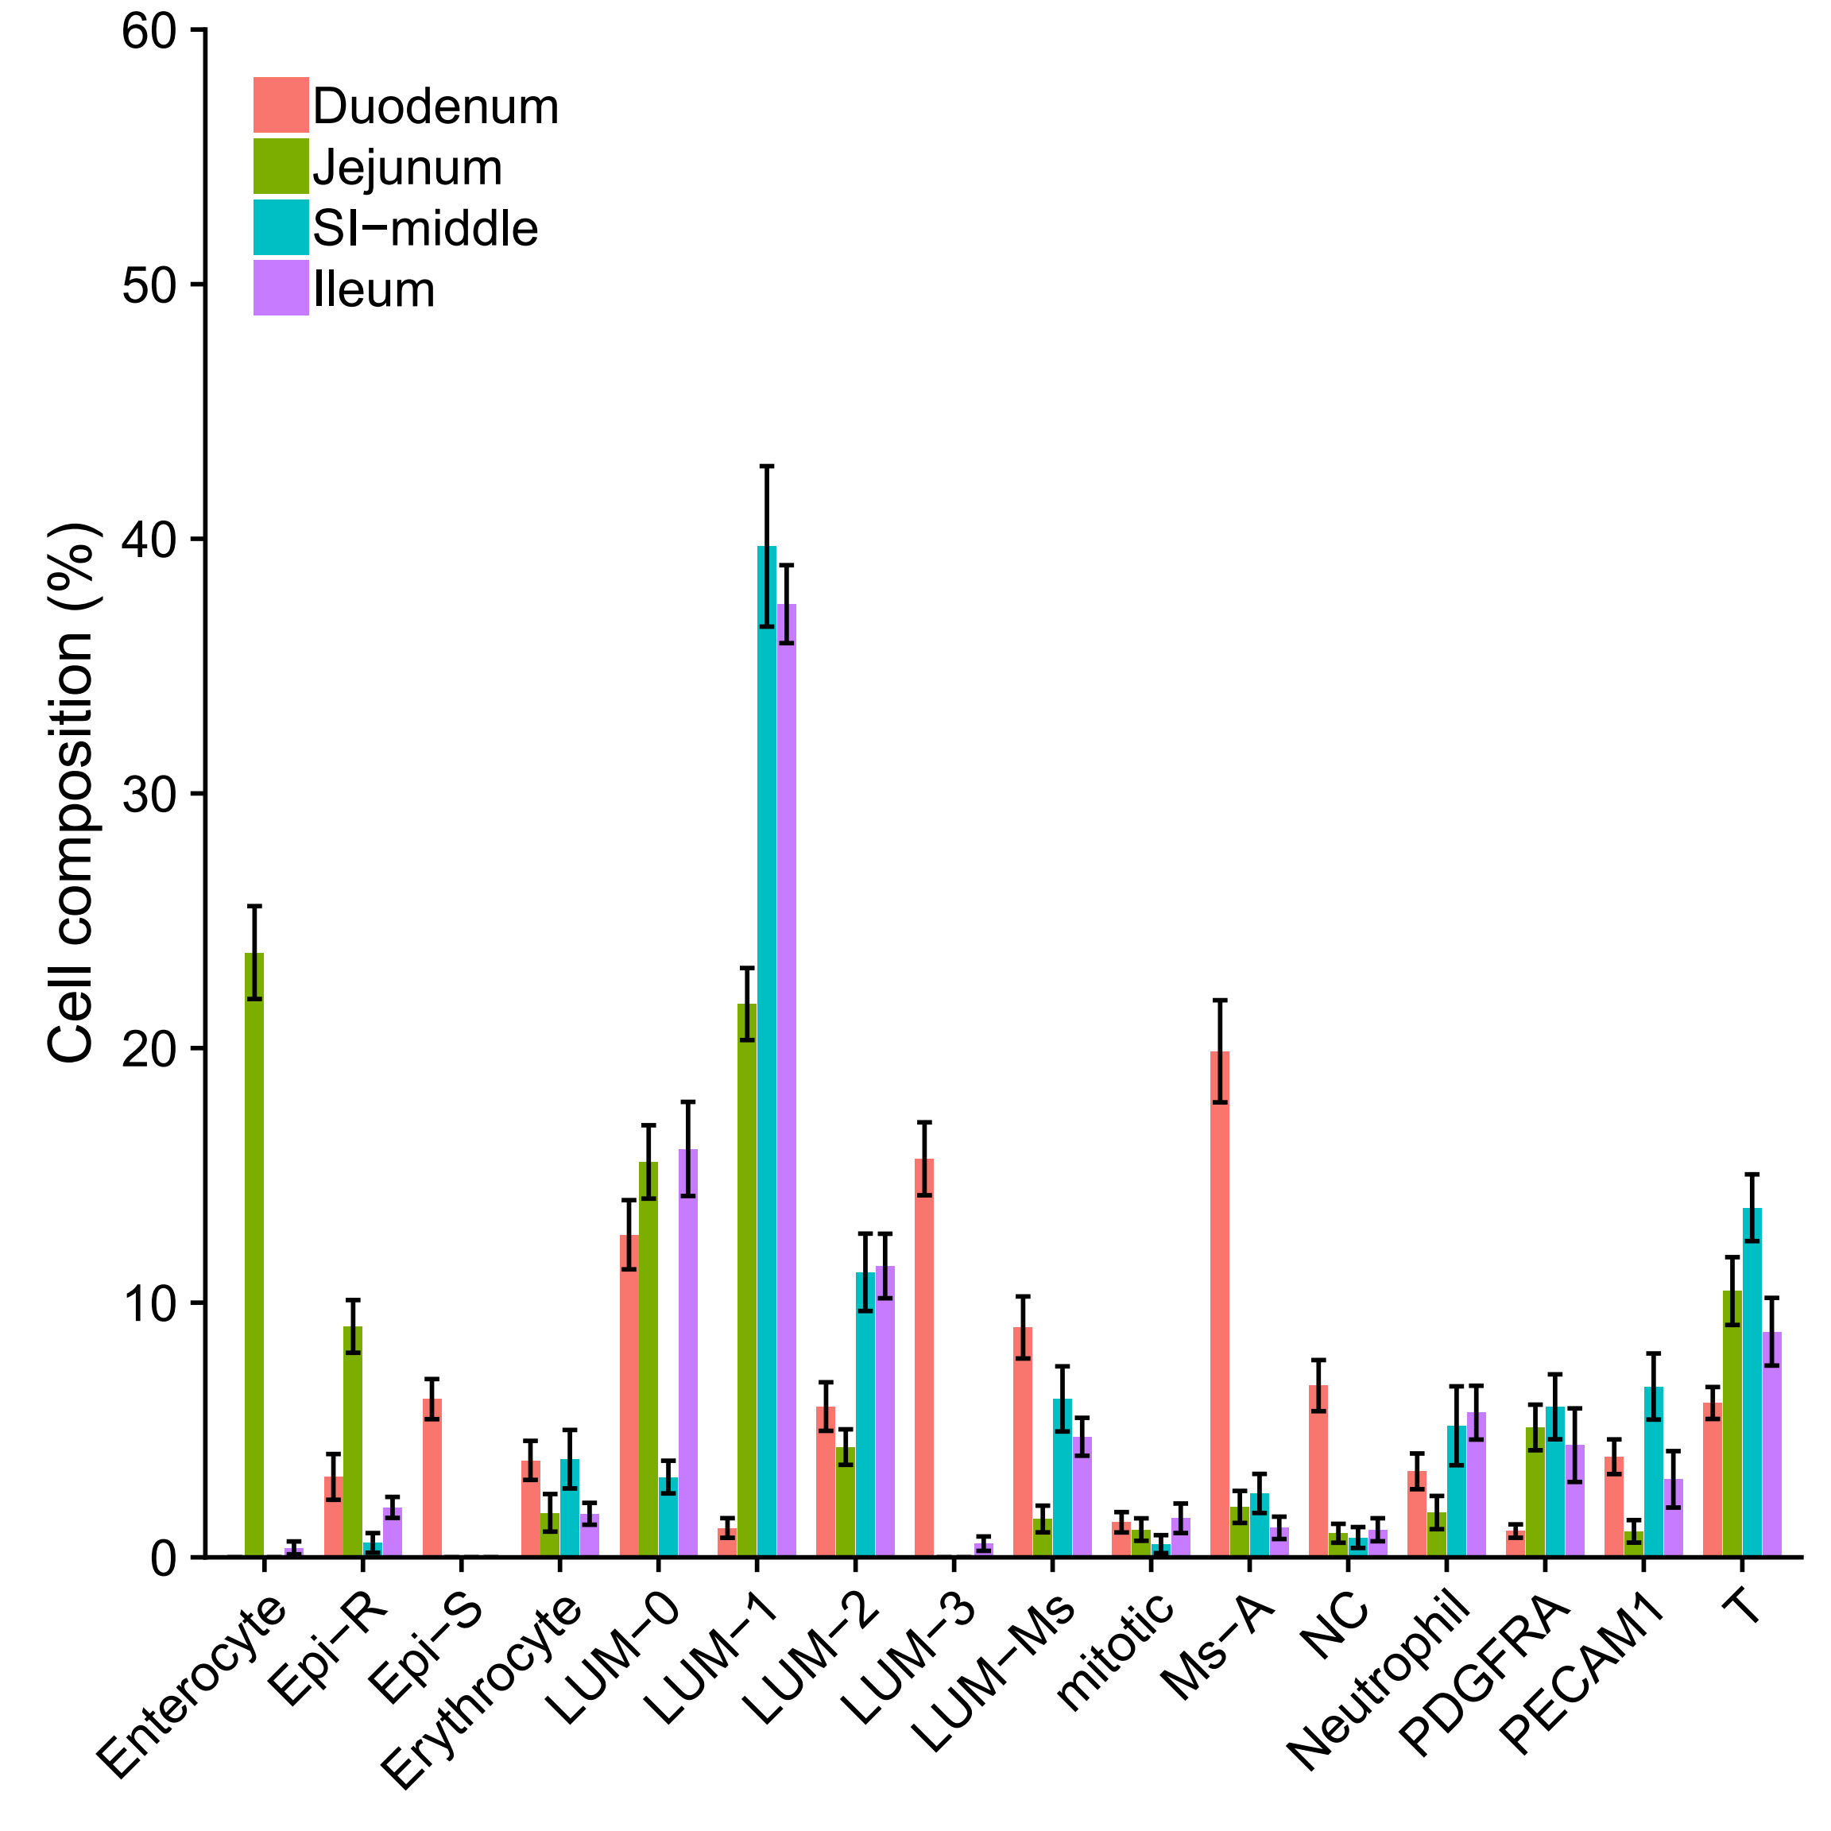
Cell type composition

Slide 24
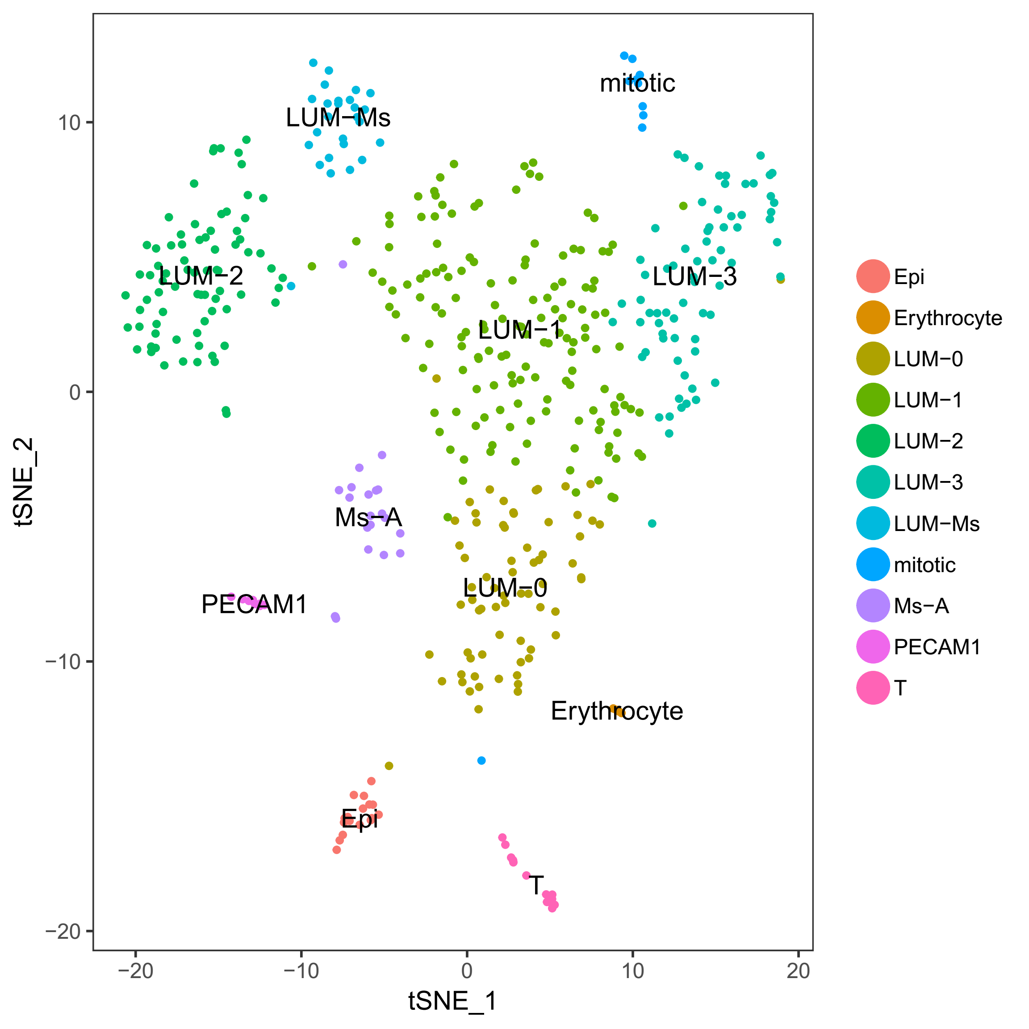
4. Large intestine (LI) (大肠)

Slide 25
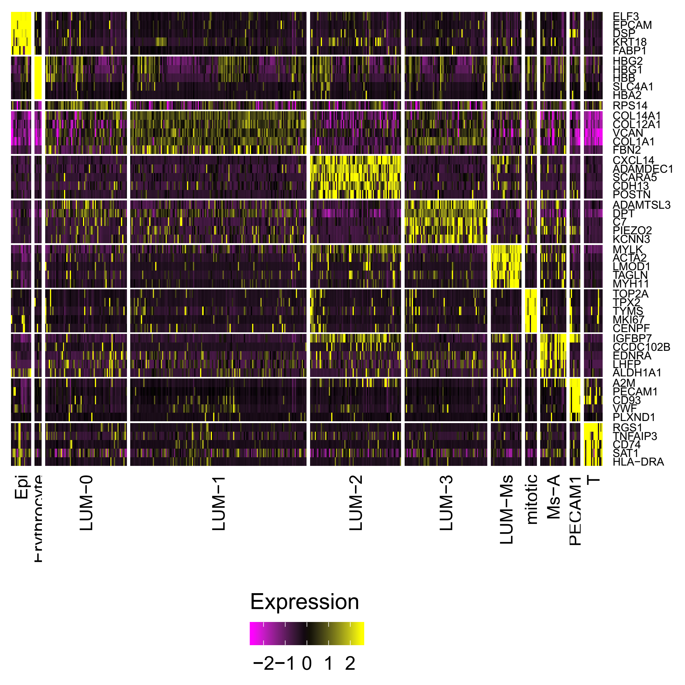
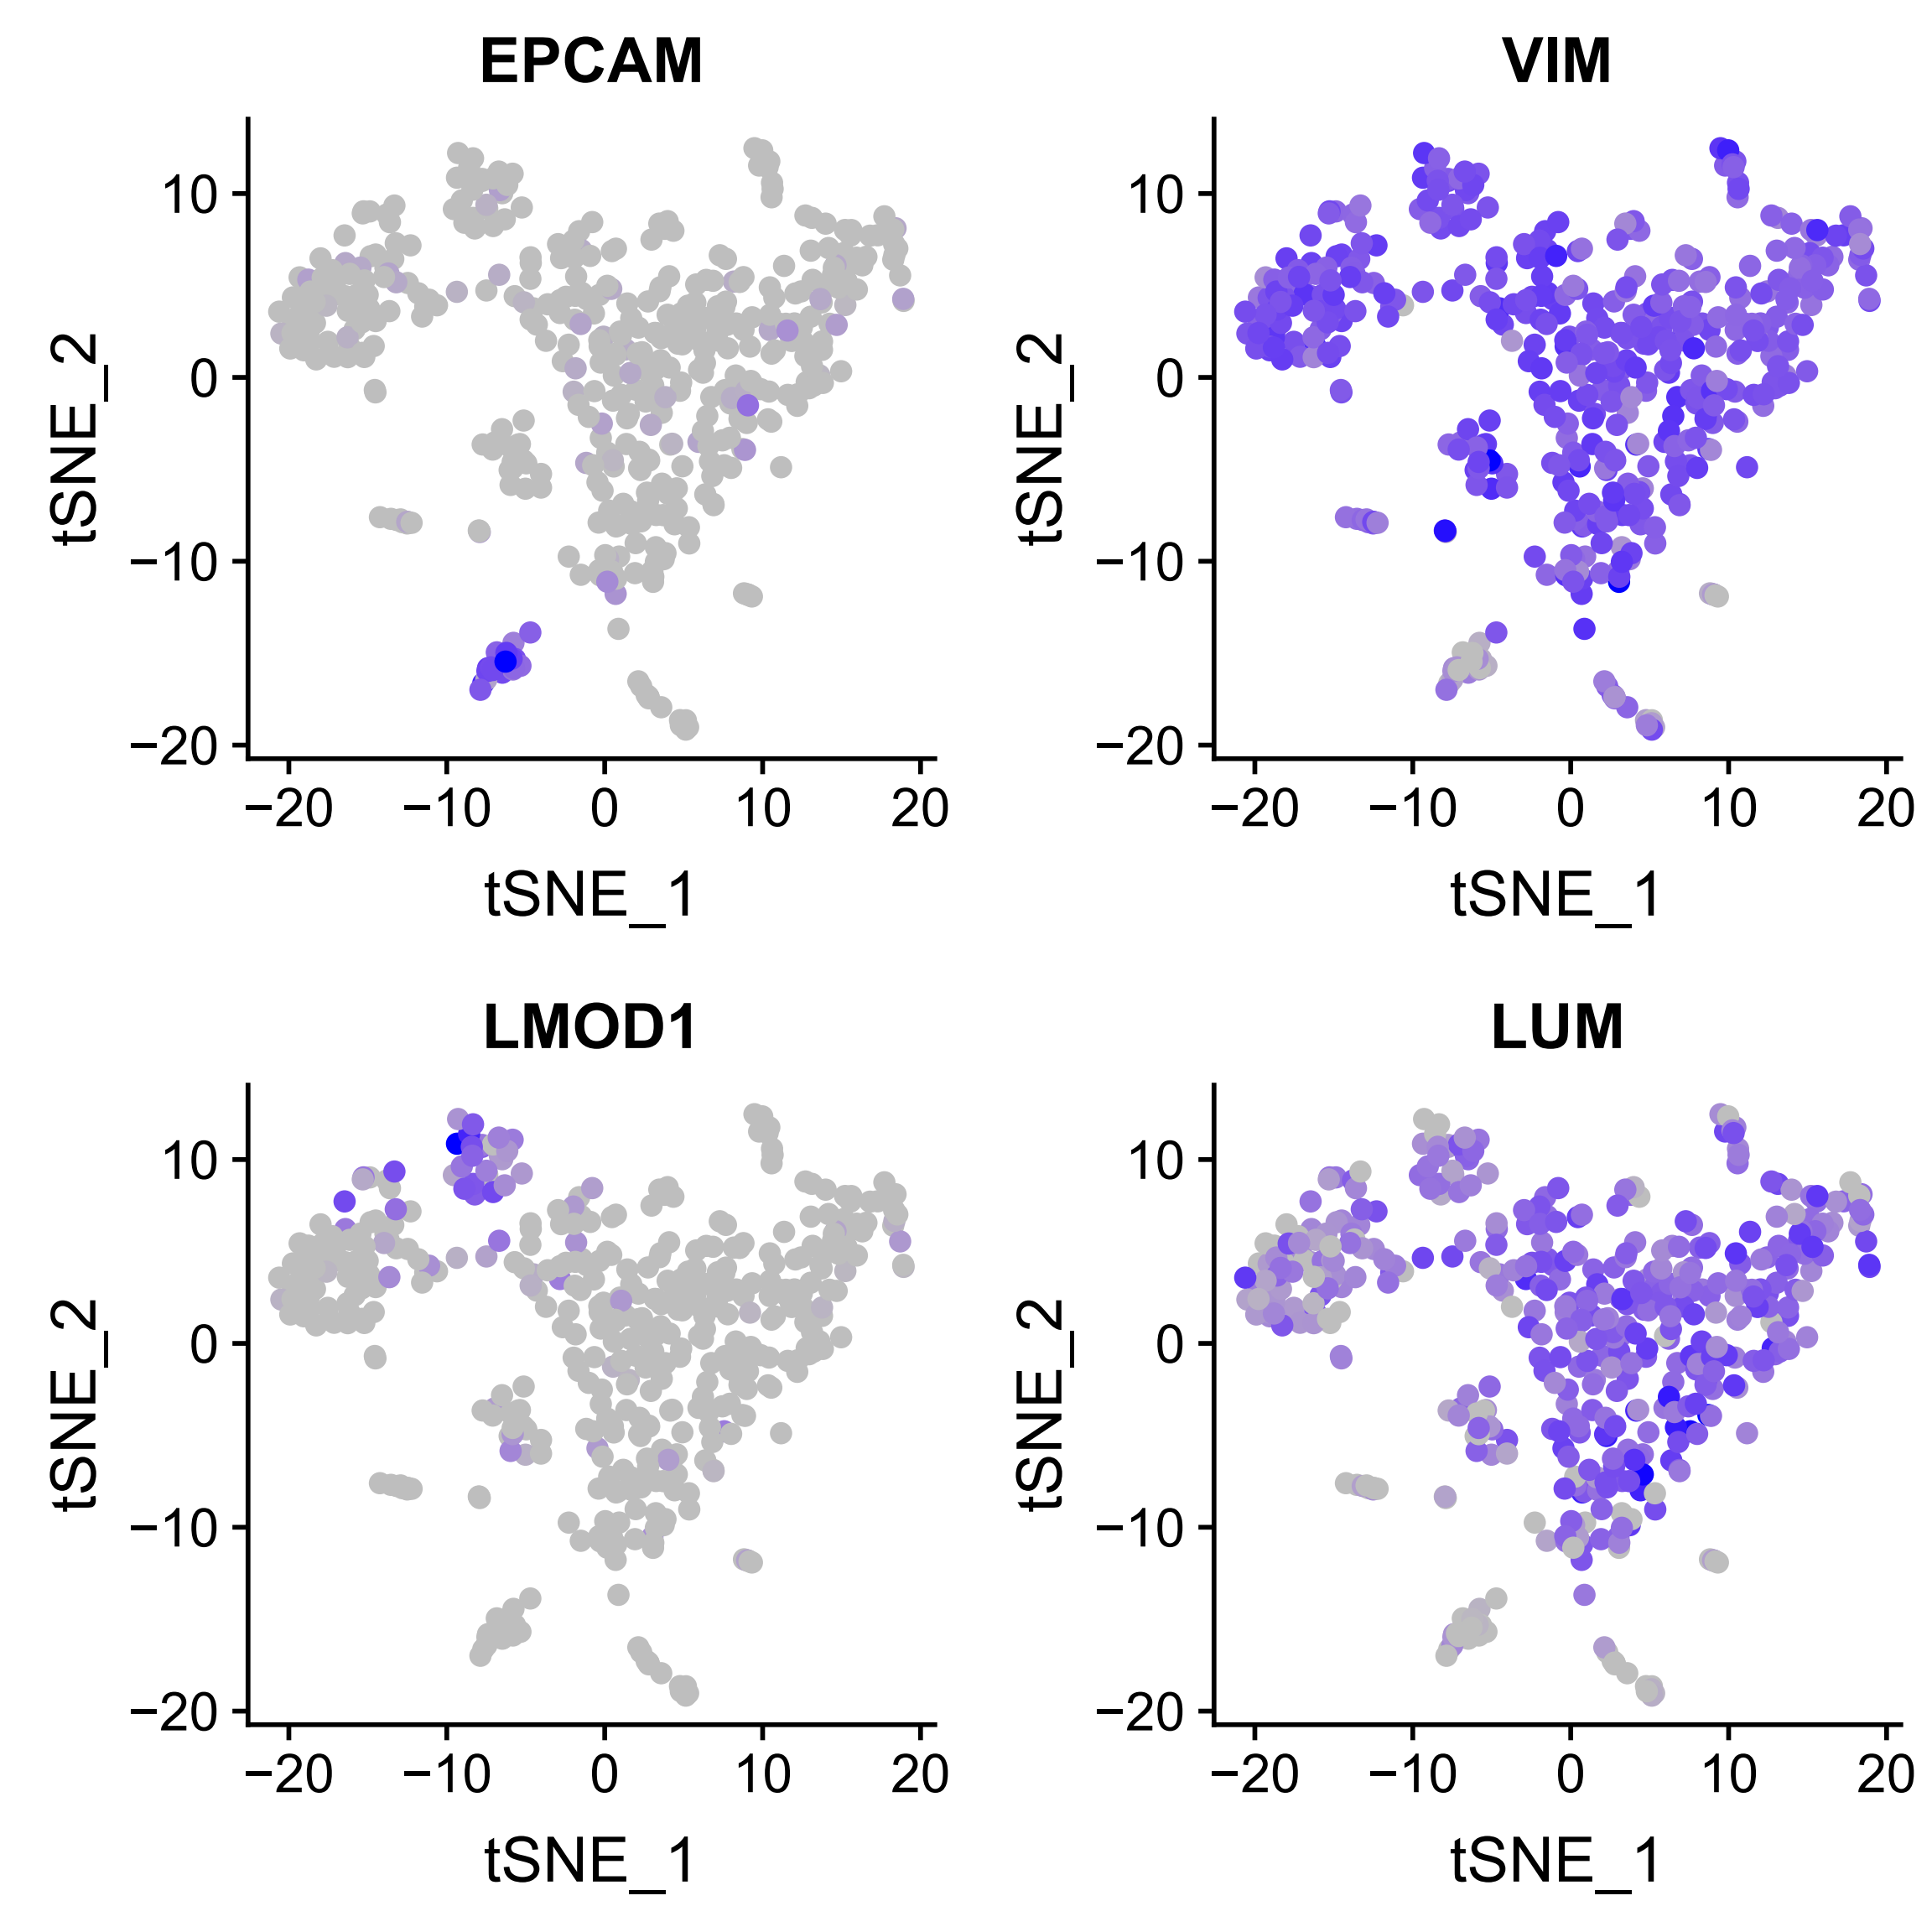
Expression of signature genes

Slide 26
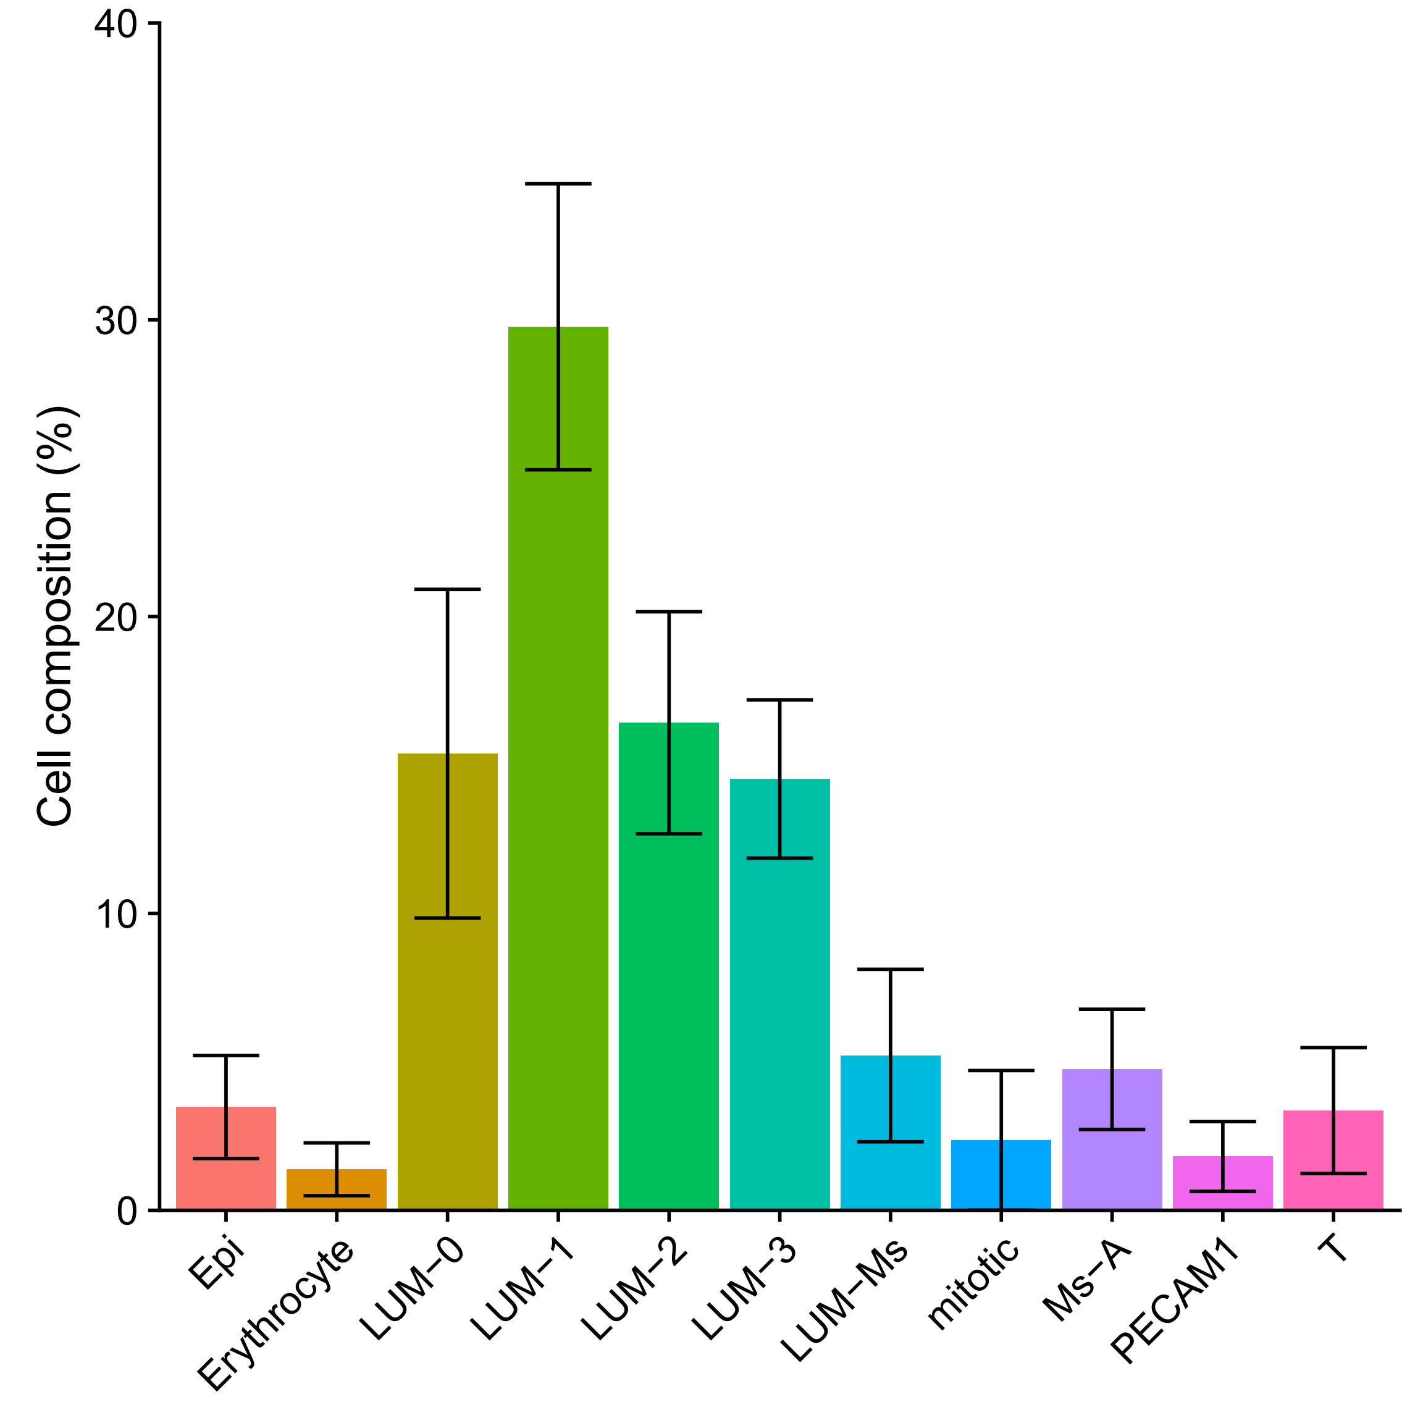
Cell type composition

Slide 27
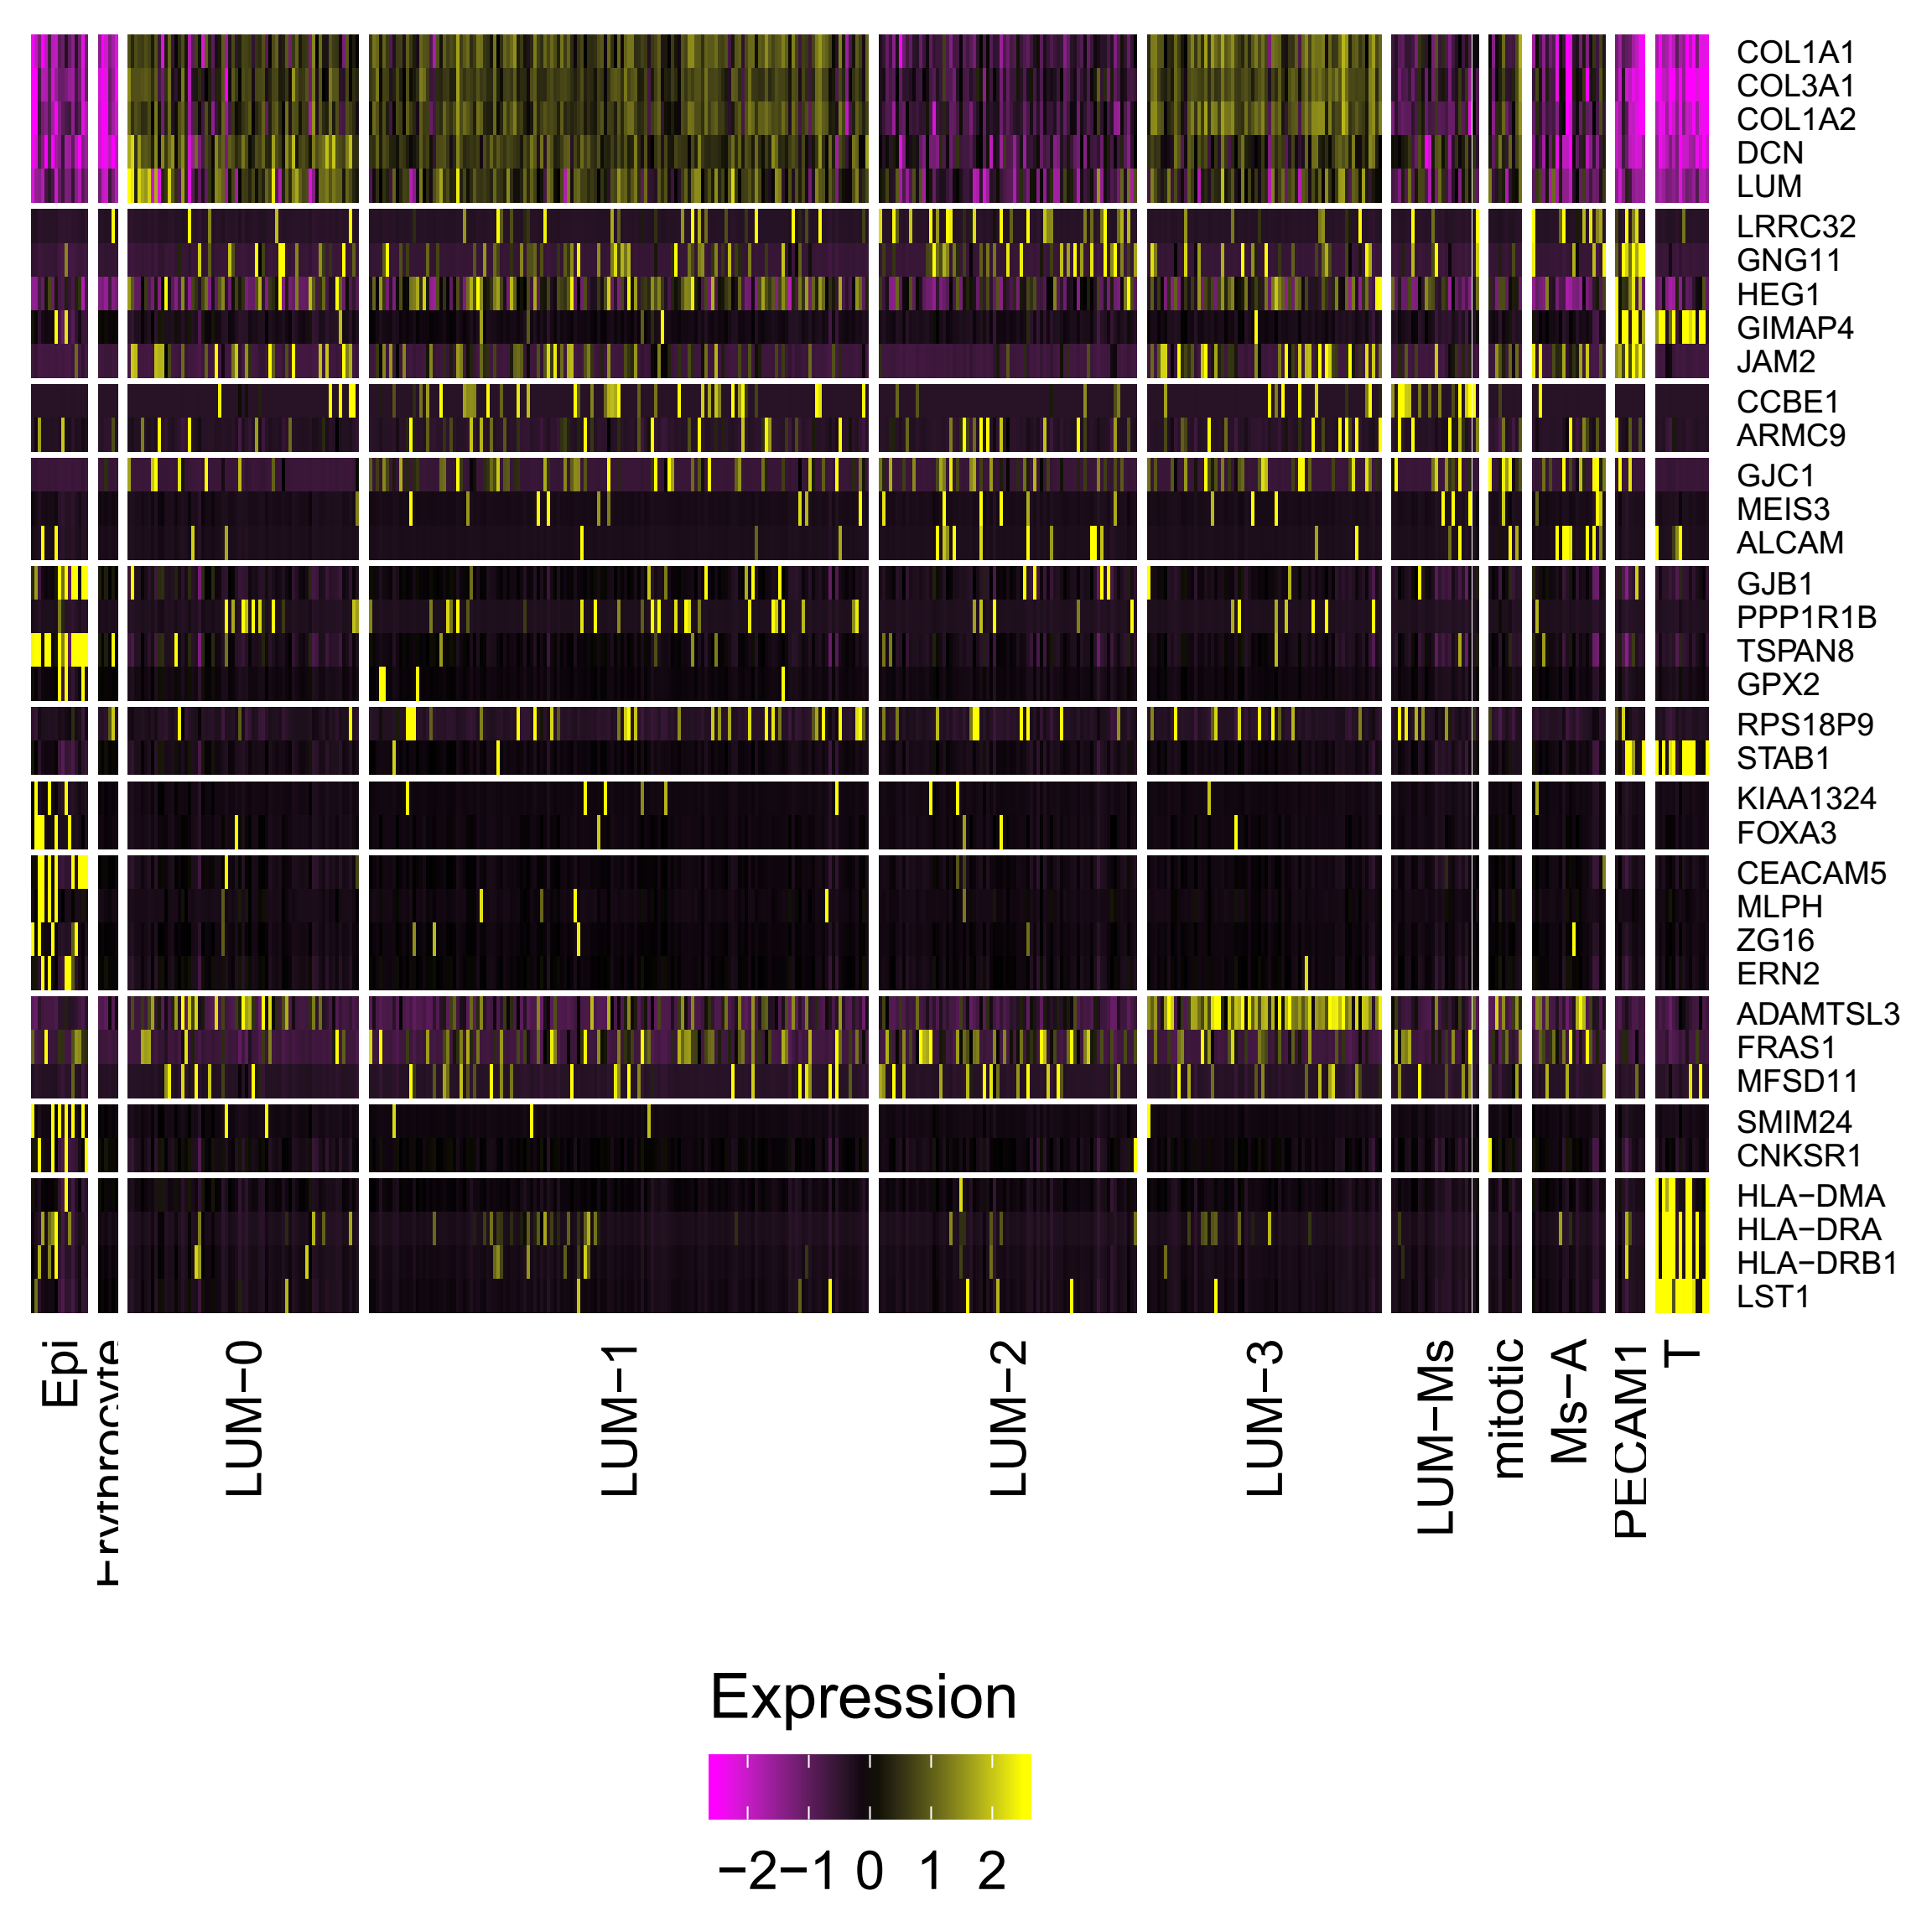
Comparison of cell types in the previous work
Gao S et al., Nat Cell Biol, 2018

Slide 28
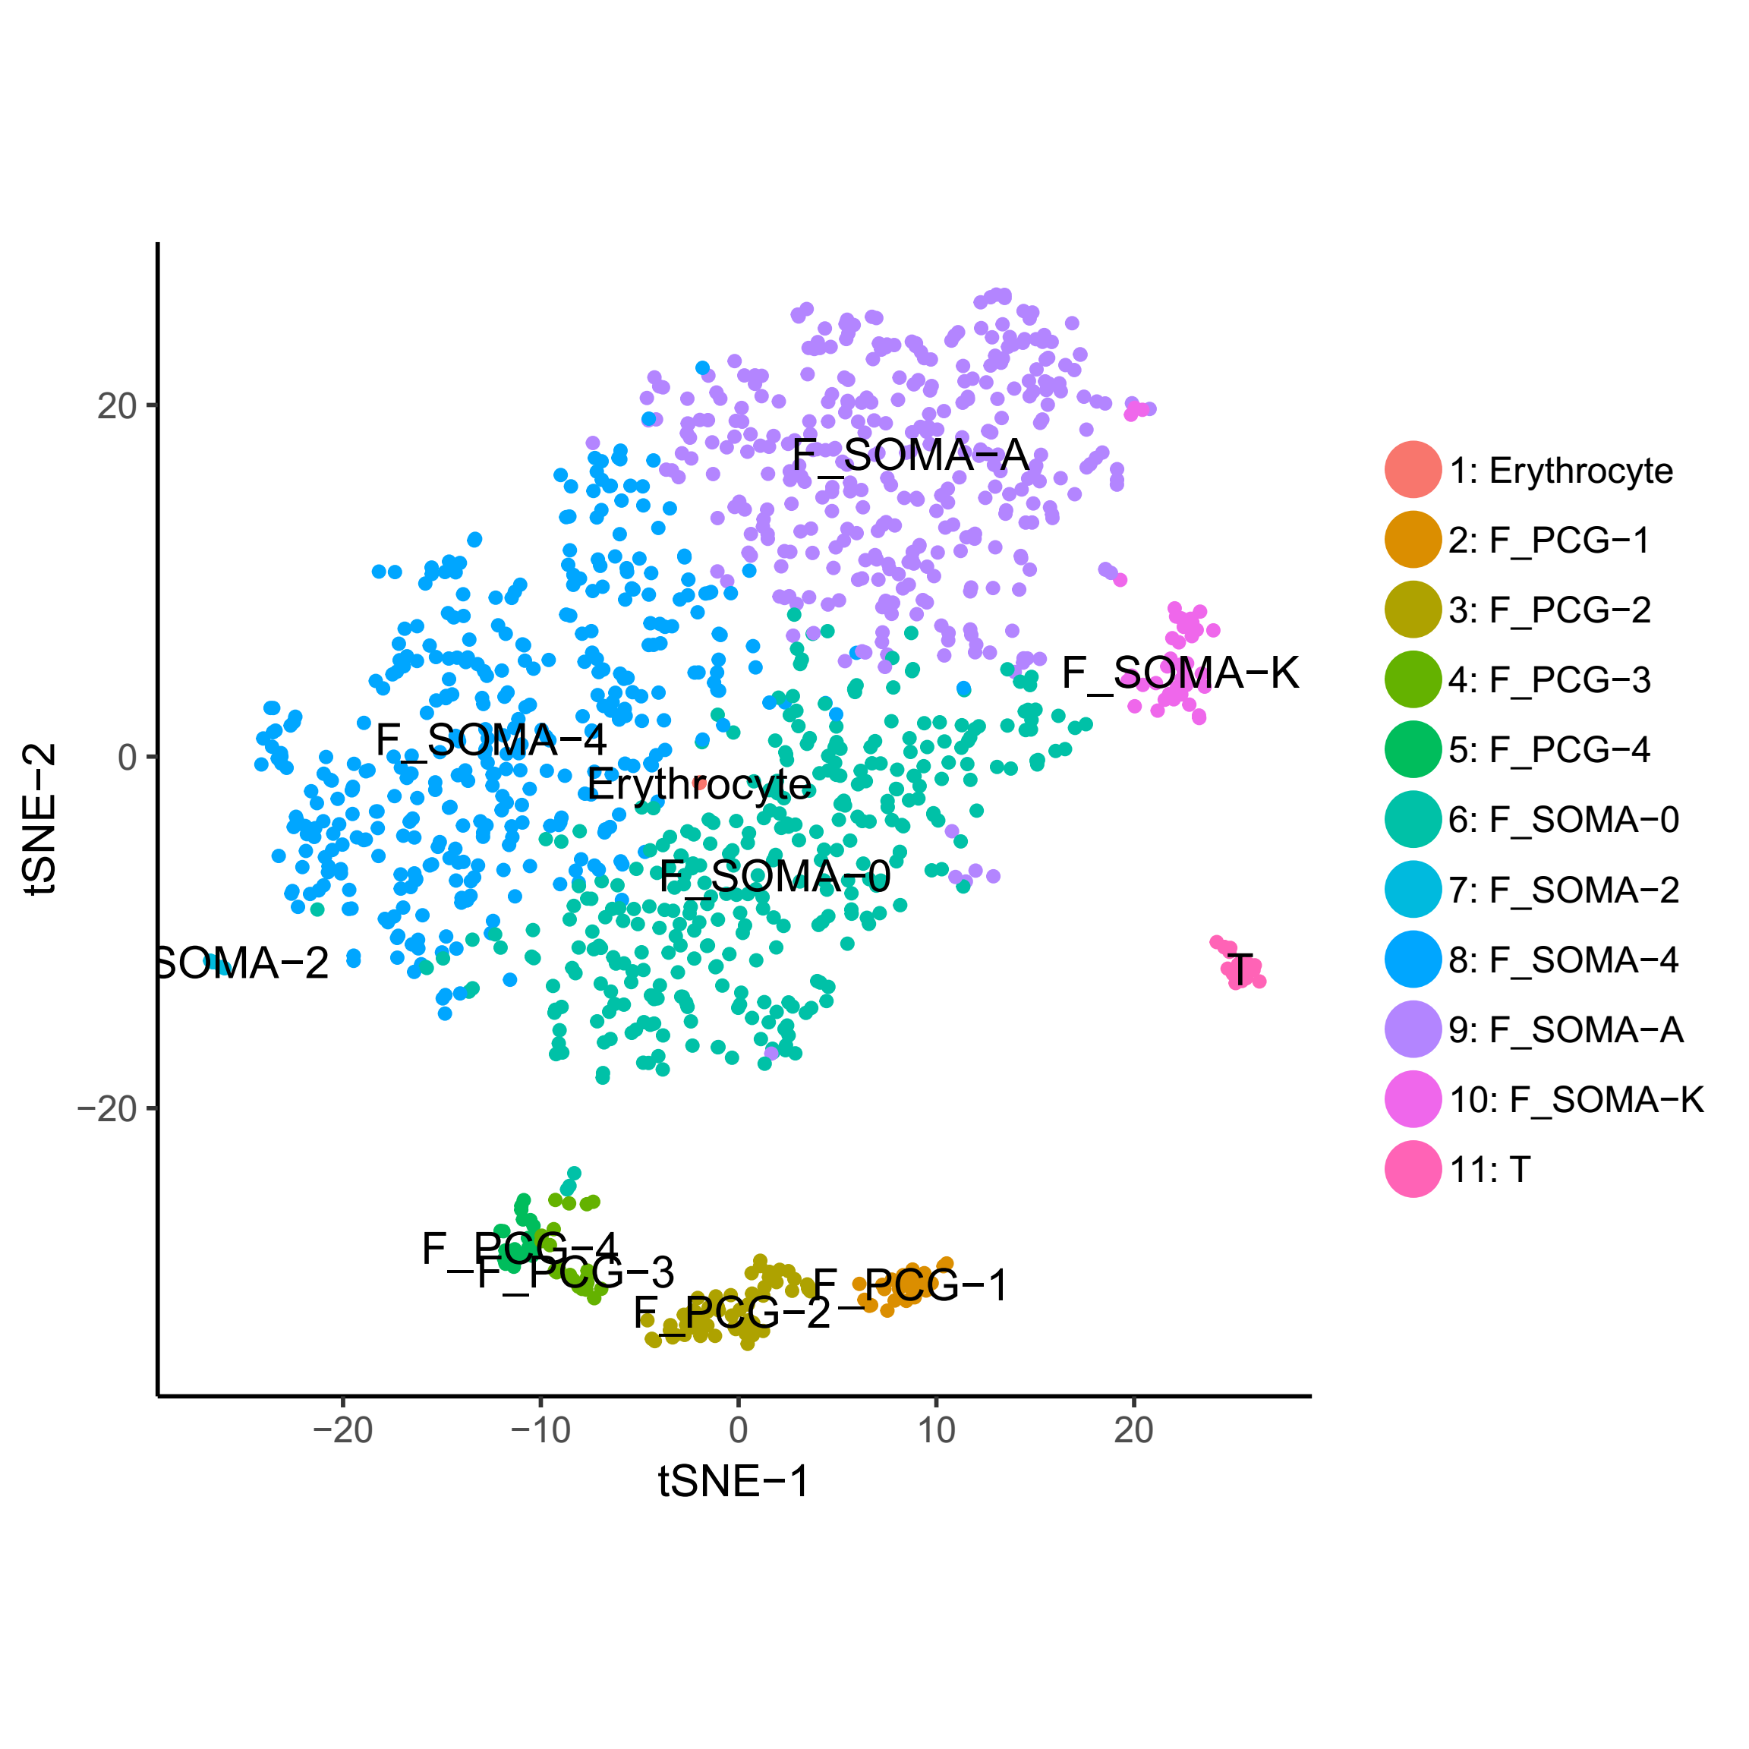

5. Ovary (卵巢)
Most of the KIT⁺ cells showed very low KIT expression.

Slide 29


Expression of signature genes

Slide 30

Heterogeneity in cell cycle

Slide 31


Cell type composition

Slide 32

Comparison of cell types in the previous work
Li L et al., Cell Stem Cell, 2017

Slide 33

The robustness of module identification

Slide 34

The robustness of module identification

Slide 35

Module identification in PROM1⁺ cells in stomach

Slide 36


Module identification in PROM1⁺ cells in stomach
extracellular matrix organization
P < 8.96E-10

Slide 37


Module identification in PROM1⁺ cells in stomach
extracellular matrix organization
P < 3.55E-03

Slide 38
Thanks

